Slide 1
Introduction to Raspberry Pi #2
Jonghwan Hyun
DPNM Lab.
Department of Computer Science and Engineering, POSTECH
noraki@postech.ac.kr
Sep. 17, 2015

Slide 2
Connecting to Raspberry Pi
Connect Raspberry Pi and your laptop using Ethernet cable
Plug in power cable to Raspberry Pi
IP settings for your laptop
  IP: 192.168.0.2
  Netmask: 255.255.255.0
Connect to Raspberry pi
  Using SSH client (console)
  Using RDP client (GUI)
  IP: 192.168.0.1
  ID/PW: root/raspberry

Slide 3
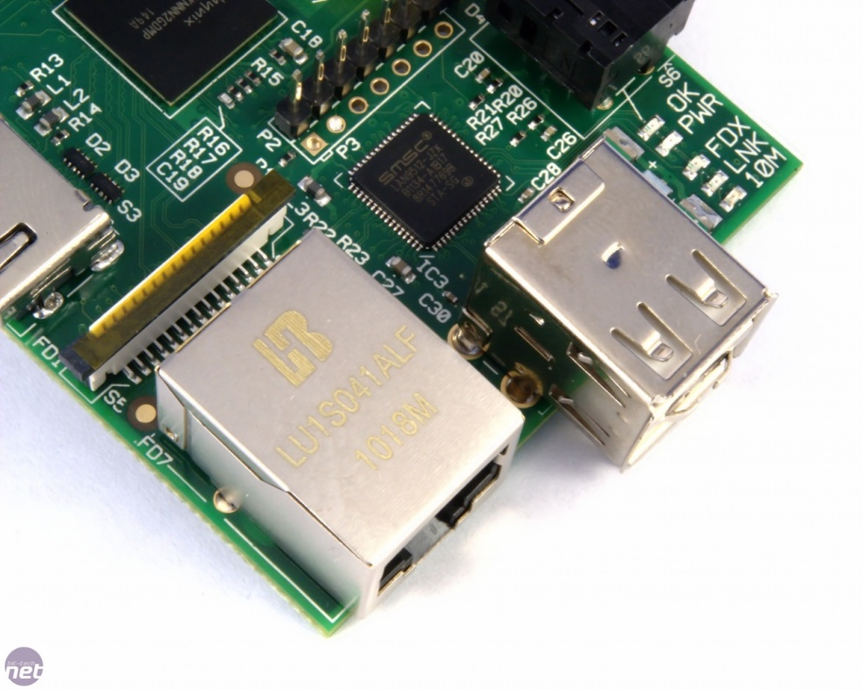
Programming Tutorial – Blinking LED
Raspberry Pi On-board LED
  OK (ACT): SD card access indicator
  PWR: 5V input power present
  FDX: Ethernet Full Duplex connection
  LNK: Ethernet connection present
  10M: 100 Mbps Ethernet connection

Slide 4
Programming Tutorial – Blinking LED
Which LED can be controlled by user?
  PWR: hardwired to the on-board 3.3V
  FDX: hardwired to the USB/Ethernet chip
  LNK: hardwired to the USB/Ethernet chip
  10M: hardwired to the USB/Ethernet chip
  OK (ACT): hardwired to GPIO 16
    Programmed in the 'firmware' to indicate SD card activity

Slide 5
Programming Tutorial – Blinking LED
Control ACT LED
  Available as /sys/class/leds/led0/
  The kernel LED driver, which controls led0, has "triggers" which let some other part of the kernel control the LED
  The default trigger for the LED is 'mmc0', which makes it turns on when the SD card is accessed
  Deactivate the trigger
  Turn on/off LED manually
  Let the LED to go back to its default function
root@raspberrypi:~# cat /sys/class/leds/led0/trigger
none [mmc0]
echo none >/sys/class/leds/led0/trigger
echo 1 >/sys/class/leds/led0/brightness
echo 0 >/sys/class/leds/led0/brightness
echo mmc0 >/sys/class/leds/led0/trigger

Slide 6
Programming Tutorial – Blinking LED
Blinking ACT LED Using Python
  Use GPIO16 to control the LED
  Active-low
    LOW: turn the LED ON
    HIGH: turn the LED OFF
  Use Python GPIO library

Slide 7
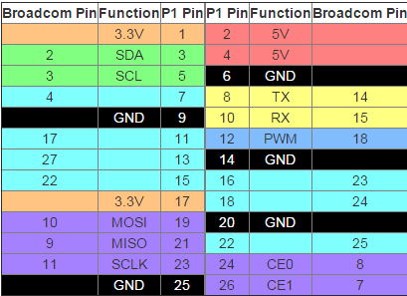
Programming Tutorial – Blinking LED
Blinking ACT LED Using Python
  Include python GPIO module
  Pin numbering declaration
    GPIO.BOARD – Board numbering scheme. The pin numbers follow the pin numbers on header P1
    GPIO.BCM – Broadcom chip-specific pin numbers. These pin numbers follow the lower-level numbering system defined by the Raspberry Pi’s Broadcom-chip brain
  Set a Pin Mode
  Digital Output
import RPi.GPIO as GPIO
GPIO.setmode(GPIO.BCM)
# set up GPIO output channel
GPIO.setup(16, GPIO.OUT)
# LED On
GPIO.output(16, GPIO.LOW)
# LED Off
GPIO.output(16, GPIO.HIGH)

Slide 8
Programming Tutorial – Blinking LED
Blinking ACT LED Using Python
#!/usr/bin/python
import RPi.GPIO as GPIO
from time import sleep
GPIO.setmode(GPIO.BCM) # Needs to be BCM.
GPIO.setup(16, GPIO.OUT) # Set up GPIO output channel
try:
while 1:
GPIO.output(16, GPIO.LOW) # LED On
sleep(2) # Wait a bit
GPIO.output(16, GPIO.HIGH) # LED Off
except KeyboardInterrupt: # If CTRL+C is pressed, exit cleanly:
GPIO.cleanup() # cleanup all GPIO

Slide 9
Programming Tutorial – Blinking LED
Blinking ACT LED Using Python
root@raspberrypi:~# python blink.py

Slide 10
IoT Assignment #3
This assignment is to be done individually and is worth a total of 4% of the final mark.
Please pick a platform from the following site:
  https://www.iotivity.org
  http://iotmobius.com
  http://postscapes.com/internet-of-things-platforms
Study it and present it in class.
Your presentation should include:
  Description of the platform
  Describe what it provides and what it is designed for.
  Describe how one can use it for developing an IoT system
  One or more example IoT systems that have been developed using it.
You may include one or more diagrams to describe the platform.
Due: midnight, Mon., Sept. 28.
Have fun!

