Slide 1
Introduction to Arduino
Jonghwan Hyun
DPNM Lab.
Department of Computer Science and Engineering, POSTECH
noraki@postech.ac.kr
Oct. 29, 2015

Slide 2
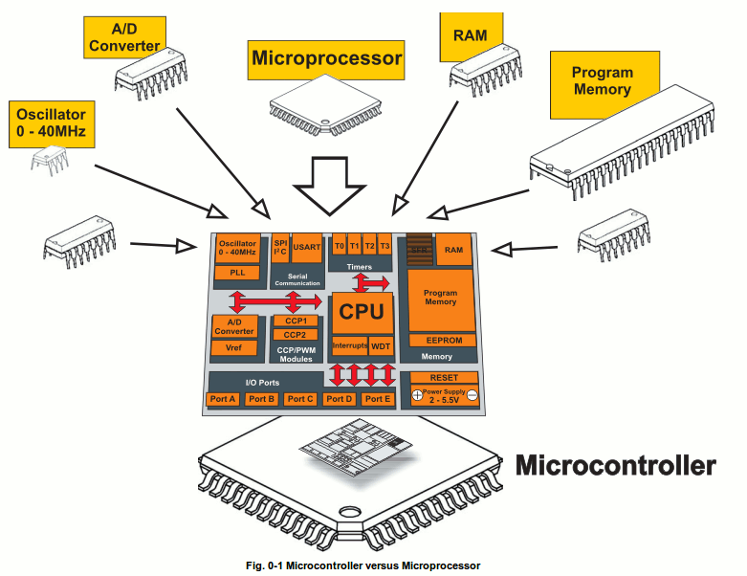
Microcontroller (μc, MCU)
A small computer on a single chip
  Containing a processor, memory, and input/output
Typically "embedded" inside some device that they control
Often small and low cost

Slide 3




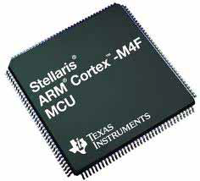
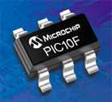
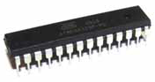
Microcontroller (μc, MCU)
Computer on a single integrated chip
  Processor (CPU)
  Memory (RAM / ROM / Flash)
  I/O ports (USB, I2C, SPI, ADC)
Common microcontroller families
  Intel: 4004, 8008, etc.
  Atmel: AT and AVR
  Microchip: PIC
  ARM: multiple manufacturers
Used in
  Cellphones
  Toys
  Household appliances
  Cars
  Cameras
  …

Slide 4
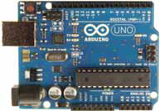
What is Arduino?
Open-source hardware platform
Open source development environment
  Easy-to learn language and libraries
  Integrated development environment
  Available for Windows / Mac / Linux
A programmable microcontroller for prototyping electromechanical devices
Able to connect digital and analog electronic parts
  Sensors (Gyroscopes, GPS Locators, accelerometers)
  Actuators (LEDS or electrical motors)

Slide 5
What is Arduino?
Taken from the official web site (arduino.cc)
  “Arduino is an open-source electronics prototyping platform based on flexible, easy-to-use hardware and software. It's intended for artists, designers, hobbyists, and anyone interested in creating interactive objects or environments.”

Slide 6
Why use Arduino?
Easy to use platform
Ease of programming
  Arduino C is a greatly simplified version of C++
Simple USB interface
Simple IDE
Many shields available
Inexpensive
  $35 retail

Slide 7
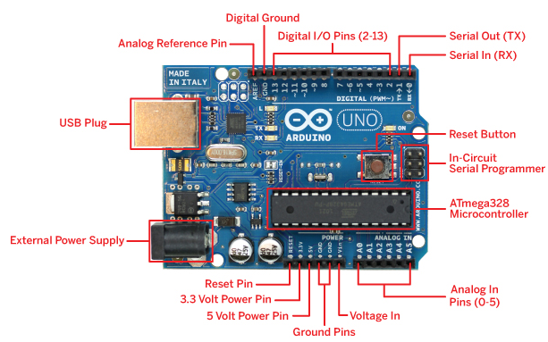
Arduino - Uno
Electrical Inputs and Outputs
  Input voltage: 7-12 V (USB, DC plug, or Vin)
  Max output current per pin: 40 mA
Hardware I/O
  13 Digital I/O bits
    2 = serial TxD/RxD
  4 LEDs
  6 “Analog” outputs
    Pulse-width modulated
    Choose digital or PWM
    8-bit resolution
  6 Analog inputs
    10-bit resolution at best

Slide 8

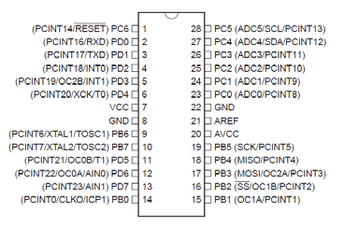
Arduino - Uno
The ATmega328P Microcontroller
  Used by the Arduino UNO
  AVR 8-bit RISC architecture
  Up to 20 MHz clock
  32kB flash memory
    30 kB available for user code
    2 kB for bootloader
  2 kB RAM
    Volatile data memory
    Variables + stack + heap + …
  23 programmable I/O channels
  Six 10-bit ADC inputs
  Three timers/counters
  Six PWM outputs

Slide 9
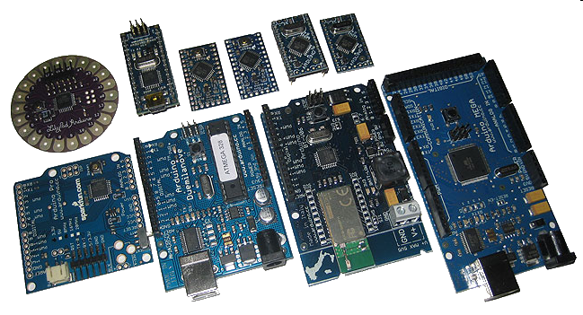
Many Flavors of Arduino
Many different version
  Number of I/O channels
  Form factor
  Processor
Uno
Leonardo
Due
Micro / Mini / Nano
LilyPad
Esplora
Mega

Slide 10
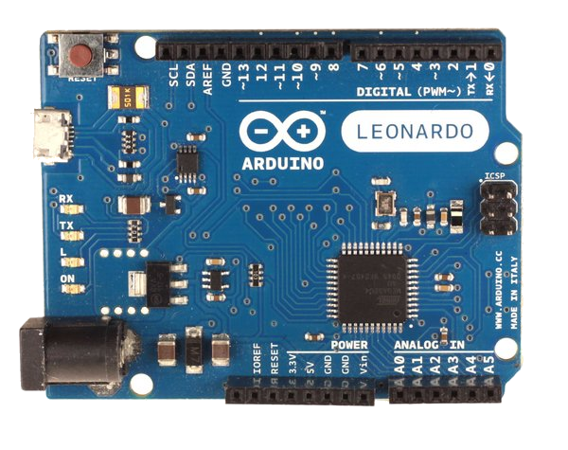
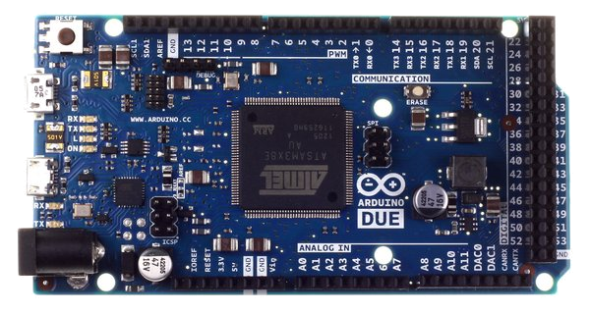
Many Flavors of Arduino
Leonardo
  Compared to the Uno, a slight upgrade
  Built in USB compatibility
    Presents to PC as a mouse or keyboard
Due
  Much faster processor, many more pins
  Operates on 3.3 volts
  Similar to the Mega

Slide 11
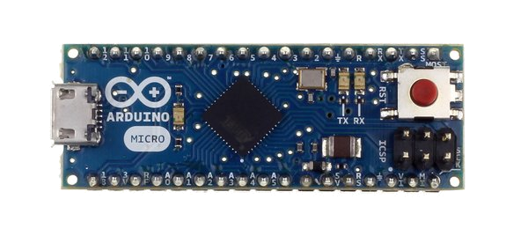
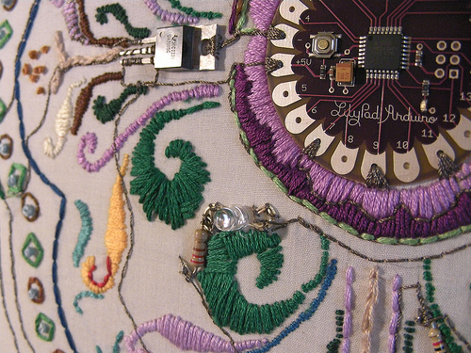
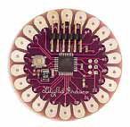
Many Flavors of Arduino
Micro
  When size matters: Micro, Nano, Mini
  Includes all functionality of the Leonardo
  Easily usable on a breadboard
LilyPad
  Popular for clothing-based projects

Slide 12
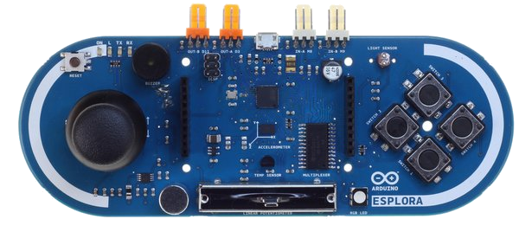
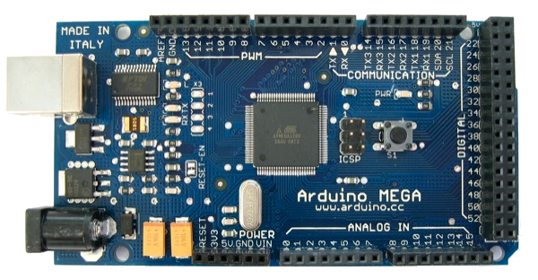
Many Flavors of Arduino
Esplora
  Game controller
  Includes joystick, four buttons, linear potentiometer (slider), microphone, light sensor, temperature sensor, three-axis accelerometer
  Not the standard set of IO pins
Mega
  Compared to the Uno:
    Many more communication pins
    More memory

Slide 13
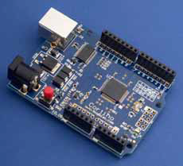
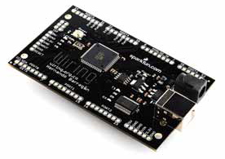
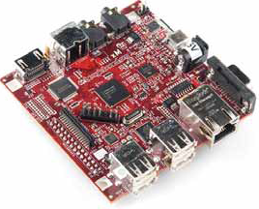
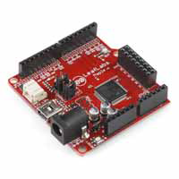
Arduino-like Systems
Cortino (ARM)
Xduino (ARM)
LeafLabs Maple (ARM)
BeagleBoard (Linux)
Wiring Board (Arduino predecessor)

Slide 14
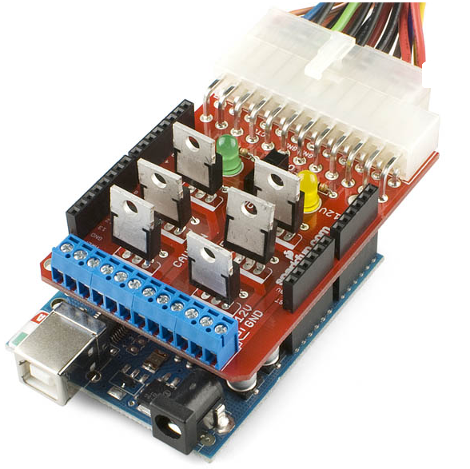
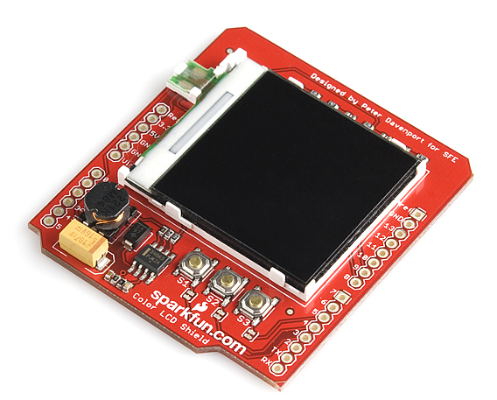
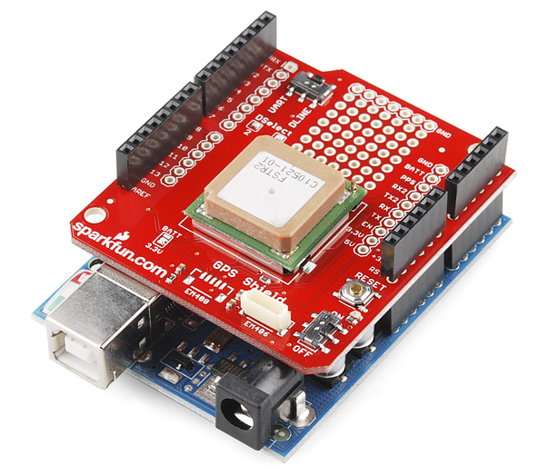
Arduino Add-ons (Shields)
<GPS shield>
<Power Driver shield>
(Connects to a computer power supply)
<Color LCD shield>

Slide 15
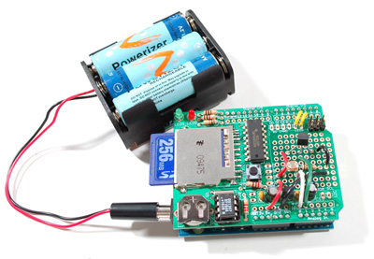
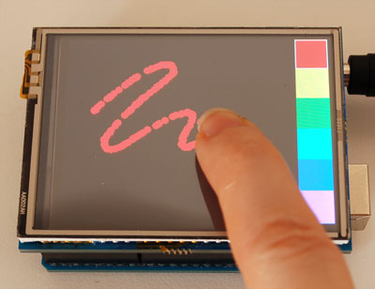
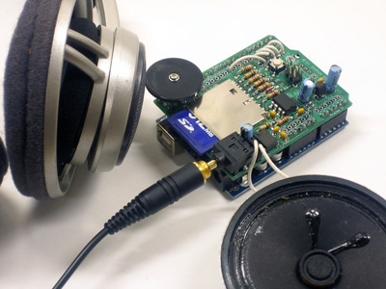
Arduino Add-ons (Shields)
<Datalogging shield>
<Touchscreen shield>
<Sound (music) shield>

Slide 16
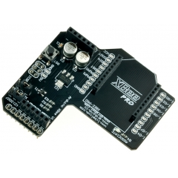
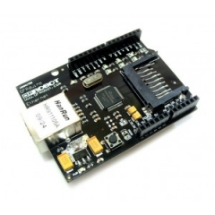
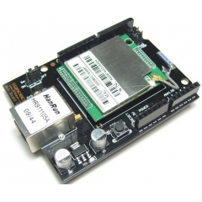
Arduino Add-ons (Shields)
Communication Shields
<XBee shield>
<Ethernet shield>
<Wi-Fi shield>

Slide 17
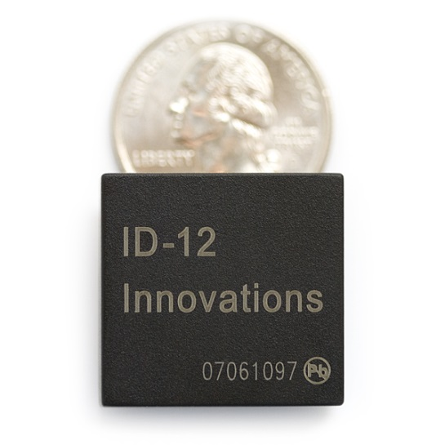
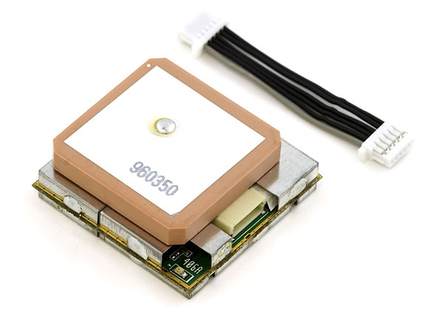
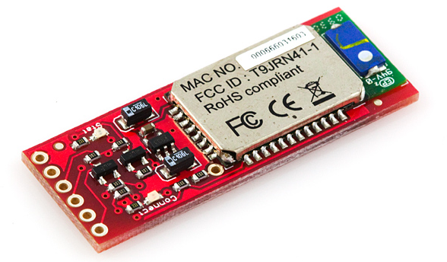
Arduino Add-ons (Modules)
Modules send serial data strings to the Arduino
<GPS module>
<Bluetooth module>
<RFID module>

Slide 18
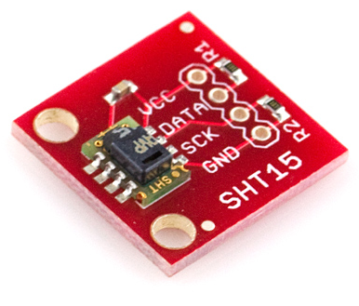
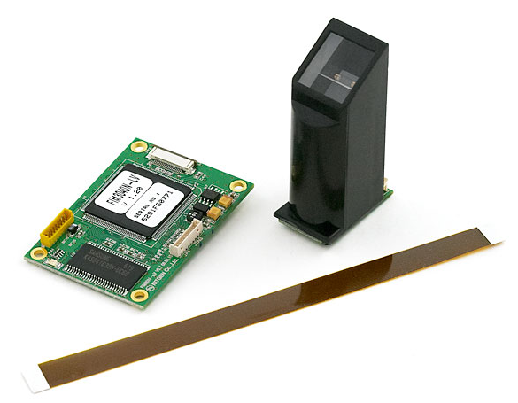
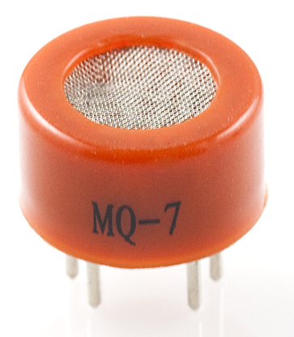
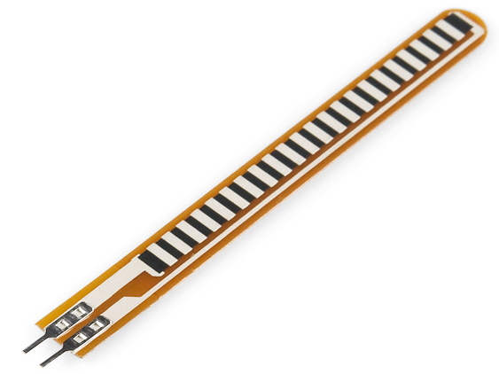
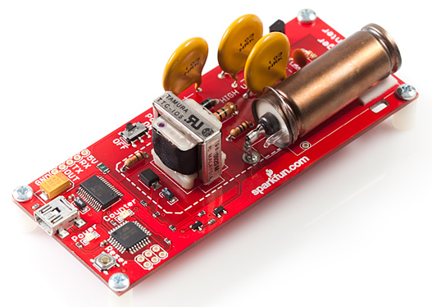
Arduino Add-ons (Sensors)
<Gas sensor>
<Temperature & humidity sensor>
<Fingerprint scanner>
<Flex(bend/stretch) sensor>
<Geiger counter>

Slide 19
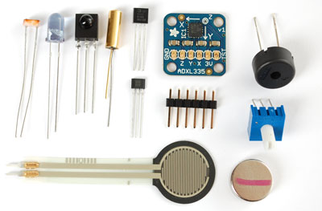
Arduino Add-ons (Sensors)
Photoresistor, infrared, force sensitive resistor,
Hall effect, Piezo, tilt sensor…

Slide 20
Arduino Add-ons (Actuators)
Actuator
  Cause some physical action to be taken
    Movement, lighting, heating, motor action, display of information, sending or receiving network, radio communications, and etc.
Types of Actuators
  Light
    LEDs, Fluorescent lamps, LCD displays, lasers
  Sound
    Buzzers, Beepers, Speakers, MP3/Audio players, synthesizers
  Motion
    DC Motors, Stepper Motors, Servo-motors, solenoids, "muscle-wire", electromagnets
  Power Control
    Control of other electrically operated devices

Slide 21
Raspberry Pi vs. Arduino
Raspberry Pi
  Fully functional computer
    CPU, memory, graphics driver, …
    Runs Linux OS
  Internal storage (SD cards)
  Network connectivity (Ethernet)
Arduino
  Microcontrollers, not full computers
  Directly executing simple code is easier
  No operating system overhead
  Good for interfacing with other devices and actuators

Slide 22
Raspberry Pi vs. Arduino
 | Raspberry Pi | Arduino
Power | Requires constant 5V power Should be shutdown via a software process | Executing code when turned on Stops when lose power
Networking | Built-in Ethernet port Easy to use Wi-Fi (using USB) | Need an extra chip with wiring and coding
Sensors | Requires software to effectively interface with these sorts of devices | Easier to connect analog sensors
When to Use? | When you would otherwise complete your task with a personal computer Connect to the Internet to read and write data, view media of any kind, or connect to an external display | When the main task is reading sensor data and changing values on motors or other devices Device will be constantly running and requires little to no interaction

Slide 23
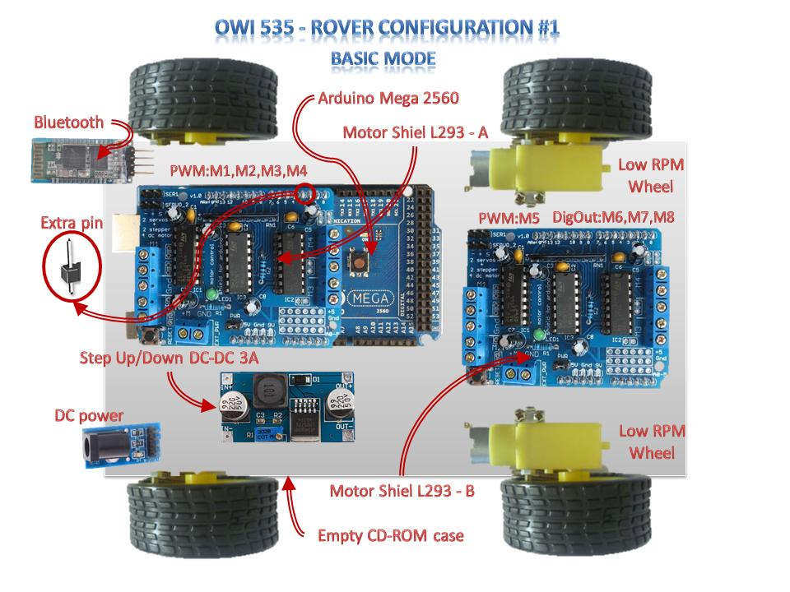
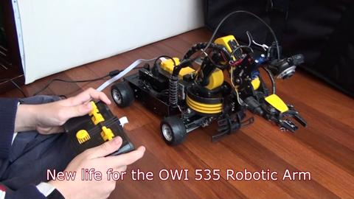
Projects
OWI535 Robotic Arm To Rover Arm
  http://sourceforge.net/projects/owi535roverarm/

Slide 24
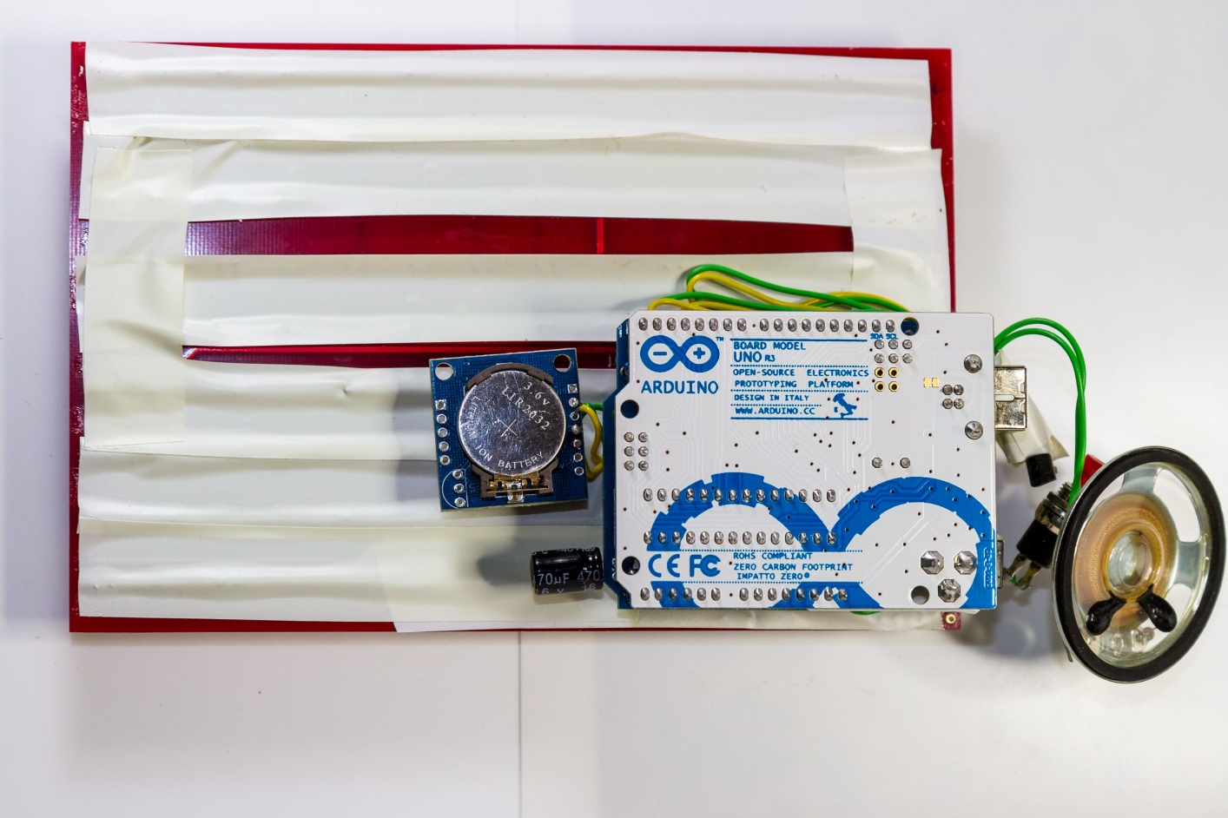
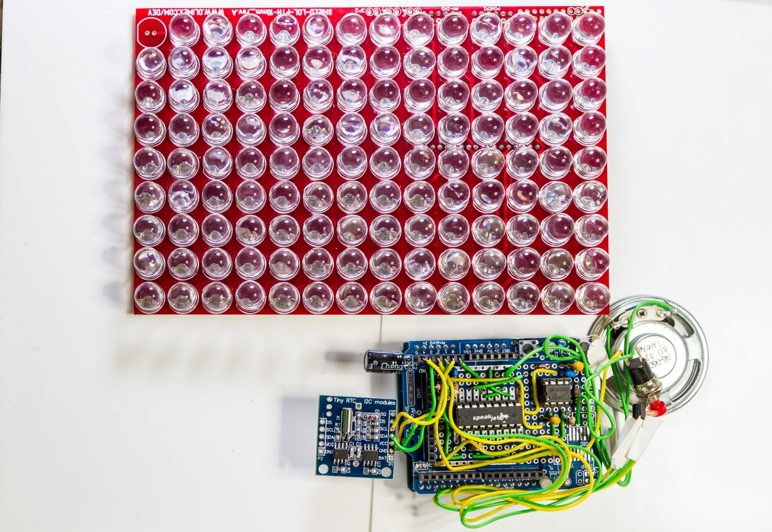
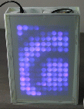
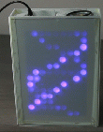
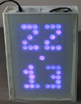


Projects
chlonos
  An open source talking multimedia clock gadget
  Using a 126 LED display, temperature and light sensors
  https://code.google.com/p/chlonos/

Slide 25
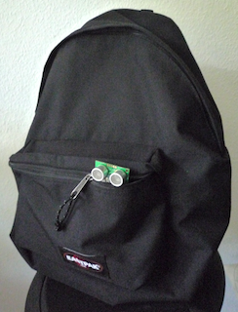
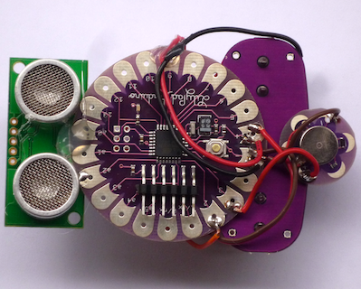
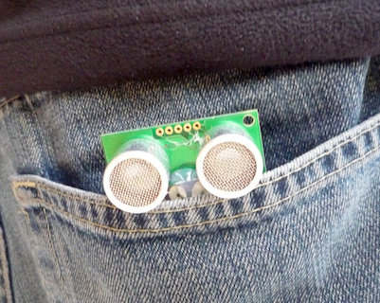
Projects
RearEye - A wearable additional eye
  Simple Lilypad project to get additional distance senses
  By putting it in pocket or backpack in order to sense someone / something approaching
  Consists of a Lilypad, a LilyPad Vibe Board and a SRF05 Ultrasonic Ranger

Slide 26
Projects
LED Matrix from processing
  http://www.youtube.com/watch?v=kkJDWrM-K4U
Arduino Flash Control
  http://www.youtube.com/watch?v=7T1jmj4KClA
Google Earthwalk
  http://www.youtube.com/watch?v=zoNwJ931aqI
Ultrasonic grass
  http://www.youtube.com/watch?v=bZIKbuZaJSQ
Piezo pong
  http://www.youtube.com/watch?v=nXLDyBFsqdg
Accelerometer and Flash
  http://www.youtube.com/watch?v=49WBPIIo3EE
Lots of interesting projects you can find in
  http://playground.arduino.cc/projects/arduinoUsers

Slide 27
References
http://arduino.cc/
  Official homepage with Playground & forums
http://ladyada.net/learn/arduino/
  Great Arduino tutorials
http://todbot.com/blog/category/arduino/
  Various movies, hacks, tutorials on Arduino
http://freeduino.org/
  Index of Arduino knowledge
http://adafruit.com/
  Arduino starter kits, Boarduino Arduino clone, lots of cool kits
http://sparkfun.com/
  Sells Arduino boards and lots of neat sensors & stuff

Slide 28
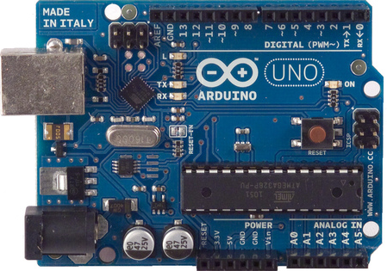
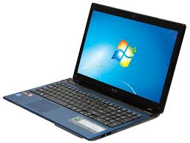
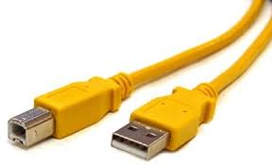


Installing Arduino
What do we need?
(Optional)

Slide 29

Installing Arduino
  Download & install the Arduino environment (IDE)
  Connect the board to your computer via the USB cable
  Install the drivers
  Launch the Arduino IDE
  Select your board
  Select your serial port
  Write codes
  Upload the program
  Reference: http://arduino.cc/en/Guide/HomePage

Slide 30

Installing Arduino
  Download & install the Arduino environment (IDE)
  Official homepage: http://arduino.cc/en/Main/Software
  Link for faster download
    http://server.noraki.net/Arduino/
  No installer needed, except for Windows
  Java needs to be installed
  (Windows) Install drivers during IDE installation
  (Linux) $ sudo apt-get install arduino
Prerequisite for Linux
  Assumes running Ubuntu
  $ sudo apt-get remove brltty

Slide 31



Installing Arduino
  Connect the board to your computer via the USB cable
USB B type
USB A type
USB B type
USB A type

Slide 32

Installing Arduino
Connecting Arduino
  MAC
    Click “Network Preferences”, and in the window that appears, click “Apply”.
  Linux
    $ ls /dev/tty*
    SHOULD have device name like ttyACM*, ttyUSB* or ttyS*
  Windows

Slide 33

Programming Arduino
Arduino IDE
  Yet Another IDE
    Very few features
  Simple programs
    Exactly the use case
  Written in Java
  Click to upload

Slide 34
Programming Arduino
Programming Language
  C like syntax, but simplified
  Abstracts the pin naming to numbers
  Trades efficience for ease of use
  Easy to learn, yet powerful
  Lots of example code
  Easy to reuse C-code from other projects
  Libraries can be written in C++
  Lots of libraries available

Slide 35

Programming Arduino
Launch the Arduino IDE

Slide 36

Programming Arduino
Select board

Slide 37



Programming Arduino
Select your serial port
  (Windows) Device manager (Win + R → “devmgmt.msc” <Enter>)
  (MAC) tty.usbmodem
  (Linux) /dev/tty/USB* or /dev/tty.USB*

Slide 38

Programming Arduino
Programming Reference

Slide 39


Sample Program – LED Blink
LED Blink
  Blinking LED on Arduino board
Codes
  Load the “Blink” example
    File→Examples→Basics→Blink

Slide 40


Sample Program – LED Blink
Verify & Compile
  Once it compiles, you must see the following messages in the Status bar and the Program notification Area

Slide 41


Sample Program – LED Blink
Upload to the board
  Once it upload, you must see the following messages in the Status bar and the Program notification Area

Slide 42
Sample Program – Serial Communication
Serial communication
  Arduino uses serial ports to communicate with PC
Writing
  Serial.begin (baud)
    Initialize serial port for communication
    Sets baud rate
    Example
      Serial.begin(9600); // 9600 baud
  Serial.print (val), Serial.print (val, fmt)
    Prints data to the serial port
    Examples
      Serial.print(“Hi”); // print a string
      Serial.print(78); // works with numbers, too
      Serial.print(variable); // works with variables
      Serial.print(78,BIN); // will print 1001110
  Serial.println(val)
    Same as Serial.print(), but with line-feed

Slide 43

Sample Program – Serial Communication
Reading
  Serial.available()
    Returns the number of bytes available to be read, if any
    Example
      if (Serial.available() > 0) data = Serial.read();
  Reading data from serial port
    letter = Serial.read()
    letters = Serial.readBytesUntil(character, buffer, length)
    number = Serial.parseInt()
    number = Serial.parseFloat()
Serial Monitor
  Send / Receive serial data
  Included in the IDE
    Ctrl – Shift – M

Slide 44
Sample Program – Serial Communication
Echo
  Arduino will echo anything you send to it until you send , (a comma)
  Source codes
/* Use a variable called byteRead to temporarily store the data coming from the PC */
byte byteRead;
void setup() {
// Turn the Serial Protocol ON
Serial.begin(9600);
}
void loop() {
/* check if data has been sent from the computer: */
if (Serial.available()) {
/* read the most recent byte */
byteRead = Serial.read();
/*Listen for a comma which equals byte code # 44 */
if(byteRead==44){
Serial.println();
}else{
/*ECHO the value that was read, back to the serial port. */
Serial.write(byteRead);
}
}
}

