Slide 1
Internet of Things
(IoT)
CSED 490K Course Introduction
Prof. James Won-Ki Hong
Sept. 1, 2015
Distributed Processing & Network Management Lab.
Dept. of Computer Science and Engineering
POSTECH
http://dpnm.postech.ac.kr/~jwkhong

Slide 2
Table of
Contents
1 Administrative Matters
2 Introduction to IoT
3. Discussions

Slide 3
Administrative Matters

Slide 4
Lectures
Location: PIRL 222
Times: Tue. & Thu. 09:30-10:45
  Lecture times may need to be changed occasionally due to conference trips and meetings that I have to attend
  Flexible lecture times are desirable – what other times are the students available?
Lecture materials
  Lecture slides
  YouTube videos
  Materials from the Internet
  Magazine articles & research papers
  Student presentations
  Invited lectures

Slide 5
How to Share Lecture/Project Materials
POSTECH Internet Disk
Band
Course homepage (http://dpnm.postech.ac.kr/cs490k)
KT uCloud
Dropbox.com
Google Drive
What else?

Slide 6
How to Communicate with me via
Email: jwkhong@postech.ac.kr
Phones: 054-279-2244, 010-3810-5641
KakaoTalk
Skype: jwkhong
Face-to-Face: PIRL 337
Facebook, Google Hangout, WhatsApp, LINE, KiK, Tango, etc.

Slide 7
How to Communicate with the Class
KakaoTalk
Band
Facebook, Google Hangout, WhatsApp, LINE, KiK, Tango, etc.
What do you prefer?

Slide 8
Lecture Assistant
1 or 2 students who can come to class at least 5 minutes before the class, turn on the computer and beam projector, open the course homepage
Any volunteers?

Slide 9
Introduction to IoT

Slide 10
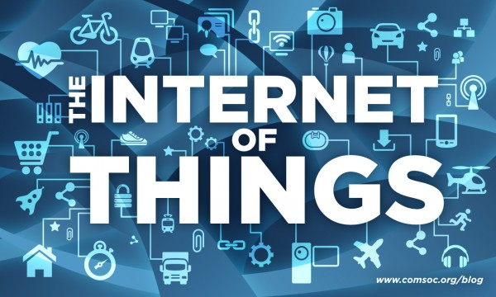
IoT
Source: IEEE ComSoc

Slide 11
What is Internet of Things (IoT) - 1
According to Wikipedia, IoT refers to the interconnection of uniquely identifiable embedded computing-like devices within the existing Internet infrastructure. Typically, IoT is expected to offer advanced connectivity of devices, systems, and services that goes beyond machine-to-machine communications (M2M) and covers a variety of protocols, domains, and applications. The interconnection of these embedded devices (including smart objects), is expected to usher in automation in nearly all fields, while also enabling advanced applications like a Smart Grid.

Slide 12
What is Internet of Things (IoT) - 2
Things, in the IoT, can refer to a wide variety of devices such as heart monitoring implants, bio-chip transponders on farm animals, automobiles with built-in sensors, or field operation devices that assist fire-fighters in search and rescue. Current market examples include smart thermostat systems and washer/dryers that utilize WiFi for remote monitoring.

Slide 13
What is Internet of Things (IoT) - 3
Due to the ubiquitous nature of connected objects in the IoT, an unprecedented number of devices are expected to be connected to the Internet. According to Gartner, there will be nearly 26 billion devices on the Internet of Things by 2020. ABI Research estimates that more than 30 billion devices will be wirelessly connected to the IoT by 2020. Per a recent survey and study done by Pew Research Internet Project, a large majority of the technology experts and engaged Internet users who responded. 83% agreed with the notion that the Internet/Cloud of Things and embedded and wearable computing will have widespread and beneficial effects by 2025. It is, as such, clear that the IoT will consist of a very large number of devices being connected to the Internet.

Slide 14
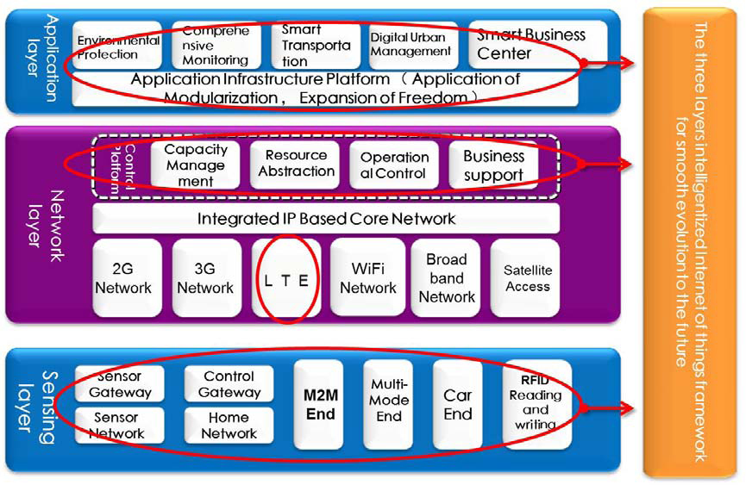
IoT Architecture
Source: Datang Telecom Technology & Industry Group

Slide 15
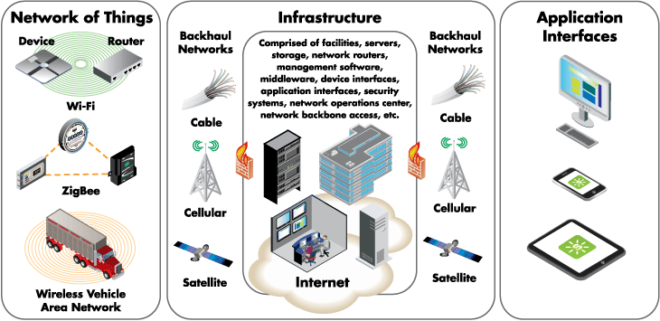
IoT Architecture
Source: digi.com

Slide 16
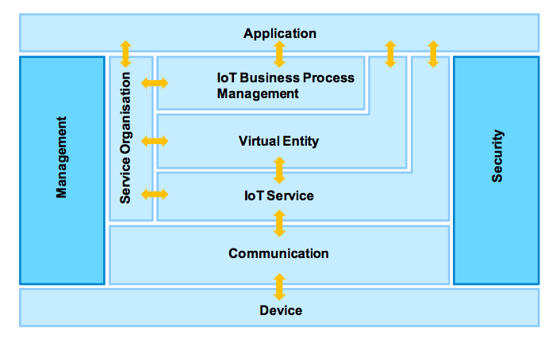
IoT Architecture
Source: IoT-A

Slide 17
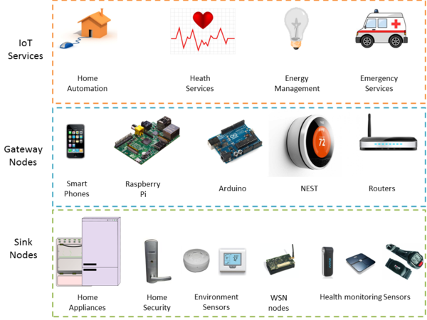
Architecture for Open IoT Services
Source: kno.e.sis

Slide 18
Introductory Videos
Intel IoT -- What Does The Internet of Things Mean?
  http://www.youtube.com/watch?v=Q3ur8wzzhBU
Cisco - How the Internet of Things Will Change Everything--Including Ourselves
  http://www.youtube.com/watch?v=B_hjAfPJeRA
IBM – Internet of Things
  http://www.youtube.com/watch?v=df9xAZZ-8zg
Dr. John Barrett at TEDxCIT – The Internet of Things
  http://www.youtube.com/watch?v=QaTIt1C5R-M

Slide 19
What are the major components of IoT?
Sensors/Actuators
Communication between servers or server platforms
Server/Middleware Platforms
Data Analytics Engines
Apps (iOS, Android, Web)

Slide 20
Communication Technologies for IoT
Bluetooth
Zigbee
Z-Wave
NFC (Near-Field Communication)
RFID
WiFi
2G/3G/LTE
Wibro/Mobile WiMax
PLC (Power Line Communication)
Ethernet
What else?

Slide 21
Terminologies similar to IoT
USN (Ubiquitous Sensor Networks)
M2M (Machine-to-Machine)
IoE (Internet of Everything) – Cisco’s favorite term
Cloud of Things
Web of Things

Slide 22
Discussions

Slide 23
Course Assignments
Will involve a number of things including:
Creating your own homepage/blog/wiki/LinkedIn/Facebook/etc. page
Survey various topics/platforms/tools/devices and presenting your findings in class – class presentations should be prepared in PowerPoint or similar presentation SW
Watching YouTube videos and answering some questions
Developing software for some “things”

Slide 24
Term Project
Will develop an IoT system involving one or more devices, IoT platform, and smartphone app
May be done in groups of 2-3 students
Go through the process of system development life cycle (i.e., project definition, requirements analysis, design, implementation, testing, deployment) and documentation – will be done throughout the course
There will be a final presentation and demo at the end of the term
50% of the course mark will be allocated for this
Think about what you would like to develop!

Slide 25

Q&A

