Slide 1
Software Defined Networking: Introduction to SDN & OpenFlow
James Won-Ki Hong
Department of Computer Science and Engineering
POSTECH, Korea
jwkhong@postech.ac.kr

Slide 2
Outline
Background
Software Defined Networking
OpenFlow

Slide 3
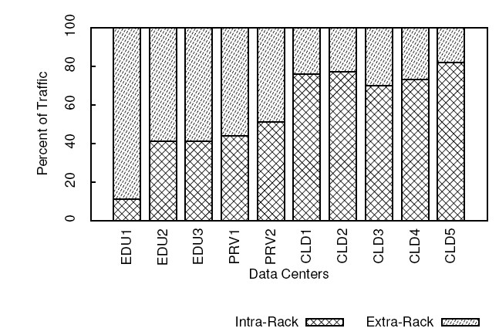
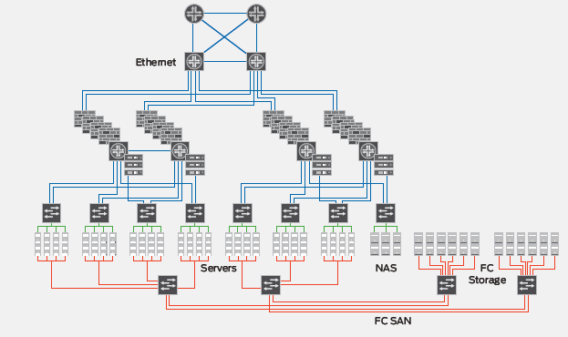
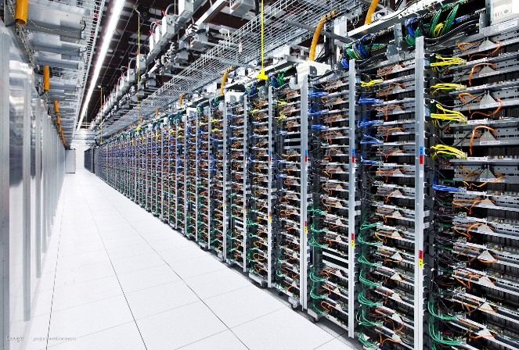
Background
Needs for a New Networking Paradigm
Changing Traffic Patterns
Data Center Traffic
North-south: 95% → East-west: 40 ~ 80%
Data Center Networks
Hyper scale network
Hundreds and thousands of servers
Hundreds and thousands of switches → Tera bit network capacity
3-4 tier architecture → over 50% of network capacity is used to connect switches → inefficient
Core Router
Aggregation
Access
TOR

Slide 4

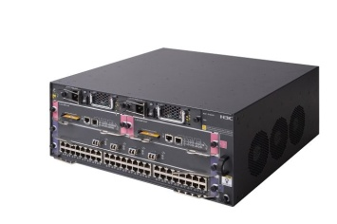



Background
Need for a new Networking Paradigm
Vendor dependency
Lack of open I/F and standard API → operators cannot tailor the N/W
Biz needs and user demand → standard → Long Time to Market
Vendor’s equipment product cycle → over 3 years
Fundamental problems of IP protocols
Protocols defined in isolation, each to solve a specific problem and without the benefit of abstractions.
~ 6,776 RFCs
Current Internet needs many new dedicated middleboxes
Lack of IPv4 addresses (2³²) → NAT, IPv6 (2¹²⁸)
Security → IDS/IPS, VLAN, VPN
Management → Authentication, QoS, ACL…
Today’s Internet… static
To add or delete any device, IT must touch multiple devices and configurations.
But, human errors are common
Application
Abstraction
Fn
Fn
Fn
Fn
Server Farm
Center Router
Core Router
GSR
GES
Metro SW
L3
L2
AAA
Mail
DNS
F/W
IPv6
MPLS
Multi- cast
NAT
DHCP
ACL
IGP
VPN
DDNS
VLAN

Slide 5
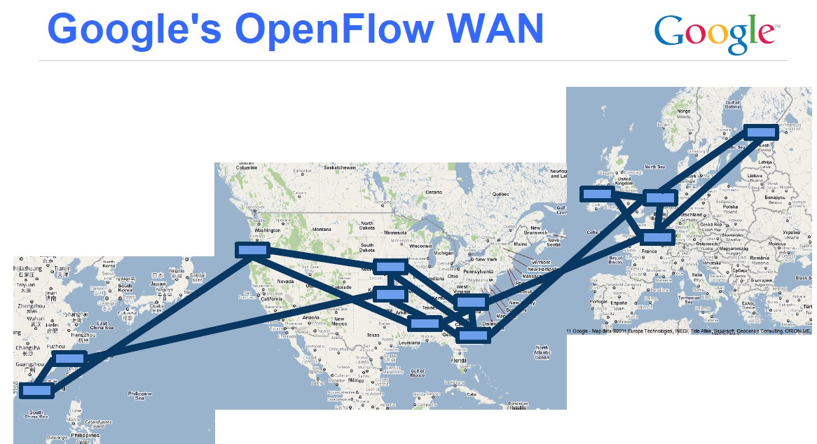
SDN Background
Rapid Development of OpenFlow Technologies
2012 ONF meeting, Google announced that…
Google’s G-Scale network is operating using OpenFlow
Developed for 2 years (2010~2012.1)
Saved CAPEX and OPEX
OpenFlow was known as an open standard to test experimental protocols in the campus networks
OpenFlow → now evolving to Enterprise and Carrier grade SDN technologies
Commercial OpenFlow switches and controllers
NEC, NTT Data, Nicira , HP, IBM, BigSwitch, Brocade……

Slide 6
Traditional Network Node
Router
Router can be partitioned into three planes
Management plane → configuration
Control plane → make decision for the route
Data plane → data forwarding
Adjacent Router
Router
Adjacent Router
Management/Policy plane
Configuration / CLI / GUI
Routing
Control plane
Control plane
Static routes
Control plane
OSPF
OSPF
OSPF
Neighbor table
Link state database
IP routing table
Switching
Data plane
Data plane
Data plane
Forwarding table

Slide 7
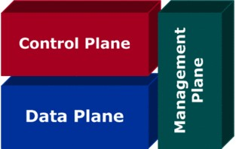
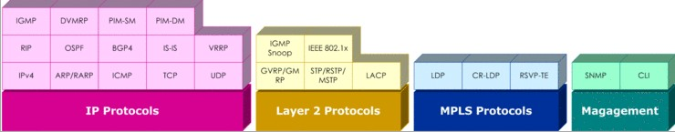
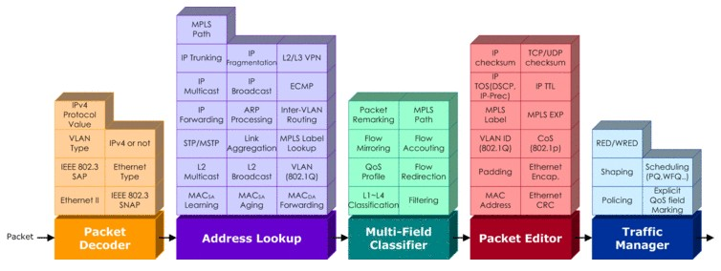
SDN Concept
SDN separates Control and Data plane functions
Control & Management Plane
SDN Controller
(S/W)
Data Plane
OpenFlow
Router/Switch
SDN Switch (H/W)
(source “Understanding L3 Switch”, Netmanias Talk, 2011/11/09)

Slide 8
SDN Concept
SDN Concept
Separates control plane and data plane entities
Network intelligence and state are logically centralized
The underlying network infrastructure is abstracted from the applications
Execute or run control plane software on general purpose hardware
De-couple from specific networking hardware
Use commodity computers
Have programmable data planes
Maintain, control and program data plane state from a central entity
An architecture to control not only a networking device but an entire network
Similar to existing Network Management System (NMS), but more powerful
Control Software (SW)
Control SW operates on view of network
Control SW is not a distributed system
Abstraction hides details of distributed states

Slide 9
SDN with Key Abstraction in the Control Plane
Network Virtualization
Well-defined API
Routing
Traffic Engineering
Other Applications
Network Map
Abstraction
Network Operating System
Forwarding
Forwarding
Forwarding
Forwarding

Slide 10
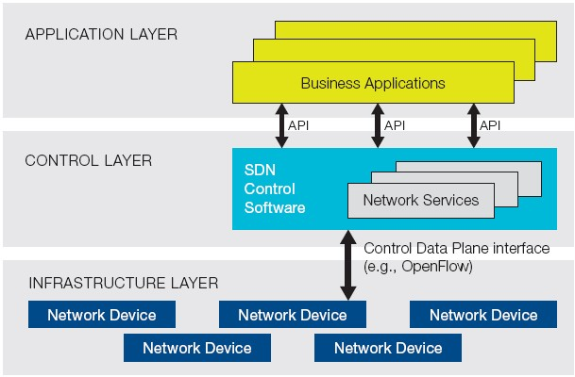
SDN vs. OpenFlow
ONF Definition
SDN performs Software Defined Forwarding
Controls data forwarding through open API
SDN provides Management Abstraction
Can make more advance applications
Currently implemented with OpenFlow
OpenFlow is misunderstood to be equivalent to SDN
No requirement for the use of OpenFlow within an SDN
OpenFlow is one of SDN protocols but most popular as of Mar. 2015
Vendor independent control…
Simplify
Logical View of SDN architecture
Version | Date | Characteristics | Organization
OpenFlow 1.0 | 2009.12 | MAC, IPv4, single flow table | OpenFlow Consortium
OpenFlow 1.1 | 2011.2 | MPLS/tunnel, multiple flow tables, group table | OpenFlow Consortium
OpenFlow 1.2 | 2011.12 | IPv6, Config., extensible match support | ONF
OpenFlow 1.3 | 2012.9 | QoS (meter table)… | ONF
OpenFlow 1.4 | 2013.10 | Optical port monitoring and config (frequency, power) | ONF
OpenFlow 1.5 | 2014.12 | Egress table, pkt. type aware pipeline, flow entry stat trigger | ONF
Notes:
OpenFlow 1.5
Egress table: In previous versions of the specification, all processing was done in the context of the input port.
Version 1.5 introduces Egress Tables, enabling processing to be done in the context of the output port
(EXT-306). When a packet is output to a port, it will start processing at the first egress table where
flow entries can define processing and redirect the packet to other egress tables.
Packet Type Aware Pipeline: In previous versions of the specification, all packets must be Ethernet packets. Version 1.5 introduces a packet aware pipeline, enabling processing of other types of packets, such as IP packets or PPP packets (EXT-112). A new OXM pipeline field identifies the packet type. The packet type is defined in an extensible manner, it uses multiple namespaces defined by other standard and allow experimenter packet types.
Flow Entry Statistic Trigger: Polling flow entry statistics can induce high overhead and utilization for the switch. A new statistics trigger mechanism enable statistics to be automatically sent to the controller based on various statistics thresholds.

Slide 11

OpenFlow
Definition
A communication protocol that gives access to the forwarding plane of the network switch or router
Features
OpenFlow is similar to an x86 instruction set for the network
Separation of control plane and data plane
The data path of an OpenFlow switch consists of a Flow Table, and an action associated with each flow entry
The control path consists of a controller which programs flow entry in the flow table
OpenFlow is based on an Ethernet switch, with an internal flow-table, and a standardized interface to add and remove flow entries
Components
OpenFlow controller
Process packet match, instruction & action set, pipeline processing
OpenFlow switch
Secure channel, flow table

Slide 12
OpenFlow History
USA NSF FIND (Future INternet Design) Program
2006, Stanford and Berkley Univ.
SANE(clean-slate Security Architecture for Enterprise Network) project
Ethane project
MS and Ph.D thesis
OpenFlow
2007, Stanford Univ.
2008, OpenFlow Consortium
2008, Nicira Networks released NOX platform.
2009, OpenFlow Spec 1.0
2009 MIT Tech. Review → SDN as one of 10 emerging technologies
2011 March, ONF (Open Networking Foundation) was born
Facebook, Google, Microsoft, Yahoo → Data Center Operators
Expand OpenFlow technologies to SDN
2012 ONF released OpenFlow 1.3
2013 ONF released OpenFlow 1.4
Dec. 19th, 2014, ONF released OpenFlow 1.5

Slide 13
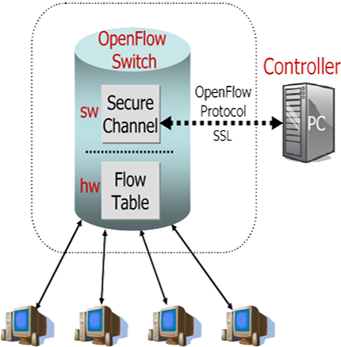

How Does OpenFlow Work?
OpenFlow Switch and Tables
App
App
App
General purpose PC, Server
Controller (Server Software)
OpenFlow
protocol
Ethernet Switch
Control Path
OpenFlow
Data Path, H/W

Slide 14
Current Status of SDN Products and Solutions
Open Source
 | Solutions | OpenFlow version
Controller | NOX | Support OpenFlow 1.3 | C++ API
 | POX | Python version of NOX, Support OpenFlow 1.1 | Python API
 | Floodlight | Support OpenFlow 1.3 | BigSwitch joined OpenDaylight but left it on June 2013
 | Ryu | Support OpenFlow 1.4 | Python API
 | OpenDayLight (ODL) | Support OpenFlow 1.3 | 2014.2
Switch | Open vSwitch | Support OpenFlow 1.3
 | Ericsson soft switch | Support OpenFlow 1.3 | Compatible with Mininet Controller: NOX 1.3
Vendors
NEC: released OpenFlow 1.3 switch and controller… 2013.9
HP: released OpenFlow 1.3 data center switch … 2013
Centec Network, China: released Open SDN switch with OpenFlow1.3 support (implemented on OpenVswitch) … 2013.4
Brocade, OpenFlow 1.3 switch … 2014.6~

Slide 15
OpenFlow Protocol Format
Protocol Layer
OpenFlow control message relies on TCP protocol
Controllers listen on TCP port 6633/6653 to setup conn. with switch
6633/6653 became the official IANA port since 2013-07-18
OpenFlow message structure
Version
Indicates the version of OpenFlow which this message belongs
Type
Indicates what type of message is present and how to interpret the payload (version dependent)
Message length
Indicates where this message will be end, starting from the first byte of header
Transaction ID (xid)
A unique value used to match requests to response
OpenFlow Message Structure
Bit Offset | 0 ~ 7 | 8 ~ 15 | 16 ~ 23 | 24 ~ 31
0 ~ 31 | Version | Type | Message Length
32 ~ 63 | Transaction ID
64 ~ ? | Payload

Slide 16
OpenFlow Protocol Messages
C: OpenFlow Controller
S: OpenFlow Switch
AM: Asynchronous message CSM: Control/Switch Message SM: Symmetric Message
Category | Message | Type | Description
Meta Info. Configuration | Hello (SM) | C → S | following a TCP handshake, the controller sends its version number to the switch.
 | Hello (SM) | S → C | the switch replies with its supported version number.
 | Features Request (CSM) | C → S | the controller asks to see which ports are available.
 | Set Config (CSM) | C → S | in this case, the controller asks the switch to send flow expirations.
 | Features Reply (CSM) | S → C | the switch replies with a list of ports, port speeds, and supported tables and actions.
 | Port Status | S → C | enables the switch to inform that controller of changes to port speeds or connectivity..
Flow Processing | Packet-In (AM) | S → C | a packet was received and it didn't match any entry in the switch's flow table, causing the packet to be sent to the controller.
 | Packet-Out (CSM) | C → S | Instructs a switch to send a packet out to one or more switch ports.
 | Flow-Mod (CSM) | C → S | instructs a switch to add a particular flow to its flow table.
 | Flow-Expired (CSM) | S → C | a flow timed out after a period of inactivity.

Slide 17




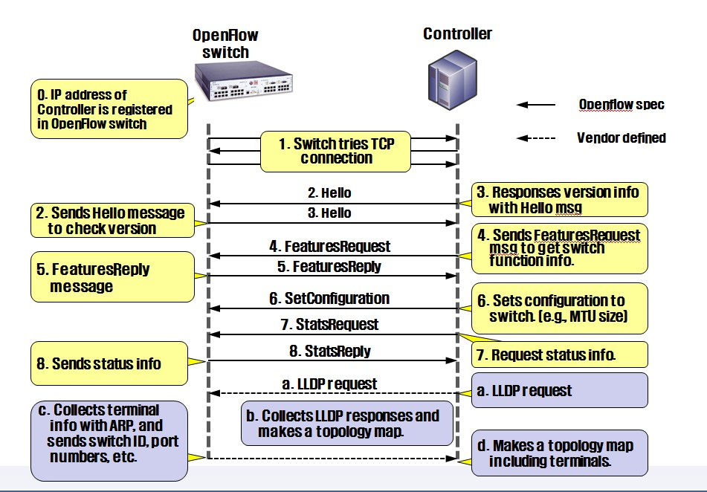


OpenFlow Communication
Connection Setup

Slide 18
OpenFlow: Flow Table
Counters used when controller calculates paths
Flow Table
Flow entry
match field
counter
Action
(Instruction)
priority
Timeout
cookie
1
n
…
…
…
Actions(Instructions)
Forward packet to port(s)
Encapsulate and forward to controller
Drop packet
Send to normal processing pipeline
Modify Fields
Etc.
Flow table
Match field= L1~L4 header information
OpenFlow 1.0 → 12 tuples
OpenFlow 1.1 → 15 tuples
OpenFlow 1.3 → 40 tuples (158 bytes)
L1
L2
L3
L4
Switch
Port
MAC src
MAC
dst
Ether type
VLAN ID
VLAN Priority
MPLS Label
MPLS traffic class
Src
IP
Dst
IP
Protocol No.
Src
TCP/UDP port
Dst
TCP/UDP port
Meta data
ToS
Match fields of OpenFlow 1.1

Slide 19
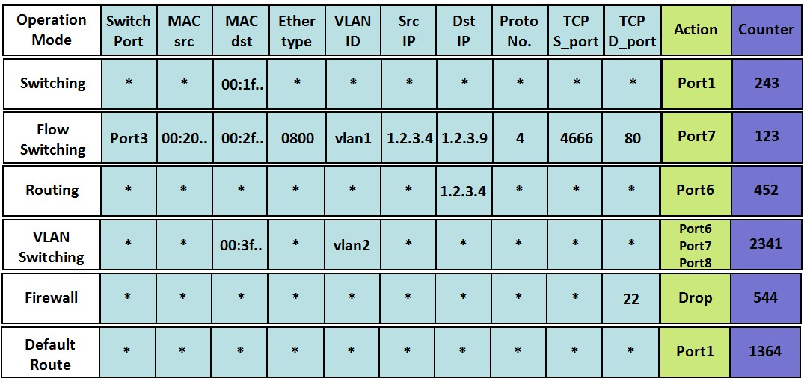
OpenFlow: Flow Table
Flow Table
Wild card (*) means “does not matter” – not important field

Slide 20
OpenFlow Pipelining
Pipelining
The flow tables of a switch are sequentially numbered, starting at 0
A packet is processed sequentially in multiple flow tables (version 1.1)
If a flow entry is found, the instruction set included in that flow entry is executed
Instructions may explicitly direct the packet to another flow table (“goto-table”)
Pipeline processing can only go forward and not backward
Two stage pipeline processing (version 1.5)
Ingress processing
Mandatory, performed before egress processing, use the rules specified in ingress tables
Egress processing
Optional, performed in the context of output port, use the rules specified in egress tables
Egress table can be configured during feature request/reply phase
Useful to manage complicated processing
E.g., table 1 for VLAN processing, table 2 for multicast group processing
Ingress processing
Egress processing
Flow Table 0
Flow Table n
Flow Table e
Flow Table e+m
Packet In
…
Group Table
…
Packet Out
Instruction/Action
Instruction/Action
Instruction/Action
Instruction/Action

Slide 21
Packet Processing Flowchart in OF Switch
Packet In
Yes
Update counters
Execute instruction set:
Update action set
Update packet headers
Update match set fields
Update pipeline fields
As needed, clone packet to egress
Yes
Group action?
Match in table n?
Yes
Goto-Table n?
No
Execute action set:
Update packet headers
Update match set fields
Update pipeline fields
No
No
Output action?
Table-miss flow entry exists?
Yes
Yes
Yes
Switch has egress tables?
No
No
Drop packet
Drop packet
No
Ingress
Start egress processing:
Action set = {output port}
Start at first egress table
Egress
Update counters
Execute instruction set:
Update action set
Update packet headers
Update match set fields
Update pipeline fields
As needed, clone packet to egress
Yes
Match in table n?
Yes
Goto-Table n?
No
Execute action set:
Update packet headers
Update match set fields
Update pipeline fields
No
Table-miss flow entry exists?
Yes
No
Output action?
Drop packet
No
Yes
Drop packet
Packet Out

Slide 22
Instructions in OpenFlow
Instructions
Instructions are executed when a packet matches an entry in a table
Instructions result in changes to the packet, action set and/or pipeline processing
Syntax | Description
Meter meter_id | Direct packet to the specified meter
Apply-Actions actions | Apply the specific actions immediately. Execute multiple actions of the same type.
Clear-Actions | Clear all the actions in the action set immediately
Write-Actions actions | Merge the specified actions into the current action set, if exists try to overwrite, otherwise try to add.
Goto-Table next-table-id | Indicate the next table in the processing pipeline. The table-id must be greater than the current table-id.

Slide 23
Actions in OpenFlow
Actions
An action is associated with each packet
When the instruction set does not contain a Goto-Table instruction, pipeline processing stops and the actions are executed
Syntax | Description
set | Apply all set-field actions to the packet
qos | Apply all QoS actions, such as set_queue to the packet
group | If a group action specified, apply the actions of the relevant group bucket(s) in the order specified by this list
output | If no group action is specified, forward the packet on the port specified by the output action
push_MPLS | Apply MPLS tag push action to the packet
push_VLAN | Apply VLAN tag push action to the packet
pop | Apply all tag pop actions to the packet

Slide 24
OpenFlow Group Table
Group Table & Types (version 1.1)
All: multicast
Select: load sharing
Indirect: simple indirection
Fast-failover: rerouting
Group Table
Action
Bucket
Table 0
Table 1
……
Table n
Instruction/Action
Instruction/Action
Instruction/Action
Group table
Group ID
Group type
Counter
Action buckets
Multicast
Load sharing
100
all
Port1 : output
Port3 : output
Port5 : output
………
Match field
Counter
Action
Flow table
Dst IP= 224.2.3.9
Group 100
Indirection
Rerouting

Slide 25
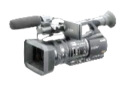

OpenFlow Group Table
Multicast
Type=all
Group Table
Group ID | Group Type | Counter | Action Buckets
100 | All | 999 | Port2, Port3, Port4
Flow Table
Switch Port | MAC src | MAC dst | Ether Type | VLAN ID | Src IP | Dst IP | Proto No. | TCP S Port | TCP D Port | Action
* | * | 00:FF:.. | * | * | * | * | * | * | * | Port 6
Port 1 | * | * | 0800 | * | 224… | 224… | 4 | 4566 | 6633 | Group 100
1
2
3
4

Slide 26
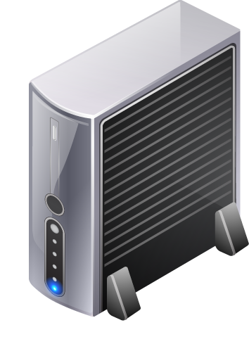
OpenFlow Group Table
Load Balancing
Type=select
Group Table
Group ID | Group Type | Counter | Action Buckets
100 | Select | 999 | Port2, Port3
Flow Table
Switch Port | MAC src | MAC dst | Ether Type | VLAN ID | Src IP | Dst IP | Proto No. | TCP S Port | TCP D Port | Action
* | * | 00:FF:.. | * | * | * | * | * | * | * | Port 1
Port 1 | * | * | 0800 | * | 1.2.3… | * | 4 | * | 80 | Group 100
1
2
3

Slide 27
OpenFlow Group Table
Indirection
Type=indirect
Group Table
Group ID | Group Type | Counter | Action Buckets
100 | Indirect | 777 | Port 5
Flow Table
Switch Port | MAC src | MAC dst | Ether Type | VLAN ID | Src IP | Dst IP | Proto No. | TCP S Port | TCP D Port | Action
* | 00:FF… | * | 0800 | * | 1.2.2… | 11.1… | * | * | * | Group 100
* | 00:FF... | * | 0800 | * | 1.2.3… | 11.1… | * | * | * | Group 100
1
4
2
3
5

Slide 28
OpenFlow Group Table
Fast Failover
Type=fast-failover (ff)
Group Table
Group ID | Group Type | Counter | Action Buckets
100 | Fast-failover | 777 | Port4, Port5, Port6
Flow Table
Switch Port | MAC src | MAC dst | Ether Type | VLAN ID | Src IP | Dst IP | Proto No. | TCP S Port | TCP D Port | Action
Port 1 | * | * | * | * | 1.2.2 | * | * | * | * | Port 7
Port 1 | 00:FF… | * | 0800 | * | 1.2.3… | 11.1… | * | * | * | Group 100
1
4
2
3
5
6

Slide 29
OpenFlow Meter Table
Meter Table (ver 1.3)
Counts packet rate of a matched flow
QoS control → Rate-limit, DiffServ …
Meter Table
Meter ID | Band Type | Rate | Counter | Argument
100 | Drop (remark DSCP) | 1000 kbps | 1000 | xxx
Flow Table
Switch Port | MAC src | MAC dst | Ether Type | Src IP | Dst IP | Proto No. | TCP S Port | TCP D Port | Inst. Meter | Action
Port 1 | * | * | * | 1.2.2 | * | * | * | * | N/A | Port 7
Port 1 | 00:FF… | * | 0800 | 1.2.3… | 11.1… | * | * | * | Meter 100 | Port 2

Slide 30
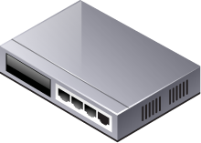
Packet Forwarding in OpenFlow
Packet Forwarding
Reactive flow insertion
A non-matched packet reaches to OpenFlow switch, it is sent to the controller, based on the info in packet header, an appropriate flow will be inserted
Always need to query the path from controller during packet arrival → slow
Can reflect the current traffic status
Proactive flow insertion
Flow can be inserted proactively by the controller to switches before packet arrives
No need to communicate during packet arrival → fast packet forwarding
Cannot reflect the current traffic status
SRC | DST | ACT | …
OpenFlow Controller
SRC | DST | ACT | …
h1 | h2 | p2
h1 h2 p2
acquire route
insert flow
1
2
1
2
host1
switch1 (reactive)
switch2 (proactive)
host2

Slide 31

Topology Discovery in OpenFlow
Purpose
To construct an entire network view
Method
Use the Link Layer Discovery Protocol (LLDP)
IDX | SRC | DST | SRC PORT | DST PORT
153 | sw. A | sw. B | p2 | p1
… | … | … | … | …
357 | sw. B | sw. A | P1 | p2
OpenFlow Controller
PACKET_OUT with LLDP
PACKET_OUT with LLDP
p1
PACKET_IN with LLDP
p2
p2
LLDP
p1
Notes:
OpenFlow Switch 포트의 status 정보를 스위치에서 Controller에 보내면서 Topology Discovery가 이루어진다.
스위치의 포트가 Down에서 Up으로 변경된다.
이 포트의 변경 사항을 Switch에서 Controller에 보낸다.
Controller는 LLDP가 Switch의 변경된 포트를 통해 전송되도록 Packet Out Message로 생성하여 전송한다.
이것을 수신한 Switch는 Packet Out Message에 담긴 LLDP를 인접한 Switch에 전달한다.
LLDP를 받은 인접한 Switch는 해당 LLDP를 어떻게 처리해야 할지를 모르기 때문에 이 Packet을 Controller에 Packet In Message 형태로 보낸다.
Controller는 이를 통해 스위치 간 연결 정보를 확인한다.

Slide 32
Communication in Legacy Network
host2 tries communication to host1 by sending a ping ICMP packet
host2 broadcasts ARP Request packet
host1 replies ARP Request with ARP Reply
host2 creates entry to ARP Cache Table
host2 sends ICMP Echo request packet
host1 replies ICMP Echo request with ICMP Echo reply
$ ping 10.1.1.11
ping
ARP Request
ARP Reply
ICMP Echo Request
ICMP Echo Reply
host2
switch1
switch2
host1
IP: 10.1.1.12
MAC:00:50:56:86:16:C8
IP: 10.1.1.11
MAC:00:50:56:86:0A:AE
host3
switch3
switch4
host4
IP: 10.1.1.13
MAC:00:50:56:86:16:99
IP: 10.1.1.14
MAC:00:50:56:86:18:78
ARP Cache Table of Host2
Internet Address Physical Address Type
10.1.1.254 00-00-0C-E7-58-CD Dynamic
10.1.1.11 00-50-56-86-0A-AE Dynamic

Slide 33
Communication in OpenFlow
If controller has no host1 information
Packet In
Packet In/Out
Packet Out
$ ping 10.1.1.11
ping
ARP Request
host2
switch1
switch2
host1
IP: 10.1.1.12
MAC:00:50:56:86:16:C8
Packet In/Out
IP: 10.1.1.11
MAC:00:50:56:86:0A:AE
Packet In/Out
host3
switch3
switch4
host4
IP: 10.1.1.13
MAC:00:50:56:86:16:99
IP: 10.1.1.14
MAC:00:50:56:86:18:78
ARP Cache Table of Host2
Internet Address Physical Address Type
10.1.1.254 00-00-0C-E7-58-CD Dynamic

Slide 34
Communication in OpenFlow
If controller has no host1 information
Packet Out
Flow Mod
Packet Out
Flow Mod
$ ping 10.1.1.11
Packet In
Packet In
ARP Reply
host2
switch1
switch2
host1
IP: 10.1.1.12
MAC:00:50:56:86:16:C8
IP: 10.1.1.11
MAC:00:50:56:86:0A:AE
host3
switch3
switch4
host4
IP: 10.1.1.13
MAC:00:50:56:86:16:99
IP: 10.1.1.14
MAC:00:50:56:86:18:78
ARP Cache Table of Host2
Internet Address Physical Address Type
10.1.1.254 00-00-0C-E7-58-CD Dynamic
10.1.1.11 00-50-56-86-0A-AE Dynamic

Slide 35
Communication in OpenFlow
Flow Mod
Controller now has the host1 info.
Packet In
Packet In
Packet Out
Flow Mod
Packet Out
$ ping 10.1.1.11
ICMP Echo Request
host2
switch1
switch2
host1
IP: 10.1.1.12
MAC:00:50:56:86:16:C8
IP: 10.1.1.11
MAC:00:50:56:86:0A:AE
host3
switch3
switch4
host4
IP: 10.1.1.13
MAC:00:50:56:86:16:99
IP: 10.1.1.14
MAC:00:50:56:86:18:78
ARP Cache Table of Host2
Internet Address Physical Address Type
10.1.1.254 00-00-0C-E7-58-CD Dynamic
10.1.1.11 00-50-56-86-0A-AE Dynamic

Slide 36
Communication in OpenFlow
Controller now has the host1 info.
Packet Out
Flow Mod
Packet Out
Flow Mod
$ ping 10.1.1.11
Packet In
Packet In
ICMP Echo Reply
host2
switch1
switch2
host1
IP: 10.1.1.12
MAC:00:50:56:86:16:C8
IP: 10.1.1.11
MAC:00:50:56:86:0A:AE
host3
switch3
switch4
host4
IP: 10.1.1.13
MAC:00:50:56:86:16:99
IP: 10.1.1.14
MAC:00:50:56:86:18:78
ARP Cache Table of Host2
Internet Address Physical Address Type
10.1.1.254 00-00-0C-E7-58-CD Dynamic
10.1.1.11 00-50-56-86-0A-AE Dynamic

Slide 37


OpenFlow Failover
Flow table of Switch A (group table combined)
OpenFlow Failover
Protection
src | dst | Out port | Failover port
h1 | h2 | 2 | 3
Set working and backup paths
Controller
1. Switch A detects port down
2. Send packets to the backup path
Working and backup paths are pre-inserted into all switches in advance
Working path
2
1
B
D
A
3
Host 2
Host 1
C
Backup path
E

Slide 38
OpenFlow Failover
1. Obtain affected flows (host1→host2)
2. Find an alternative path for each flow
path: <ACED>
OpenFlow Failover
Restoration
Controller
3. Set up alternative paths
Port down message
Port down message
Working path
B
D
A
Host 2
Host 1
C
Backup path
E

Slide 39
OpenFlow Example
Example of Routing Control (hop-by-hop routing)
AAA
(VM1)
Firewall(VM2)
Flow table of OFSW_1
MAC=b
MAC=c
Match Fields |  |  |  | Actions
Phy port | Src MAC | Dst MAC | VLAN ID
1 | a | d | 1 | Forward to p3
3 | a | d | 1 | Forward to p2
2 | a | d | 1 | Forward to p5
Virtual switch A
Virtual switch B
MAC=a
PC_A
2
3
Web Server 1 (VM3)
1
Virtual switch C
4
OFSW_1
6
5
OFSW_2
MAC=d
PC_B
Virtual switch D
Web Server 2 (VM4)
OFSW_3
OFSW_4

Slide 40
Related Work: NFV (Network Function Virtualization)
2012 Sep., Telcos Proposed NFV
AT&T, Verizon, BT, DT, NTT, Telefonica, China Mobile…
NFV committee (ISG: Industry Specification Group) was setup under ETSI
Current SDN/OpenFlow is Data Center oriented…
Proposed to develop new virtualization technologies which allows to abstract underlying hardware… development of API for NFV
Hopes to replace a large variety of vendor-proprietary nodes and hardware appliances
Can reduce CAPEX, OPEX (including space & power consumption)
BSSs
OSSs
NMSs
EMSs
Server Farm
Center Router
Core Router
GSR
GES
Metro SW
L3
L2
AAA
Mail
DNS
DPI
F/W
G/W
Cache
NAT
DHCP
ACL
IGP
STB
IMS
DPI
DDNS
VLAN

Slide 41
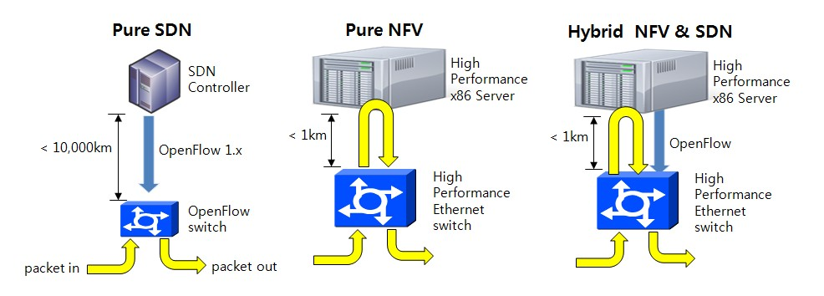
NFV (Network Function Virtualization)
NFV Definition
NFV is a network architecture concept
Virtualize the entire classes of network node functions into building block that may be connected, or chained, to create comm. Services
Relationship to SDN
Notes:
In essence, Software-defined networking (SDN) is an approach to building data networking equipment and software that separates and abstracts elements of these systems. It does this by decoupling the control plane and data plane from each other, such that the control plane resides centrally and the forwarding components remain distributed. The control plane interacts both northbound and southbound. In the northbound direction the control plane provides a common abstracted view of the network to higher-level applications and programs using APIs. In the southbound direction the control plane programs the forwarding behavior, using device level APIs, of the physical network equipment distributed around the network.
Thus, NFV is not dependent on SDN or SDN concepts. It is entirely possible to implement a virtualized network function (VNF) as a standalone entity using existing networking and orchestration paradigms. However, there are inherent benefits in leveraging SDN concepts to implement and manage an NFV infrastructure, particularly when looking at the management and orchestration of VNFs, and that's why multivendor platforms are being defined that incorporate SDN and NFV in concerted ecosystems.[12]
An NFV infrastructure is more than simply adapting existing network applications to run on x86 technology. It needs a central orchestration and management system that takes operator requests associated with a VNF, translates them into the appropriate compute, storage and network configuration needed to bring the VNF into operation. Once in operation, the VNF potentially needs to be monitored for capacity and utilization and adapted if necessary.
All these functions can be accomplished using SDN concepts and NFV could be considered one of the primary SDN use cases in service provider environments. It is also apparent that many SDN use-cases could incorporate concepts introduced in the NFV initiative. Examples include where the centralized controller is controlling a distributed forwarding function that could in fact be also visualized on existing compute or routing equipment.

Slide 42
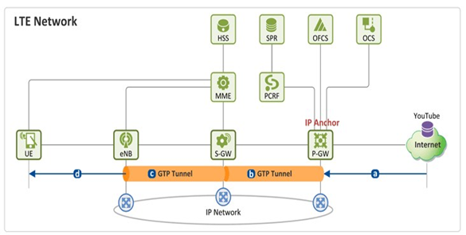
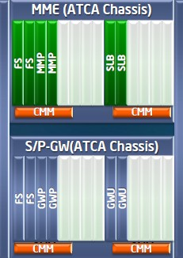
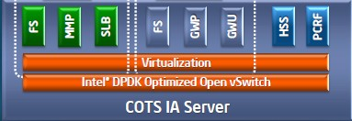
NFV (Network Function Virtualization)
Benefits of NFV
Standard APIs → third party S/W vendors will speed up the dev.
More effective resource utilization
Virtualization allows Telco to allocate necessary resources
Easy to manage, reduce CAPEX/OPEX
Example of NFV
NEC + Telefonica
Impl. of EPC (Evolved Packet Core) → first demo at MWC 2013
General purpose computers (CAPEX, OPEX → 50%)
Flexibly respond to the change of traffic with cloud computing technologies
Innovative technology to lower Entry barrier of Telco business
MME
S/P-GW

Slide 43


Example: Kanazawa General Hospital (with NEC solution)
Problem
Individual network optimization led to complex network structure
Configuration errors
Rewiring whenever a new equipment is connected
Difficult to find fault location
L3 Core Switch
Servers
F/W x 2
F/W x2
Lobby, registration
Emergency Room
Surgery

Slide 44
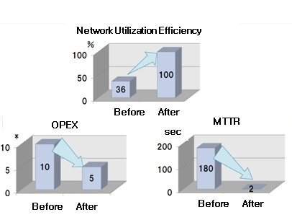



Example: Kanazawa General Hospital (with NEC solution)
Solution
16 OpenFlow switches and 2 controllers
Create virtual network/department
Flow patch control
Save CAPEX and OPEX
Fast recovery from failure
OpenFlow Controller x2
OpenFlow Switch x2 /floor x 7 floor
F/W pool
Full nesh N/W
L3 Core switch
Server pool
Notes:
MTTR: Mean time to repair
A basic measure of the maintainability of repairable items. It represents the average time required to repair a failed component or device.

Slide 45

Q&A

