Slide 1

Network Softwarization: SDN/NFV and Open Networking
Prof. James Won-Ki Hong
Distributed Processing and Network Management (DPNM) Lab.
Dept. of Computer Science & Engineering
POSTECH
Pohang, South Korea
http://dpnm.postech.ac.kr/
jwkhong@postech.ac.kr
2023. 2. 14

Slide 2
Outline
Evolution of Networks
Challenges for Telecom operators
SDN
NFV
Open Networking Ecosystem
SDN/NFV Use Cases
SDN/NFV Forums, Conferences & Journals
Concluding Remarks
Glossary & References

Slide 3

Short Bio
Education
1991 – PhD in Computer Science, Univ. of Waterloo, Canada
1985 – MSc in Computer Science, Univ. of Western Ontario, Canada
1983 – HBSc in Computer Science, Univ. of Western Ontario, Canada
Professional Activities
Co-Founder & Technical Advisor, Kedutech, Korea (2020. 8 – present)
Director, POSTECH Innovation Center for Education (Nov. 2019 – present)
Executive Director, SDN/NFV Forum (2014.10 – 2019. 4)
CTO & SEVP, KT (Korea Telecom) (2012. 3 – 2014. 2)
President, Intelligent Communication Industry Association (2013.1 - 2014.2)
Chairman, Korea ICT Standards Committee (2012.3 – 2014.2)
Dean, Graduate School of Information Technology, POSTECH (2007.3 – 2012.2, 2015.11 – 2019.10)
Head, Division of IT Convergence Engineering, POSTECH (2008.12 – 2012.2)
Head, Dept. of Computer Science and Engineering, POSTECH (2008.12 – 2010.02)
Director, POSTECH Information Research Labs (2007.9 – 2010.02)
Professor, Dept. of Computer Science and Engineering, POSTECH (1995.5 – present)
Research Professor, Univ. of Western Ontario, Canada (1992.5 – 1995.4)
Editor-in-Chief, Int. Journal of Network Management (2012.1-present)
Editorial Board Member of IEEE TNSM, JCN, JNSM
IEEE Communications Society Member-at-Large (2015.1 – 2017.12)
Co-Founder & CTO, Netstech, Palo Alto, USA (2000.6 – 2002.2)
Steering Committee Member of IEEE NOMS, IM, APNOMS, CNSM, NetSoft, NFV-SDN
General Chair (IEEE ICBC 2019, NOMS 2018, NetSoft 2016, NOMS 2010, APNOMS 2008 & 2006)
Technical Chair (2001-2002) & Chair (2005-2009), IEEE ComSoc CNOM
Prof. James Won-Ki Hong
30+ Years Education Experience in Canada & Korea
Global Startup Experience
Industry Senior Executive Experience
Notes:
I will present challenges that are faced by telecom operators. I will then address the recent SDN/NFV technology trend. After that, I will introduce what artificial intelligence (AI) is and how AI technology is being applied in network management. Specifically, I will introduce AI-based NFV Life Cycle management technology, which has been studied in the DPNM laboratory for the last four years. Finally, I will introduce AI-based traffic engineering and summarize this talk.

Slide 4
Evolution of Networks

Slide 5

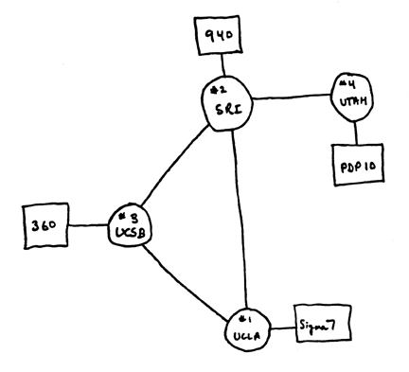
Internet History
54 years later
1969
Notes:
The network has been growing larger and more complex over the past five decades while adopting new technologies and services. In South Korea, Telco networks consist of hundreds of backbone routers, thousands of edge routers, and hundreds of thousands of access switches. As shown in this slide, Telco networks are built as either best-effort networks to provide general web services (e.g., email, web surfing) or premium networks to support high-quality services. In particular, premium networks are used to provide enterprise services, such as VPNs and IPTVs, requiring high reliability and high quality, and mobile services, such as 4G and 5G.
Thousands of middleboxes are being virtualized based on cloud computing and NFV technologies to support and perform various networks functions, such as BSS/OSS/NMS/EMS, carrier-grade NAT/DNS, and firewall/DPI/IDS, in networks.

Slide 6
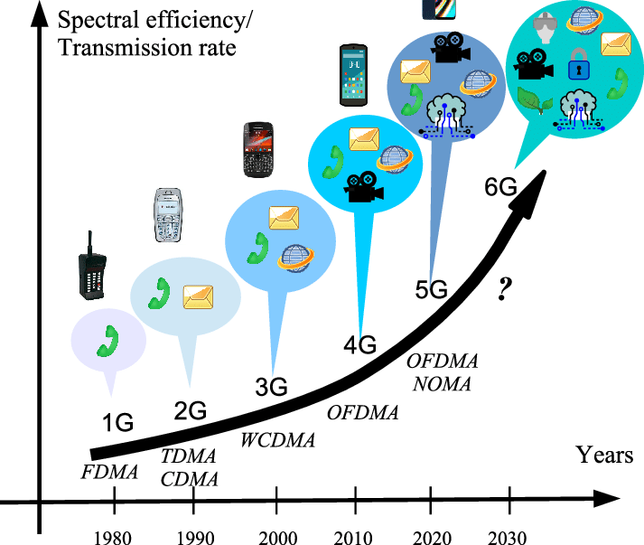
Evolution of Mobile Networks
Source: https://www.researchgate.net/publication/350889195_5G_and_Beyond_Past_Present_and_Future_of_the_Mobile_Communications_English_Version
Notes:
Mobile networks have been evolving over the past 5 decades, starting from 1G to 5G and soon to 6G. The new technology has been introduced every 10 years.

Slide 7
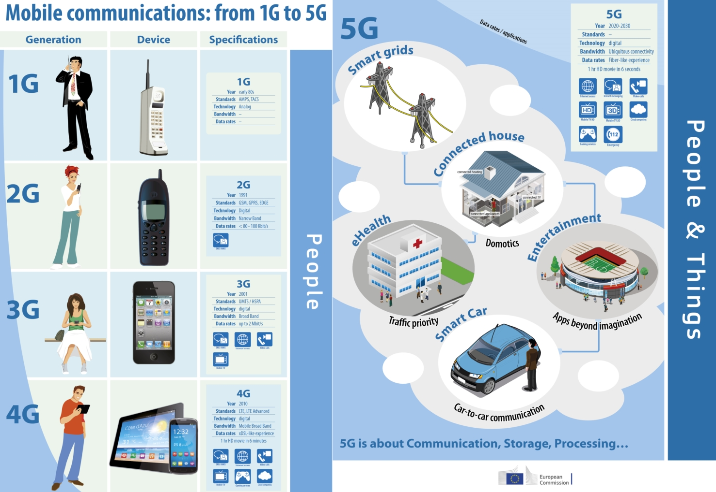
Evolution of Mobile Communications
Source: European Commission
Notes:
The network has been growing larger and more complex over the past five decades while adopting new technologies and services. In South Korea, Telco networks consist of hundreds of backbone routers, thousands of edge routers, and hundreds of thousands of access switches. As shown in this slide, Telco networks are built as either best-effort networks to provide general web services (e.g., email, web surfing) or premium networks to support high-quality services. In particular, premium networks are used to provide enterprise services, such as VPNs and IPTVs, requiring high reliability and high quality, and mobile services, such as 4G and 5G.
Thousands of middleboxes are being virtualized based on cloud computing and NFV technologies to support and perform various networks functions, such as BSS/OSS/NMS/EMS, carrier-grade NAT/DNS, and firewall/DPI/IDS, in networks.

Slide 8

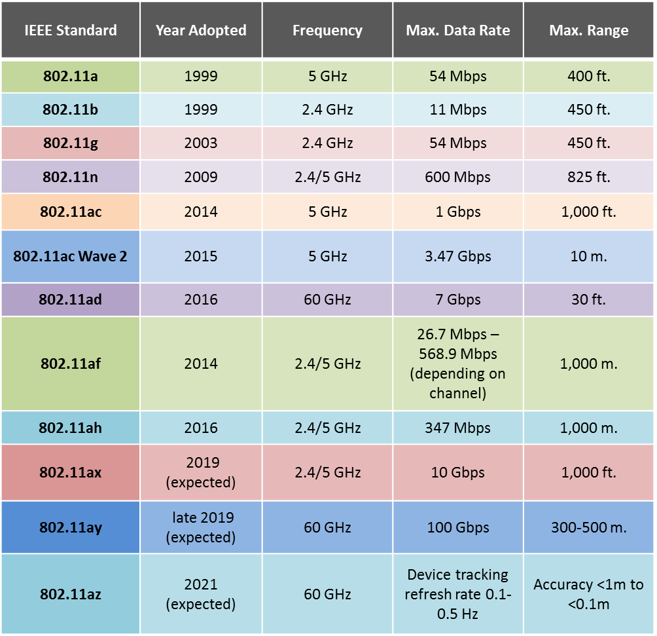
Evolution of Wireless Networks (WiFi)
Source: L-com
Notes:
The network has been growing larger and more complex over the past two decades while adopting new technologies and services. In South Korea, Telco networks consist of hundreds of backbone routers, thousands of edge routers, and hundreds of thousands of access switches. As shown in this slide, Telco networks are built as either best-effort networks to provide general web services (e.g., email, web surfing) or premium networks to support high-quality services. In particular, premium networks are used to provide enterprise services, such as VPNs and IPTVs, requiring high reliability and high quality, and mobile services, such as 4G and 5G.
Thousands of middleboxes are being virtualized based on cloud computing and NFV technologies to support and perform various networks functions, such as BSS/OSS/NMS/EMS, carrier-grade NAT/DNS, and firewall/DPI/IDS, in networks.

Slide 9
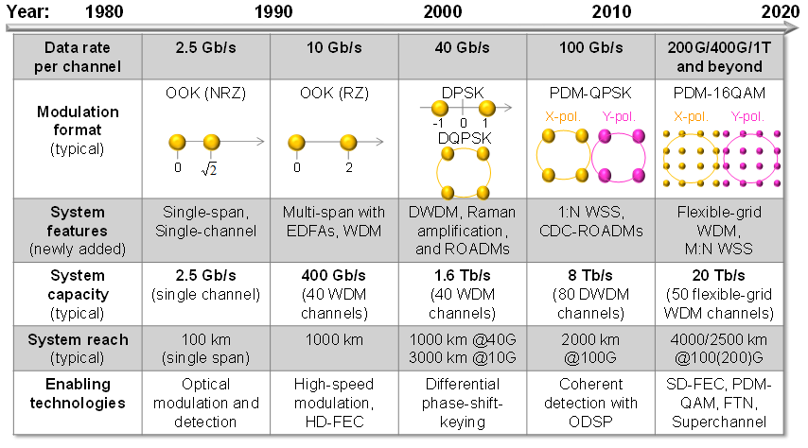
Evolution of Optical Networks
Source: Huawei
Notes:
The network has been growing larger and more complex over the past two decades while adopting new technologies and services. In South Korea, Telco networks consist of hundreds of backbone routers, thousands of edge routers, and hundreds of thousands of access switches. As shown in this slide, Telco networks are built as either best-effort networks to provide general web services (e.g., email, web surfing) or premium networks to support high-quality services. In particular, premium networks are used to provide enterprise services, such as VPNs and IPTVs, requiring high reliability and high quality, and mobile services, such as 4G and 5G.
Thousands of middleboxes are being virtualized based on cloud computing and NFV technologies to support and perform various networks functions, such as BSS/OSS/NMS/EMS, carrier-grade NAT/DNS, and firewall/DPI/IDS, in networks.

Slide 10
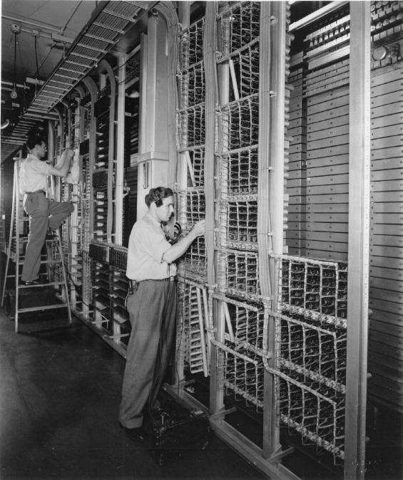
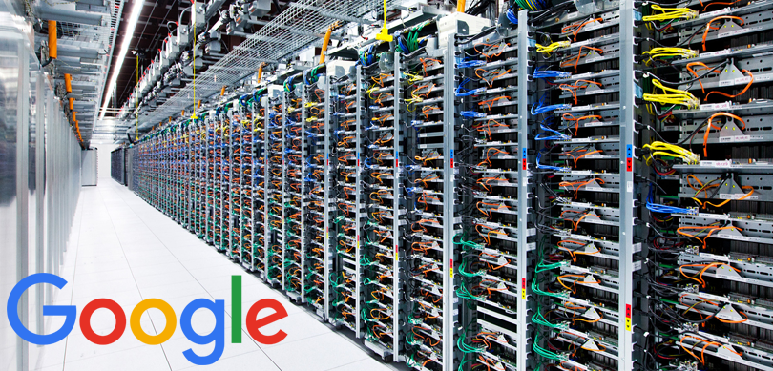
Evolution of Data Centers
Notes:
The network has been growing larger and more complex over the past two decades while adopting new technologies and services. In South Korea, Telco networks consist of hundreds of backbone routers, thousands of edge routers, and hundreds of thousands of access switches. As shown in this slide, Telco networks are built as either best-effort networks to provide general web services (e.g., email, web surfing) or premium networks to support high-quality services. In particular, premium networks are used to provide enterprise services, such as VPNs and IPTVs, requiring high reliability and high quality, and mobile services, such as 4G and 5G.
Thousands of middleboxes are being virtualized based on cloud computing and NFV technologies to support and perform various networks functions, such as BSS/OSS/NMS/EMS, carrier-grade NAT/DNS, and firewall/DPI/IDS, in networks.

Slide 11
Challenges for Telecom operators (Telcos)

Slide 12

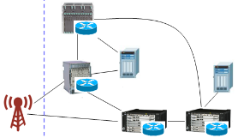



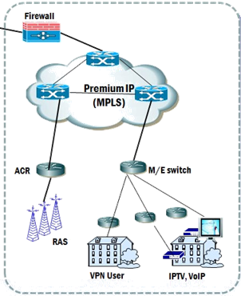


Challenges for Telcos
Telco Networks
SGSN
EPC Core
Foreign Carriers
BSS
OSS
NMS
EMS
Web
PCRF
NAT
IDS
IPS
DPI
FW
Global Hub
HSS
Server Farm
MME
Data Centers
GSR
1
eNodeB
S-GW
P-GW
1
Center
Router
IX
Other Carriers
premium
Core Router
best-effort
Core
Router
Core
Router
Core
Router
GSR
Notes:
The network has been growing larger and more complex over the past two decades while adopting new technologies and services. In South Korea, Telco networks consist of hundreds of backbone routers, thousands of edge routers, and hundreds of thousands of access switches. As shown in this slide, Telco networks are built as either best-effort networks to provide general web services (e.g., email, web surfing) or premium networks to support high-quality services. In particular, premium networks are used to provide enterprise services, such as VPNs and IPTVs, requiring high reliability and high quality, and mobile services, such as 4G and 5G.
Thousands of middleboxes are being virtualized based on cloud computing and NFV technologies to support and perform various networks functions, such as BSS/OSS/NMS/EMS, carrier-grade NAT/DNS, and firewall/DPI/IDS, in networks.

Slide 13
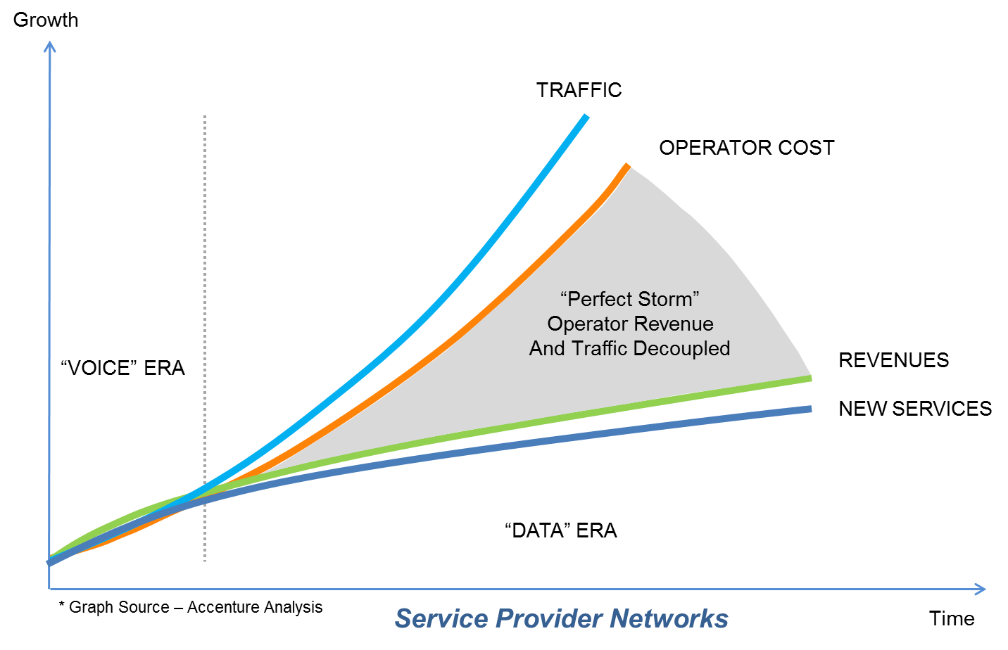
Challenges for Telcos
A rapid increase in data volume in Telco Networks
 | More Mobile Users | More Traffic Volume (per month) | More Mobile Video | Faster Mobile Speeds
2015 | 4.8 Billion | 3.7 EB | 55% of Traffic | 2.0 Mbps
2018 | 5.1 Billion | 30.6 EB | 75% of Traffic | 6.5 Mbps
2023 | 5.7 Billion | 224.08 EB | 80% of Traffic | 43.9 Mbps
CAPEX, OPEX
Increase!!!
Source: CISCO VNI Global Mobile Data Traffic Forecast, 2015-2020 & 2018-2023
Notes:
In Telco networks, traffic volume began to grow around 2007 drastically, when smartphones began to spread worldwide. The data traffic is still growing more than 20% per year. In the case of mobile communication, data traffic was audio traffic in the 2G era. However, with the advent of smartphones and mobile communication services through 3G, 4G, and 5G, most of the data traffic has been audio, video streaming, and web browsing. Although Telcos continue to increase network capacity to cope with this increase in traffic, reduction of CAPEX/OPEX is a challenge for Telcos as global subscriber growth continues to decline.

Slide 14
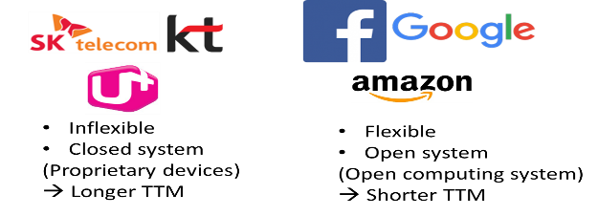
Challenges for Telcos
Reduced revenue share in Telco’s Business Model
Changes in Business model
Closed Market (Feature phone era)
Open Market (Smartphone era)
Telco’s Share? 0%
TTM (Time to Market)
<Revenue Share>
Content Providers
Telco
70%
30%
Content Providers (App Developers)
App. Stores
(Apple, Google)
70%
30%
Notes:
In the 2G era, there was a competition between Telcos to attract subscribers, and there were no other competitors. Thus, Telcos were able to earn stable revenue. However, the smartphone era changed the situation a lot. New content and service providers, i.e., Internet players, such as Google, Amazon, and Facebook, have emerged as powerful competitors for Telcos. They were much more innovative in their operations and faster time-to-market than Telcos.
It might be due to manpower efficiency differences between service providers and Telcos. However, the main reason was that Telcos used a hardware-based communication system that was less flexible, so it took much longer to develop and provide new services. After all, Telcos invested a lot of money to build high-speed wired and wireless networks, but they could not earn more revenue. Instead, Internet players, such as Google, Amazon, Facebook, and Netflix made high revenue by using the networks.

Slide 15
Challenges for Telcos
Infrastructure of Internet players (e.g., Amazon, MS, Google)
Rents cloud computing & storage resources to operate services
Builds a data center using bare metal servers & switches running open source software
➔ Inexpensive, flexible, dynamic
Infrastructure of Telecom operators
Tens of thousands of blackboxes (Router, Switch, Middlebox)
Cable, tower, antenna
➔ Very expensive, inflexible, static
It is desirable to change the infrastructure of Telcos!
Notes:
Internet players, such as Amazon, Microsoft, and Google do not build networks themselves. Instead, they build data centers or rent cloud computing and storage resources to provide services. When building a data center, they design hardware and make vendors compete to implement it at a low cost. After that, Internet players select a vendor that provides the cheapest hardware. In addition, open-source software, such as Linux and Apache, is used to build a dynamic and flexible infrastructure at a low cost. Thus, Internet players can deploy their infrastructure dynamically and flexibly at a low cost.
(Click) On the other hand, Telcos have built networks composed of expensive hardware-based entities and have operated services on the infrastructure. In addition, it was hard for telcos to adopt new technologies quickly due to vendor dependency and incompatibility issues of network entities. As a result, Telcos are aware of the need to change their networks and service environments into a similar and competitive infrastructure of Internet players.

Slide 16





Challenges for Telcos
Mobile Instant Messaging Apps (as of Mar. 2022)
WhatsApp (USA)
KakaoTalk (Korea)
Started: Nov. 2009
Monthly Active Users: 2.0 Billion
Dominant: USA, Europe, Brazil, Mexico, India
Acquired by Facebook (Feb. 2014)
for $19B
Started: March 2010
Monthly Active Users: 50 Million
Dominant: Korea (90% of Koreans use)
Revenue from gaming, emoticon, finance
90% drop in Telco SMS Usage for last 10 years in Korea
WeChat (China)
Line (Japan/Taiwan/Thailand)
Started: Jan. 2011
Monthly Active Users: 1.26 Billion
Dominant: China but growing in USA, Europe & Africa
Revenue from gaming, shopping, banking
Started: June 2011
Monthly Active Users: 187 Million
Dominant: Japan, Taiwan, Southeast Asia and South America
Revenue from gaming, stickers, ads
Why are these apps challenge to Telcos?
Source: techcrunch.com, Statista (www.statista.com), DMR (https://expandedramblings.com)

Slide 17
Challenges for Telcos
In the current era, where costs are rising but revenues and profits are continuously falling, how can Telcos reduce CAPEX & OPEX and have a flexible, agile and efficient operations environment to have a chance to compete against Internet players (such as Google, Apple, Amazon, Facebook, Microsoft, Naver, Kakao, Tencent, Baidu, Alibaba, etc.)?
➔ SDN/NFV = ‘Network Softwarization’ is a promising & desperately needed approach for telco service infrastructures

Slide 18
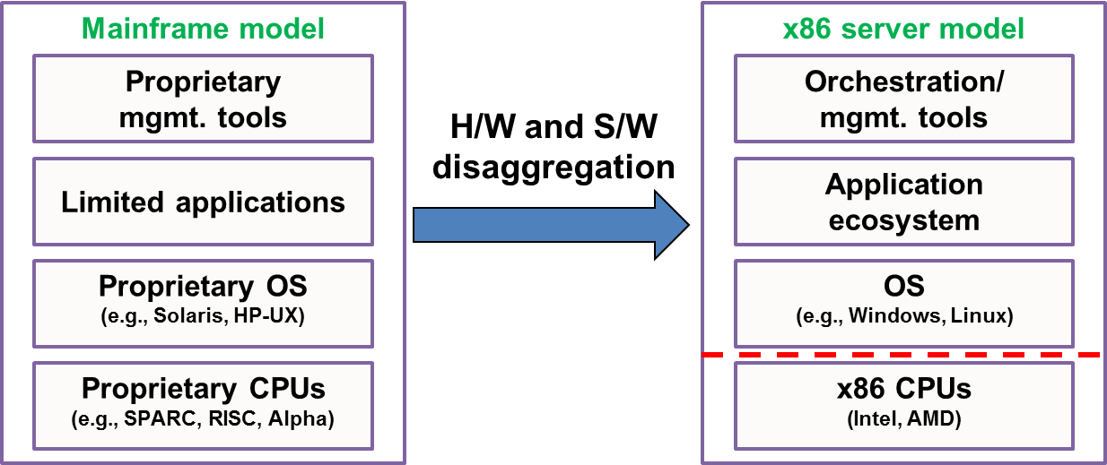
Challenges for Telcos
Comparison to the Compute Paradigm
Compute paradigm for the past few decades
Benefits
Open/flexible choices and cost-effective solutions for customers
Rapid innovation (CPU, OS, Applications)
Rich ecosystem

Slide 19
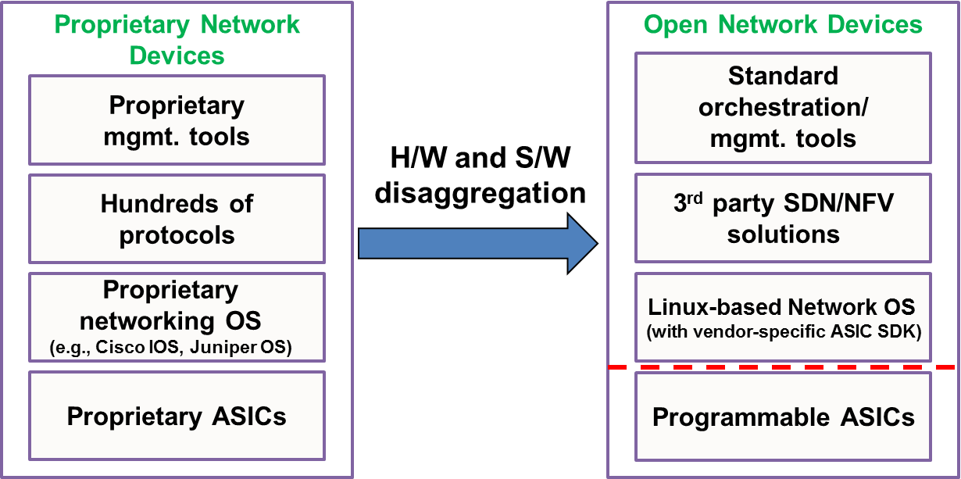
Challenges for Telcos
Comparison to the Compute Paradigm
SDN/NFV is changing the paradigm in networking area

Slide 20
SDN/NFV
(Open Networking)

Slide 21




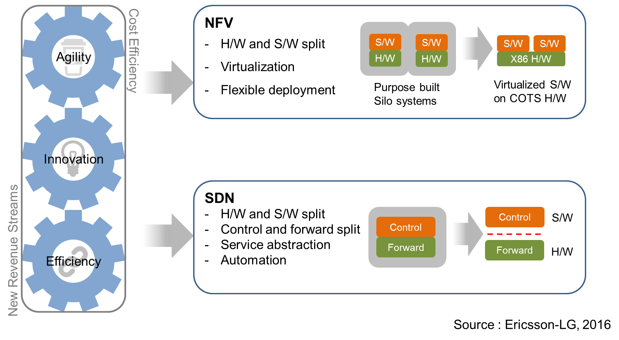
SDN/NFV
Legacy Network
SDN/NFV – Key to network evolution
BSS
OSS
NMS
NMS
NMS
NMS
EMS
Server Farm
Center Router
Core Router
GSR
GES
Metro SW
L3
L2
AAA
Mail
DNS
Cache
Cache
Firewall
DPI
NAT
DHCP
ACL
IGMP
STB
DDNS
VLAN

Slide 22
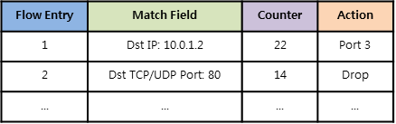



SDN
Software Defined Networking (SDN)
Separates the control plane from the underlying data plane
Supports the centralized management (SDN controller)
Features of SDN
Programmability
Agility
Flexibility
Vendor neutrality
CAPEX/OPEX saving
Controller
Flow Table
Control Plane
Mgmt.
Plane
Data Plane
OpenFlow
Traditional Network
SDN
Notes:
As you may already know, SDN is a technology that separates the control plane from the underlying data plane of the communication system. It allows the control plane that is complex and hard for implementing to be operated in a centralized manner based on cloud computing. Thus, it is possible to build networks without expensive network entities. In addition, SDN supports network programmability and provides vendor neutrality by building software-based infrastructures.

Slide 23
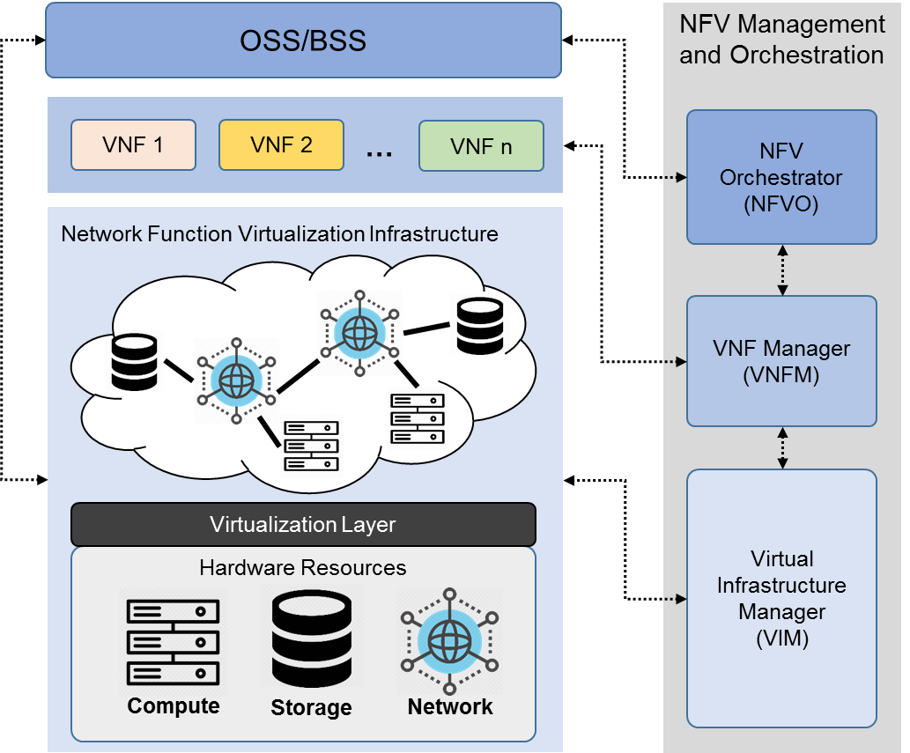
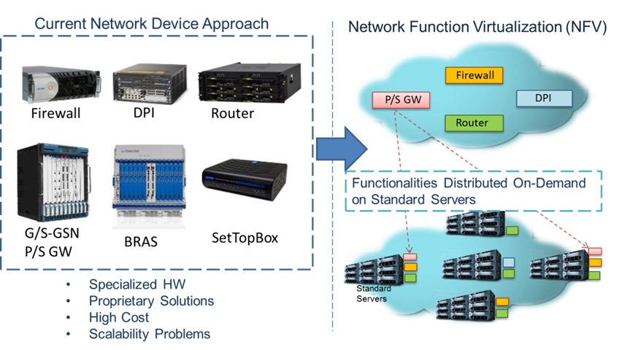
NFV
Network Function Virtualization (NFV)
Replaces physical hardware with software
Uses the technologies of IT virtualization to virtualize network functions to reduce costs and improves flexibility, operability, and maintenance
Source: https://www.tekedia.com/5-0-5g-core-5gc/
Notes:
Network Function Virtualization, NFV, is a technology that significantly reduces CAPEX and provides easy-to-use network functions by leveraging open-source software from white boxes instead of using expensive middleboxes described in the previous slide.

Slide 24
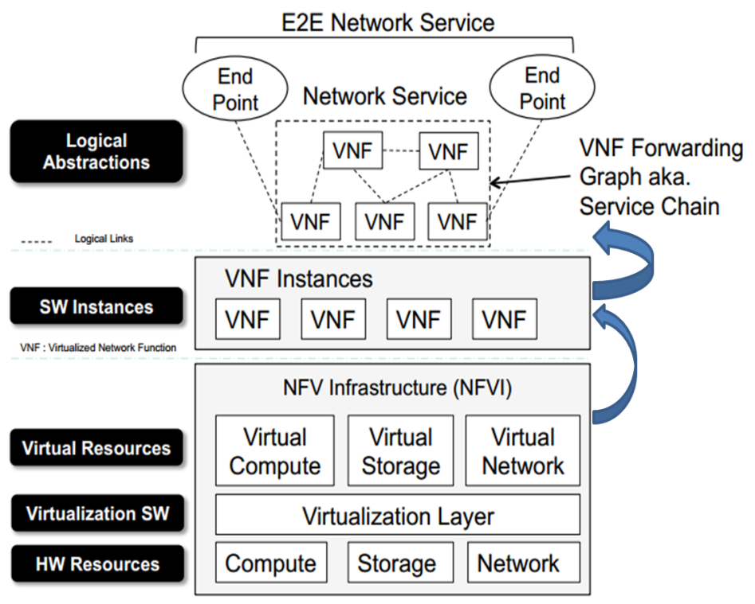
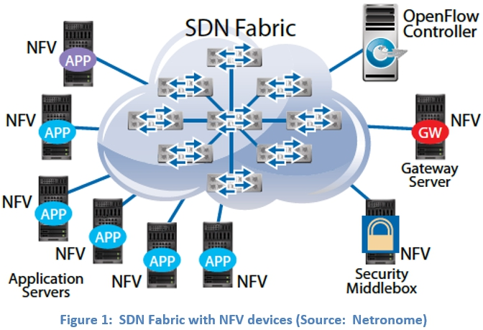
SDN/NFV
Virtualized Network Function (VNF)
SDN can support flexible chaining of VNFs (in servers, data centers)
to provide agile and efficient network services
Source: https://eogogics.com/enhancing-network-capacity-functionality-sdn-nfv/, https://blog.advaoptical.com/en/nfv-and-sdn-the-roadmap-to-programmable-networks
Notes:
With a combination of SDN and NFV, middleboxes can be implemented and managed as Virtual Network Functions (VNFs). SDN can make connections between VNFs flexibly for Service Function Chaining, SFC, and apply auto scaling that adjusts resources allocated to VNFs, in response to traffic changes. Thus, SDN/NFV has the advantage of enabling powerful and flexible network operations.

Slide 25
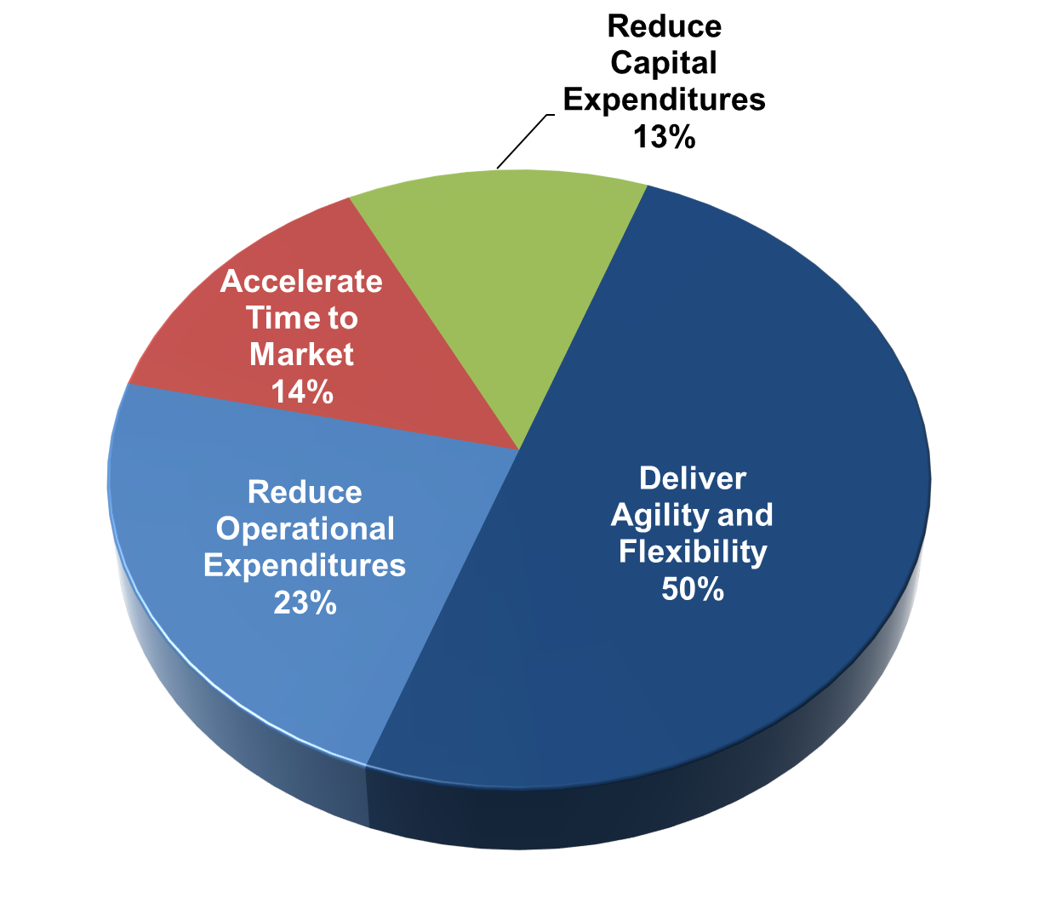
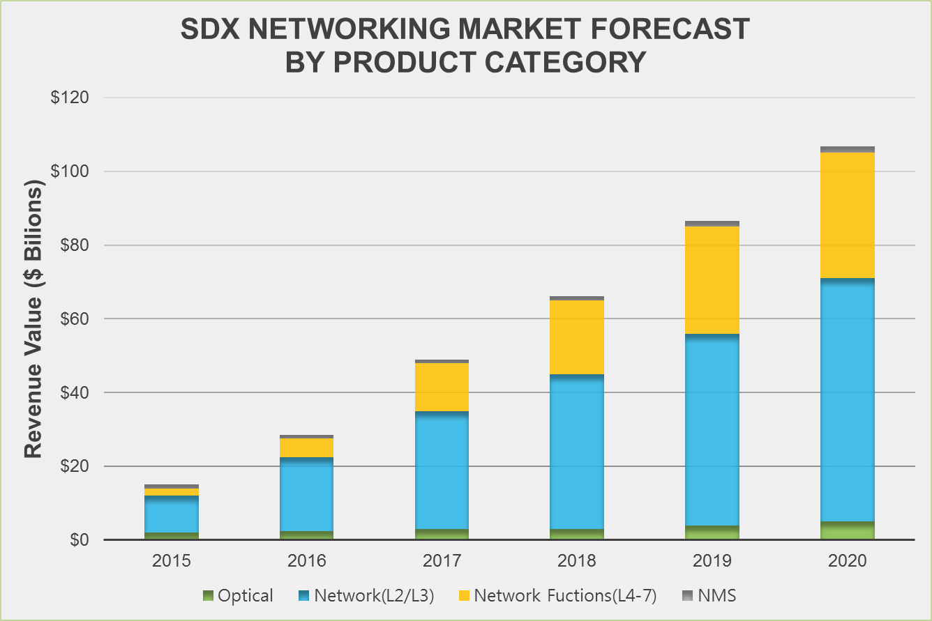
SDN/NFV
Major NFV Drivers
Source: SDx Central, 2016
SDN/NFV Market
Revenue Forecast
Source: SDx Central, 2016

Slide 26
SDN/NFV
Benefits of SDN/NFV
Operators manage VNFs in a centralized manner and configure networks optimally while considering network status
It reduces telco operator’s dependency on vendor-specific hardware
It manages VNFs rapidly in response to network environment changes
Limitations
Increased complexity in network management
Network management is getting difficult due to a massive amount of network traffic
Additional SDN/NFV entities complicate network management
Increase in vulnerability
SDN/NFV enables network operators to configure network environment rapidly and flexibly, but it can cause network failure frequently due to the wrong configuration
A new approach for network management is required ➔ Application of AI technology
Notes:
The introduction of SDN and NFV has dramatically reduced costs while enabling flexible and dynamic infrastructure operations.
(Click) However, the network scale and complexity have also increased significantly due to SDN/NFV. Specifically, Virtual Machines (VMs) run VNFs, so there are numerous VMs in networks, making it human operators hard to handle them manually. In addition, the transformation from hardware-based to open-source software-based environment causes vulnerability issues generating network failures frequently. As a result, it is too difficult to manage the complex network by human operators. Thus, R&D approaches using artificial intelligence (AI) have been proposed to solve the complicated network management in the past few years.

Slide 27
Open Networking Ecosystem

Slide 28






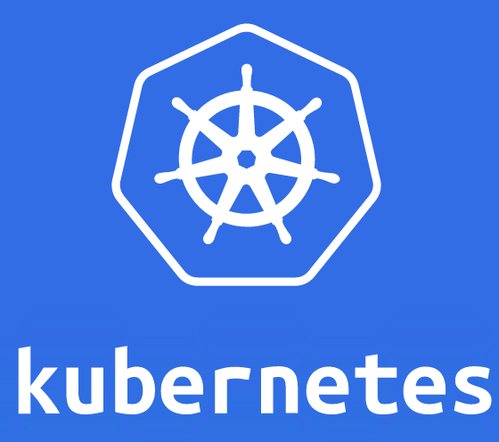
















Open Networking Ecosystem
Open Networking Reference Model
Programming Frameworks
Application Platforms
Management & Orchestration
VM/VI Managers
Containers
Virtual Machines
Compute Server Operating Systems
Carrier Networking Functions
Network Controllers
Programmable Data Plane Services
Network Switch Operating Systems
Hardware
Source: Huawei

Slide 29
Software-Defined Networking
(SDN)

Slide 30

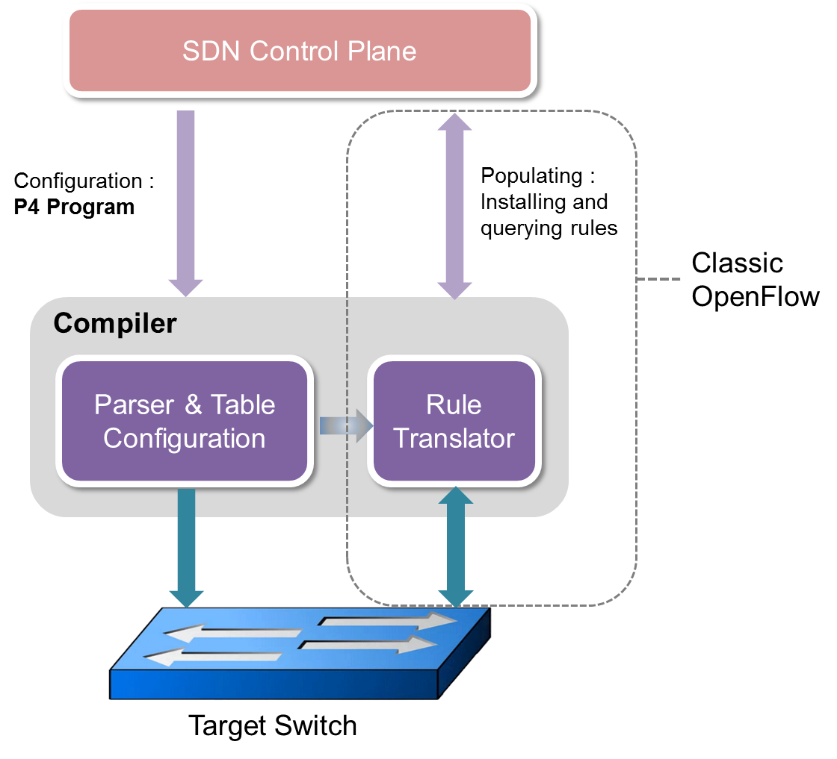
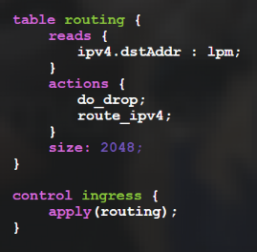


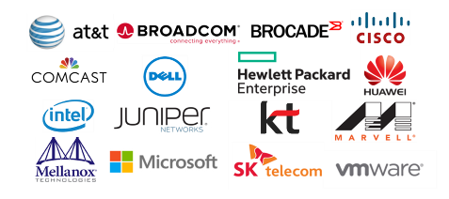
Open Networking Ecosystem
Hardware
P4 (programming protocol-independent packet processors)
Declarative language for telling forwarding-plane devices
(switches, NICs, firewalls, filters, etc) how to process packets
Characteristics
Protocol Independence
Target Independence
Field Re-configurability
Members
Contributors
https://p4.org/join/
https://opennetworking.org/member-listing/ (including POSTECH)

Slide 31

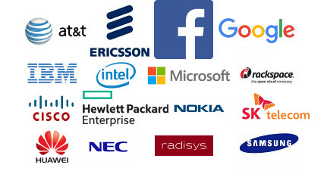
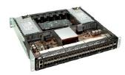
Open Networking Ecosystem
Hardware
OCP (Open Compute Project)
Started by Facebook in 2011
Redesign hardware technology to efficiently support the growing demands on compute & network infrastructure
Break open the black box of proprietary IT infrastructure to achieve greater choice, customization, and cost savings
Projects
Server Design
Storage
Data Center
Hardware Management
Networking
Open Rack
Certification
https://www.opencompute.org/
Members

Slide 32

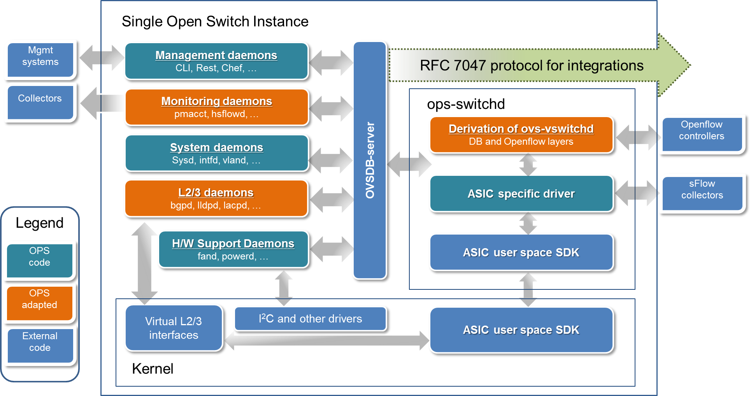
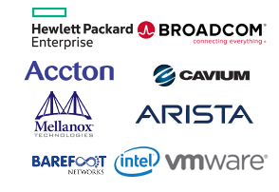
Open Networking Ecosystem
Network Switch Operating Systems
OpenSwitch (OPX)
Linux based operating system originally developed by HP
For OCP compliant hardware
Includes full L2/L3 switching functions
Routing / OpenFlow agents are included
Members
https://www.openswitch.net/

Slide 33


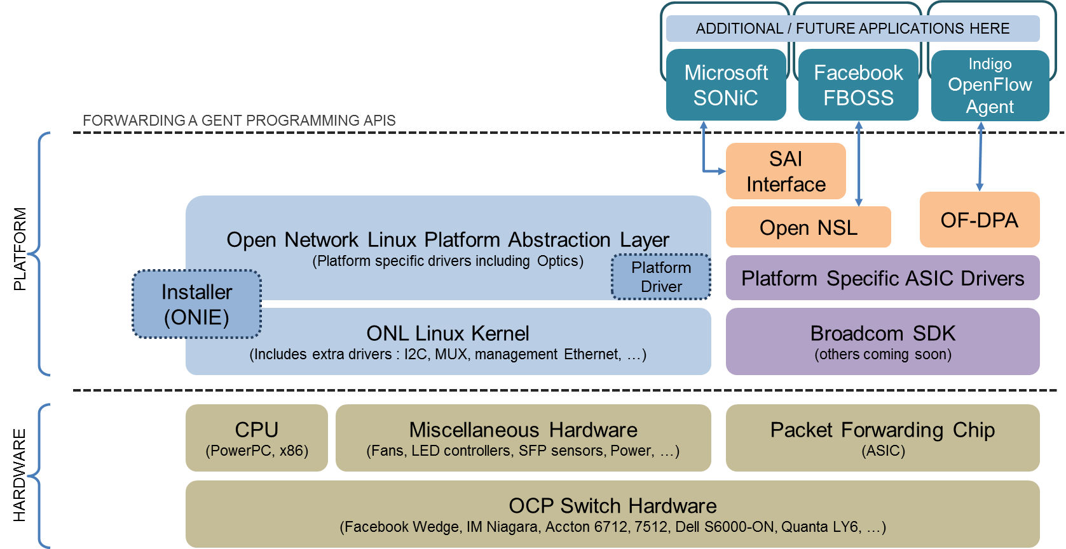
Open Networking Ecosystem
Network Switch Operating Systems
ONL (Open Network Linux)
Linux distribution for "bare metal" switches
A collection of software packages, utilities, drivers,
and abstractions to run on OCP Switch hardware (https://opennetlinux.org/)
Members
Open Network Linux | OpenSwitch
Features / Functionalities
- OpenPlatform Distribution for NOS - Routing / OpenFlow agents NOT included (only samples) | - Open NOS with full L2/L3 Switching functionalities - Routing/ OpenFlow agents are included
Target Hardware
OCP (Open Compute) Switch, Bare metal (White Box) Switch
Contributors
Big Switch Networks, Pica8, Accton | HP Enterprise, Accton, Broadcom Intel, Qosmos, VMWare, Arista
License
Eclipse Public License and GPL for Kernel | Apache License, v. 2.0
Source: “Open Network Linux: A Programmer’s View”, Big Switch Networks

Slide 34


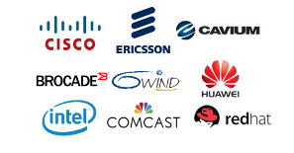
Open Networking Ecosystem
Programmable Data Plane Services
DPDK
A set of libraries and drivers for fast packet processing by bypassing OS kernel
Enables faster development of high-speed data packet networking applications
Supported processors
Intel x86, IBM Power 8, EZchip TILE-Gx, ARM, etc. (https://core.dpdk.org/supported/)
FD.io
Create a platform that enables Data Plane Services that are:
Highly performant
Modular and extensible
Open source, Interoperable, Multi-vendor
Usable in cloud, VMs, containers, bare metal and others
Members

Slide 35
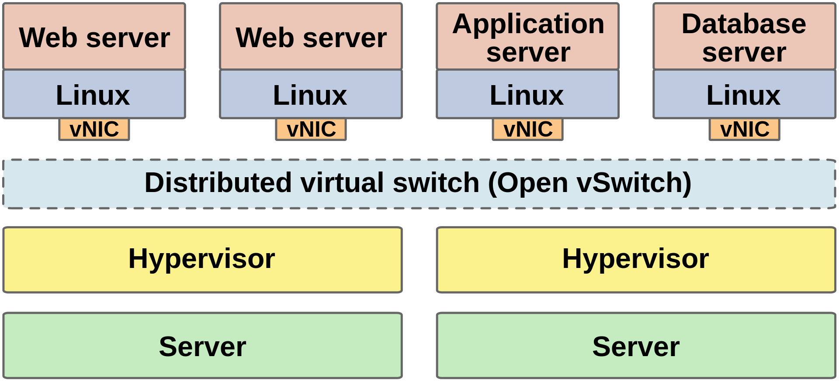
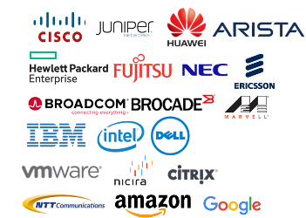
Open Networking Ecosystem
Programmable Data Plane Services
Open vSwitch (OvS)
Open source software switch used as a virtual switch in virtualized server environments
Leverages OpenFlow and Open vSwitch Database (OVSDB) management protocol
Runs on any Linux-based virtualization platform
KVM, VirtualBox, Xen
Members
https://www.openvswitch.org/
Source: https://en.wikipedia.org/wiki/Open_vSwitch

Slide 36

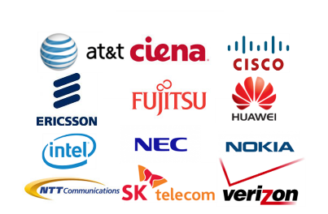
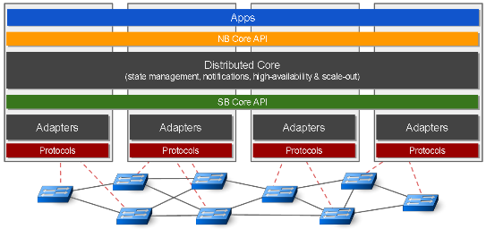

Open Networking Ecosystem
Network Controllers
ONOS (Open Network Operating System)
Open source SDN network OS from ONF (formerly ON.Lab)
The goal is to create a SDN OS for service providers (Carriers)
Provides scalability, high availability, high performance and abstractions
https://onosproject.org/
Members

Slide 37

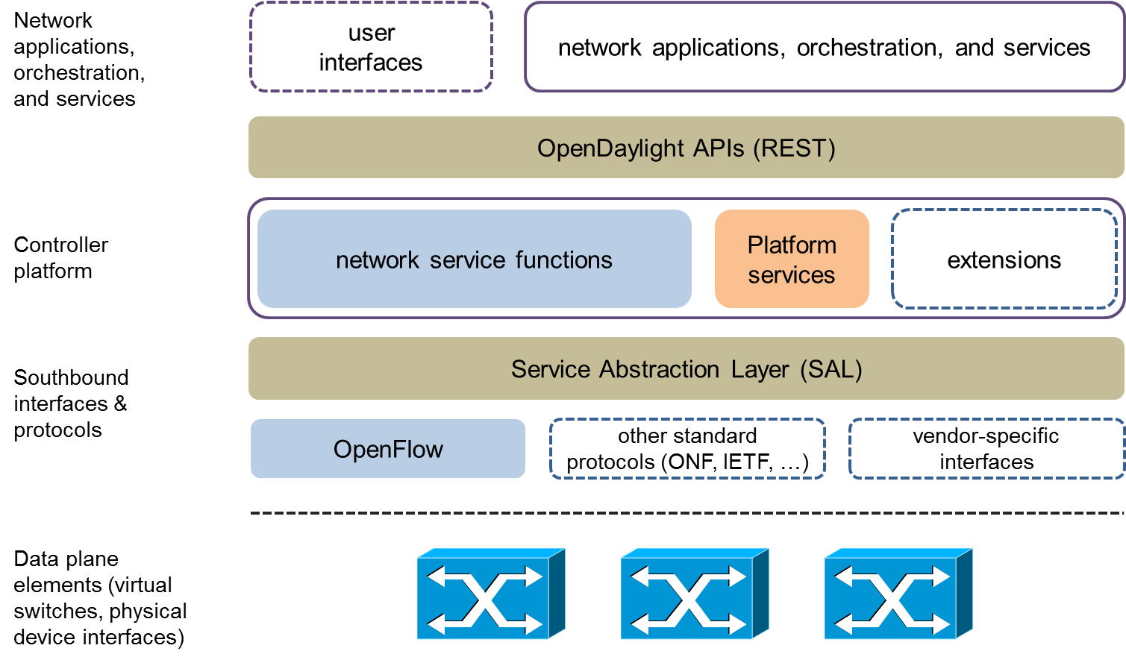
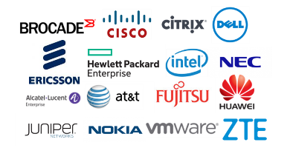
Open Networking Ecosystem
Network Controllers
ODL (OpenDaylight)
A collaborative open source SDN controller project managed by Linux Foundation
Most of the global hardware & software vendors are members
Modular Open SDN platform for networks
Provides a model-driven service abstraction platform
Members

Slide 38
Network Function Virtualization (NFV)

Slide 39
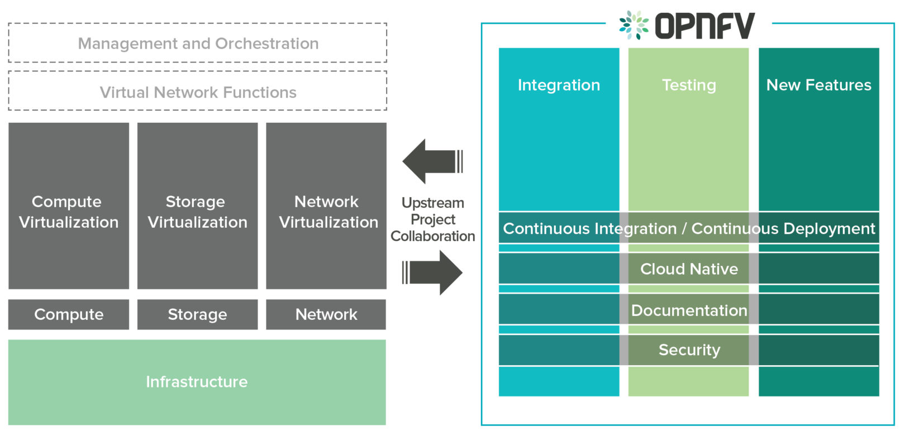
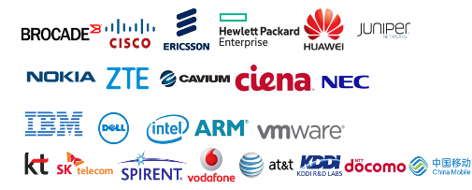
Open Networking Ecosystem
Carrier Networking Functions
OPNFV (Open Platform for NFV Projects)
A carrier-grade, integrated, open source platform that accelerates the introduction of new NFV products and services
Brings together network functions across compute, storage and network virtualization in order create an end-to-end platform
Members
https://www.opnfv.org/

Slide 40

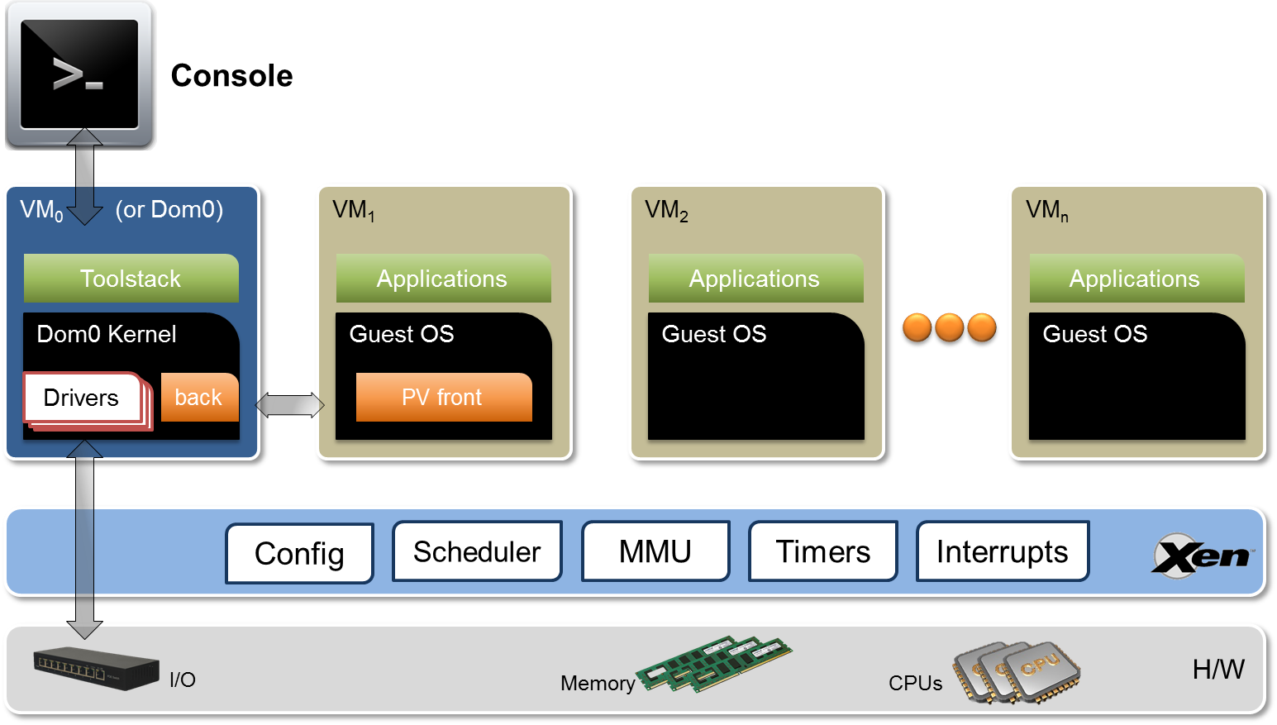
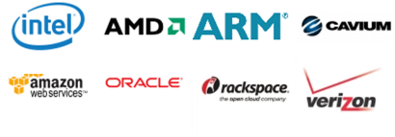
Open Networking Ecosystem
Virtual Machines
Xen Project
Hypervisor using a microkernel design
Provides services that allow multiple OSes to execute on the same computer hardware concurrently
Supports multiple guest operating systems
Linux, Windows, NetBSD, FreeBSD
Supports multiple Cloud platforms
OpenStack, CloudStack
Members
https://xenproject.org/
Source: https://wiki.xenproject.org/wiki/Xen_Project_Software_Overview

Slide 41
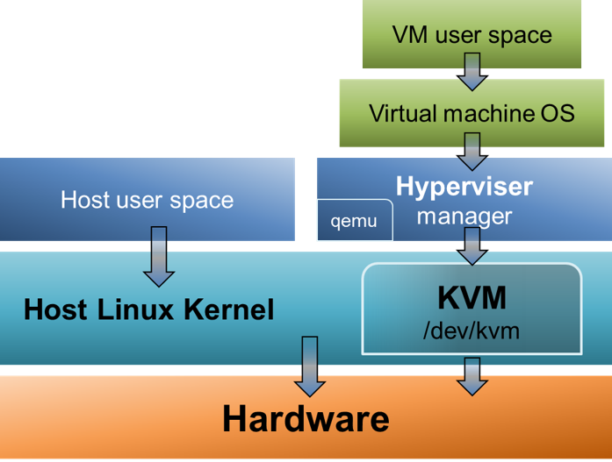
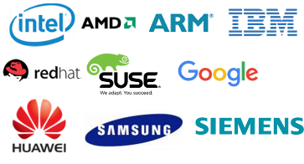
Open Networking Ecosystem
Virtual Machines
KVM (Kernel-based Virtual Machine)
Full virtualization solution for Linux on x86 hardware
Merged into the Linux kernel mainline in kernel version 2.6.20
Supports multiple guest operating systems
Linux, BSD, Solaris, Windows, Mac OSX
Members
https://www.linux-kvm.org/
Source: https://computingforgeeks.com/how-to-create-vm-snapshot-on-kvm/

Slide 42


Open Networking Ecosystem
Operating Systems
Linux
Best-known and most-used open source OS
Assembled under the model of free and open-source software development and distribution
Popular mainstream Linux distributions
Debian, Ubuntu, Linux Mint, Fedora, openSUSE, Arch Linux and Gentoo
FreeBSD
OS for a variety of platforms which focuses on features, speed, and stability
Major differences with Linux
Complete OS vs. a kernel and drivers only
BSD license vs. copyleft GPL

Slide 43

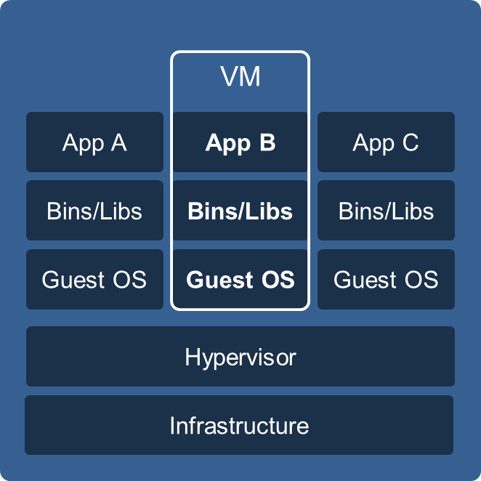
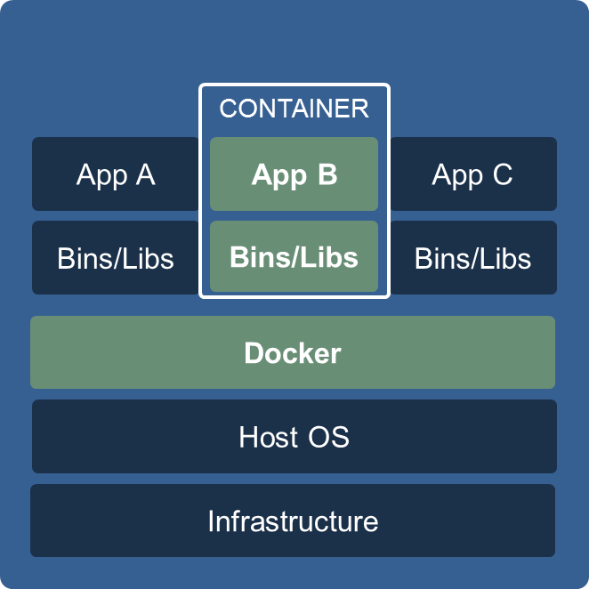
Open Networking Ecosystem
Containers
Docker
Automates the deployment of applications inside software containers
Provides an additional layer of abstraction and automation of OS-level virtualization on Linux
Enables to package an application with all of its dependencies into a standardized unit for software development (https://www.docker.com/)
VMs | Containers
Entire OS installation | Multiple isolated user-space instances
Entire OS needed | Only libraries and components needed for application
VM runs using emulation or virtualization on host OS | Runs on the same kernel
Independent to host OS | Dependent to host OS (Linux)
Entire VM OS and disk images | Much smaller, easier to package
Longer to start | Faster to start
Security issues of running OS | Security limited to app
Inefficient use of resources | Efficient use of resources
Source: https://www.docker.com/what-container

Slide 44
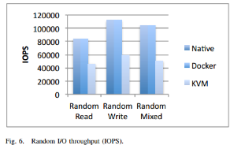
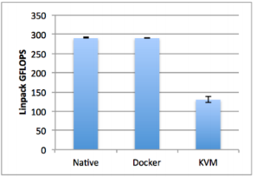
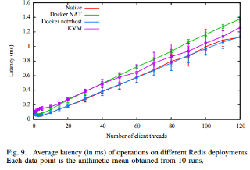
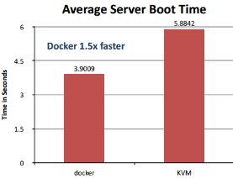
Open Networking Ecosystem
VMs vs. Containers
Performance comparison
The general result is that Docker is nearly identical to native performance and faster than KVM in every category
I/O
CPU
Network
Boot Time
Source: IBM Research Report: An Updated Performance Comparison of Virtual Machines and Linux Containers, July 21, 2014. Passive Benchmarking with docker LXC, KVM & OpenStack, IBM

Slide 45
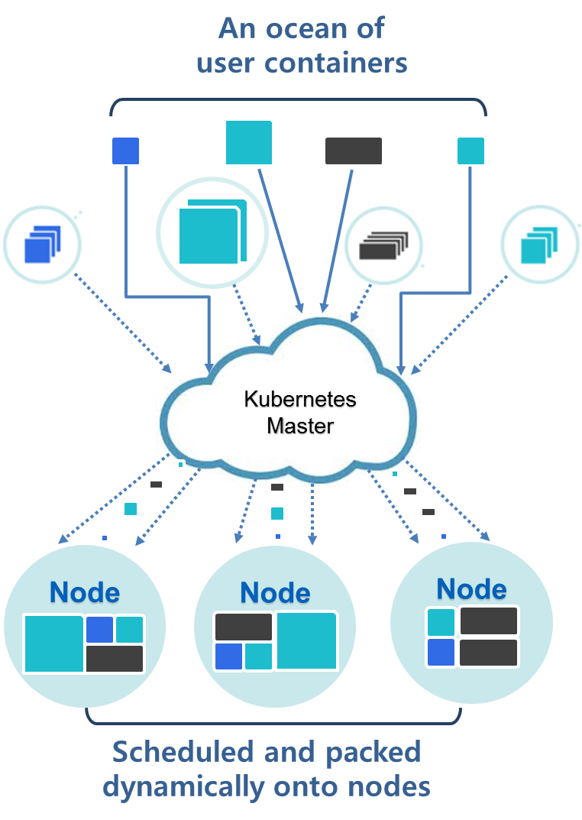

Open Networking Ecosystem
VM/VI Managers
Kubernetes
Open-source platform for automating deployment, scaling, and management of containerized applications
Functionalities
Auto-placement, auto-restart, auto-replication, auto-scaling
Schedule across hosts
Container grouping
Load balancing
Members
https://kubernetes.io/
Source: https://cloudplatform.googleblog.com/2015_01_01_archive.html

Slide 46


Open Networking Ecosystem
VM/VI Managers
OpenStack
Open source software platform for cloud computing
Mostly deployed as an IaaS (like Amazon EC2)
Controls large pools of compute, storage, and networking resources throughout a datacenter
Core services
swift (object storage), keystone (identity), nova (compute), neutron (networking), cinder (block storage), glance (image service)
https://www.openstack.org/

Slide 47


Open Networking Ecosystem
VM/VI Managers
OpenStack Tacker
OpenStack project building a Generic VNF Manager (VNFM) and an NFV Orchestrator (NFVO) to deploy and operate Network Services and Virtual Network Functions (VNFs)
Based on ETSI MANO Architectural Framework

Slide 48



Open Networking Ecosystem
Management & Orchestration
Open Source MANO (OSM)
Develop an Open Source NFV Management and Orchestration (MANO) software stack aligned with ETSI NFV
Features
End-to-end service fulfilment
Enhanced platform awareness extensions
SDN underlay control
Multi-site capability
Multi-cloud VIM capability
Members
https://osm.etsi.org/

Slide 49











Open Networking Ecosystem
Management & Orchestration
Open Network Automation Platform (ONAP)
Brings together top global carriers and vendors to allow end users to automate, design, orchestrate and manage services/virtual functions
Collaboration of two open networking and orchestration projects
ECOMP and Open-O
Members (90+, as of July 2019)
Source: https://virtualizationreview.com/articles/2017/04/10/~/media/ECG/VirtualizationReview/Images/2016/11/1116vrm_openo_architecture.png
Source: http://passionateaboutoss.com/the-components-of-sdn-nfv-mano-oss/

Slide 50




























Open Networking Ecosystem
Open Source vs. Commercial Solutions
Open Source
Commercial
Programming Frameworks
Application Platforms
Management & Orchestration
VM/VI Managers
Containers
Operating Systems
Virtual Machines
Carrier Networking Functions
Network Controllers
Programmable Data Plane
Network Switch OS
Hardware

Slide 51


Open Networking Ecosystem
A simple scenario for Open Networking Ecosystem
Phase 1 – Infrastructure building & NFV Development
Frameworks
Application Platforms
IDS
Cache
VM/VI Managers
Firewall
DPI
Billing
OS
Virtual Machines
Edge Cloud
Data Plane
Switch OS
P4 ASIC
Network Switch
OCP Switch H/W

Slide 52



Open Networking Ecosystem
A simple scenario for Open Networking Ecosystem
Phase 2 – Network & Service Configuration
Orchestration
Network Functions
Firewall
DPI
Network Controller
Datacenter
Client

Slide 53
SDN/NFV Use Cases

Slide 54


SDN/NFV Use Cases
ONOS CORD (Central Office Re-architected as a Datacenter)
Key idea
To concentrate distributed central offices to a re-architected datacenter
Goal
To construct cost-effective network by reducing CAPEX/OPEX
Fast & flexible service provisioning
Building blocks
Commodity hardware
ONOS, OpenStack/Kubernetes, XOS, vOLT, vSG, vRouter, vG.Fast, …
Commodity Hardware
(White-Box Servers and Switches, I/O Blades)

Slide 55

SDN/NFV Use Cases
Aether
Key idea
To construct open source 5G connected edge platform for distributed enterprise networks
Goal
To provide mobile connectivity and edge cloud services
E2E network slicing
Building blocks
Commodity hardware
SD-Fabric/RAN (ONOS, P4/INT, Stratum, …), SD-CORE (4G/5G components)

Slide 56


SDN/NFV Use Cases
Pronto
Key idea
To build and develop a connected edge cloud by leveraging network programmability
Goal
To provide secure & reliable network functionality
Deep and wide network visibility, verification, and closed-loop control
Building blocks
Commodity hardware
Based on Aether platform
High-level
specification
Closed-loop
control
Verifier
Fine-Grained Network Telemetry

Slide 57
SDN/NFV Forum, Conferences & Journals

Slide 58

ONF (Open Networking Foundation)
Non-profit organization promoting SDN, founded in 2011
Funded by service providers such as AT&T, China Unicom, Comcast, Deutsche Telekom, Google, NTT Communications, SK Telecom, Verizon, and vendors such as Cisco, Ericsson, Huawei, Nokia, Samsung, Intel, etc. (currently over 150 members companies)
Standardized the OpenFlow protocol
Offers product and skills certifications
OpenFlow® Conformance Testing Program
ONF-Certified SDN Professional Program (OCSP)
Recently merged with Open Networking Lab (ON.Lab)
Led by Guru Parulkar, Executive Director

Slide 59

SDN/NFV Forum (http://www.sdnnfv.org)
Founded on Oct. 1, 2014 in Korea

Slide 60

NetSoft (https://site.ieee.org/netsoft-2016/)
New IEEE conference focusing on “Network Softwarization”
NetSoft 2016 (June 6-10, 2016)
7 keynote speakers, 57 technical papers
250 attendees (http://sites.ieee.org/netsoft-2016/)
General Chair
Prof. James Won-Ki Hong
Workshops
SDN and IoT
Open-Source Software Networking (OSSN)
Software Defined 5G Networks (Soft5G)
Security in Virtualized Networks (Sec-VirtNet)
Tutorials
Smart Applications on Virtual Infrastructure (SAVI)
NFV Management and Orchestration in the Age of 5G
P4
Central Office Re-architected as a Data Center (CORD)
Powering Internet of Things with Cloud and NFV
Software Defined Network Security – In Practice
NetSoft 2015 (London, UK, Apr. 13-17, 2015) (http://sites.ieee.org/netsoft-2015/) , NetSoft 2017 (Bologna, Italy, July 3-7, 2017) (http://sites.ieee.org/netsoft-2017/)
NetSoft 2018 (Montreal, Canada, June 25-29, 2018) (http://netsoft2018.ieee-netsoft.org/), NetSoft 2019 (Paris, France, June 24-28, 2019) (https://netsoft2019.ieee-netsoft.org/)
NetSoft 2020 (29 June-3 July 2020 // Virtual) (https://netsoft2020.ieee-netsoft.org/), NetSoft 2021 (28 June–2 July 2021 // Virtual) (https://netsoft2021.ieee-netsoft.org/)
NetSoft 2022 (27 June–1 July 2022 // Milan, Italy) (https://netsoft2022.ieee-netsoft.org/) NetSoft 2023 (19-23 June 2023 // Madrid, Spain) (https://netsoft2023.ieee-netsoft.org/)

Slide 61

IJNM
International Journal of Network Management
Publisher: Wiley, UK from 1990
Editor-in-Chief: Prof. James Won-Ki Hong
Impact Factor: 1.914, SCI(E)
https://onlinelibrary.wiley.com/journal/10991190
Keywords
SDN/NFV
IoT management
5G network management
Mobile network management
Telecommunications networks
Network & service management
Network monitoring and analysis
Network security
Virtual Issue (free!)
http://onlinelibrary.wiley.com/journal/10.1002/(ISSN)1099-1190/homepage/VirtualIssuesPage.html

Slide 62
Concluding Remarks
Urgent need to reduce CAPEX & OPEX by Telcos
Need for more flexible, agile, efficient infrastructure to reduce time-to-market of new services & to be competitive
SDN/NFV (Open Networking, Network Softwarization) is a promising approach
Most telcos will NOT acquire proprietary HW/SW (e.g., middleboxes) any more
5G & 6G will be based on SDN/NFV for the infrastructure
SDN/NFV is a promising area to study, research & develop!

Slide 63

Q & A

Slide 64
Appendix

Slide 65
Glossary
BSS: Business Support Systems
OSS: Operations Support Systems
GSR: Gigabit Switch Router
ACR: Access Control Router
RAS: Radio Access Station
vOLT: virtual Optical Line Terminal
vSG: virtual Subscriber Gateway
RRU: Remote Radio Unit
BBU: BaseBand Unit
SON: Self-Organizing Networks
GPON: Gigabit Passive Optical Network
ONT: Optical Network Terminal
PCE: Path Computation Element
MSPP: Multi Service Provisioning Platform
OXC: Optical Cross-Connect
PTN: Packet Transport Network
RNE: Radio Network Elements
CNE: Core Network Elements
FuAg: Function Agent
SE: Switching Elements
RAT: Radio Access Technology
MBH: Mobile BackHaul
MFH: Mobile FrontHaul
FQAM: Frequency & Quadrature Amplitude Modulation
SCMA: Sparse Code Multiple Access
NOMA: Non-Orthogonal Multiple Access
SOMA: Semi Orthogonal Multiple Access
D2D: Device To Device
eMTC: enhanced Machine-Type Communication

Slide 66
References (1/2)
Hardware
P4 – http://p4.org
P4 Introduction/Tutorial 2016 – http://www.eventbrite.com/e/p4-introductiontutorial-2016-tickets-23066146465
P4 Workshop 2016 – https://www.eventbrite.com/e/p4-workshop-2016-tickets-22712549848
OCP - http://www.opencompute.org/
Network Switch Operating Systems
ONL - https://opennetlinux.org/
OpenSwitch – http://www.openswitch.net/
Indigo - https://github.com/floodlight/indigo
Programmable Data Plane Services
DPDK - http://dpdk.org/
FD.io - https://fd.io/
Open vSwitch - http://openvswitch.org/
Network Controllers
ONOS - http://onosproject.org/
OpenDaylight - https://www.opendaylight.org/
Carrier Networking Functions
OPNFV - https://www.opnfv.org/
SDN/NFV Use cases
CORD - https://opennetworking.org/cord/
Aether - https://opennetworking.org/aether/
Pronto - https://opennetworking.org/pronto-project/

Slide 67
References (2/2)
Operating Systems
Linux - http://www.linuxfoundation.org/
FreeBSD - https://www.freebsd.org/
Virtual Machines
Xen – http://www.xenproject.org/
KVM - http://www.linux-kvm.org/page/Main_Page
Containers
Docker - https://www.docker.com/
VM/VI Managers
Kubernetes - http://kubernetes.io/
OpenStack - https://www.openstack.org/
Mesos - http://mesos.apache.org/
Management & Orchestration
Open O - https://www.open-o.org/
OSM - https://osm.etsi.org/, http://sdn.ieee.org/newsletter/july-2016/opensource-mano
ONAP - https://www.onap.org/
Application Platforms
Cloud Foundry - https://www.cloudfoundry.org/
OpenShift - https://www.openshift.com/
Programming Frameworks
Node.js - https://nodejs.org/en/
Django - https://www.djangoproject.com/

