Slide 1
Open Compute Project:
Data Center
Marko Kajzer
CS 702E
Open Networking Systems
2016-09-26

Slide 2
Outline
What are Data Centers?
Why do we need Data Centers?
Why Open Source?
OCP Data Center Specification
  Air Conditioning
  Power Supply
  „Cold Storage“
  Servers

Slide 3
What are Data Centers?

Slide 4
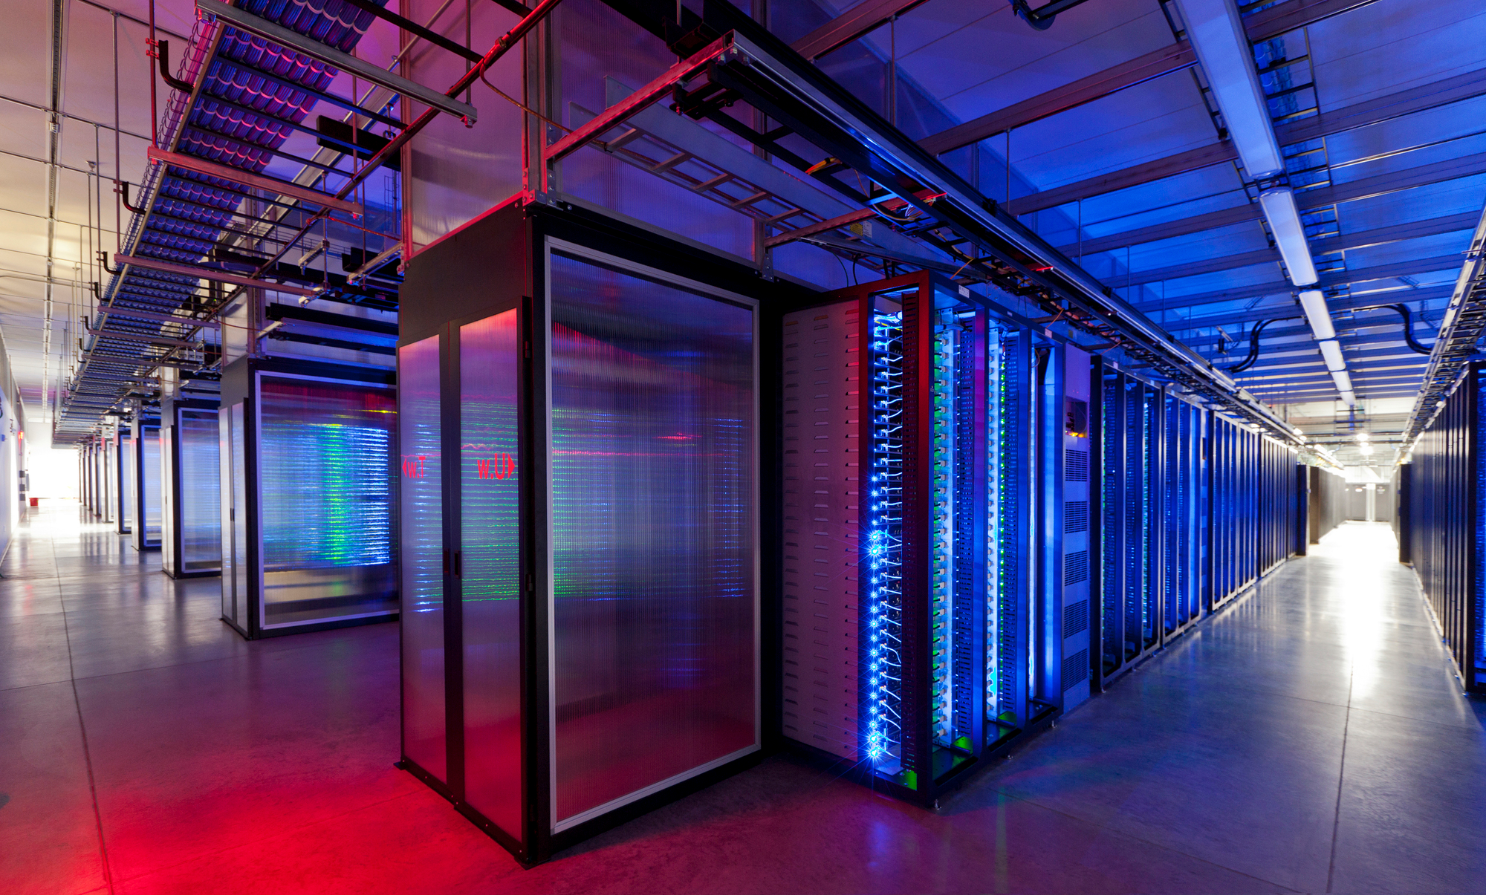
What are Data Centers?

Slide 5
What are Data Centers?
Storage for Applications and Data
  Databases, Images, Videos
Computational power to process the data

Slide 6
Why do we need Data Centers?

Slide 7
Why do we need Data Centers?
Very high amount of data creation
  More devices, more users, more apps
  Only smaller part of world population has access to internet today
2.8 ZB
0.8 ZB
2010
2012

Slide 8
Why do we need Data Centers?
~45 ZB
0.8 ZB
2.8 ZB
2010
2012
2020

Slide 9
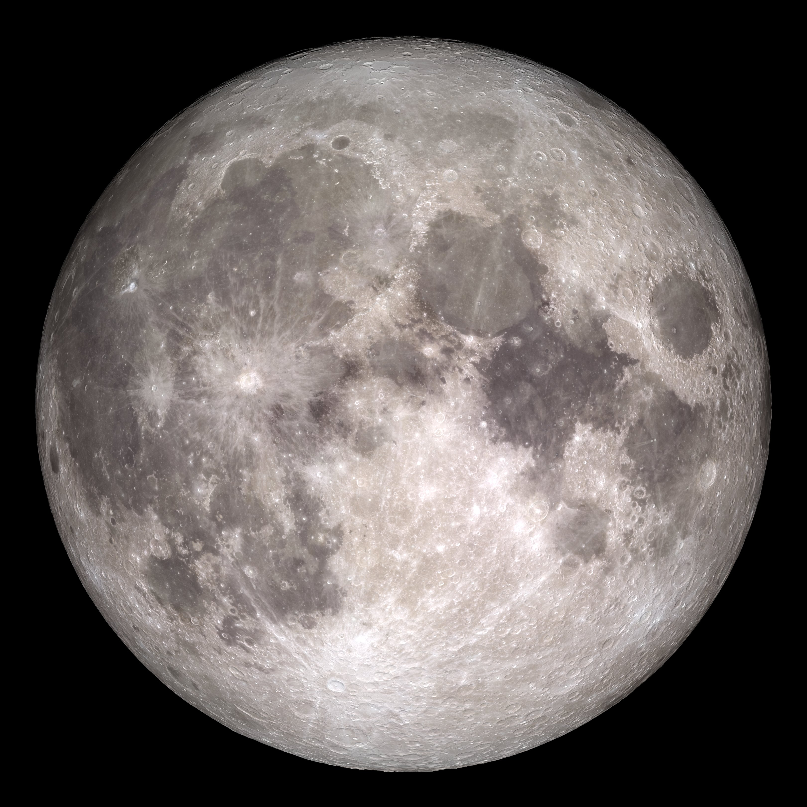
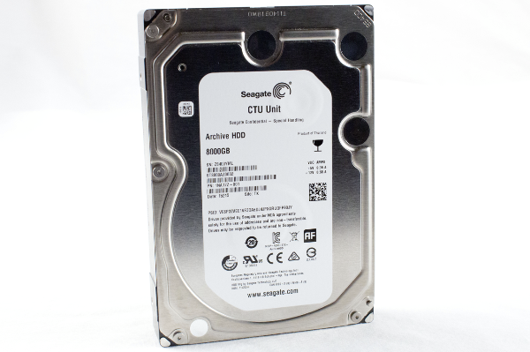
Why do we need Data Centers?
Reach moon twice by stacking up 3TB hard drives in 2020

Slide 10
Why Open Source?

Slide 11
What are Data Centers?
Driven by a need to scale efficiently
Scale is a problem bigger than just one company
Open Source Community
  Can point out flaws of an initial design
  Can develop ideas further
  Should adapt practices in own businesses

Slide 12
OCP Data Center

Slide 13
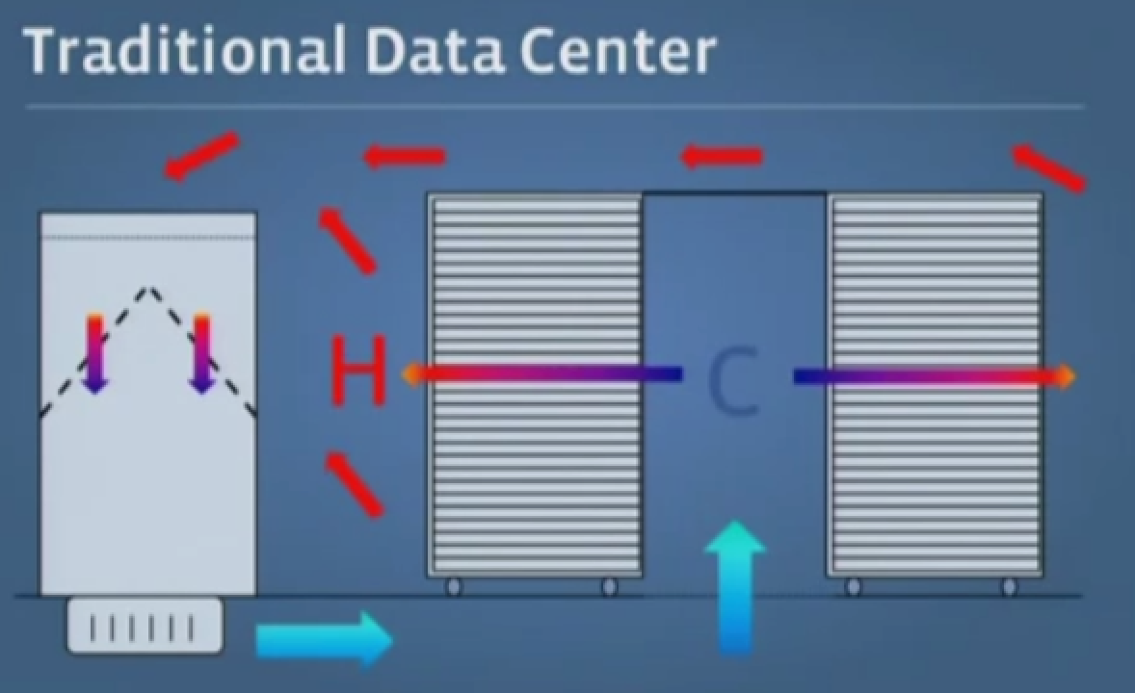
Air Conditioning

Slide 14
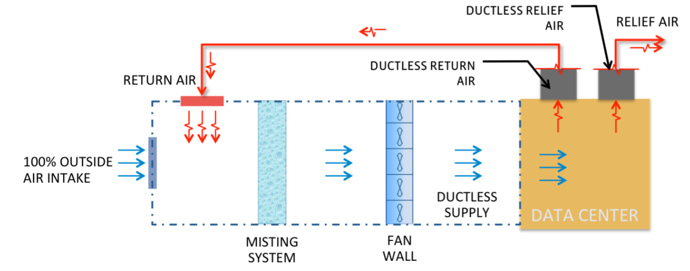
Air Conditioning

Slide 15
Air Conditioning
Outside air (OA) enters through vertical drainable louvers in the penthouse.
The air proceeds into the OA intake corridor.
OA mixes in with data center return air and passes through the filter bank in the filter room.

Slide 16
Air Conditioning
Air enters the evaporative cooling/humidification room and may get sprayed by the misting system.
The air passes through mist eliminators to prevent water carryover.
The air enters the supply fan room, and gets pushed down the supply air openings to the data center cold aisles.

Slide 17
Air Conditioning
The air enters the front of the server cabinets, passes through to the contained hot aisles, which then enters the return air plenum. The air then is returned back to the filter room or exhausted out of the building by natural pressure and/or relief fans.

Slide 18
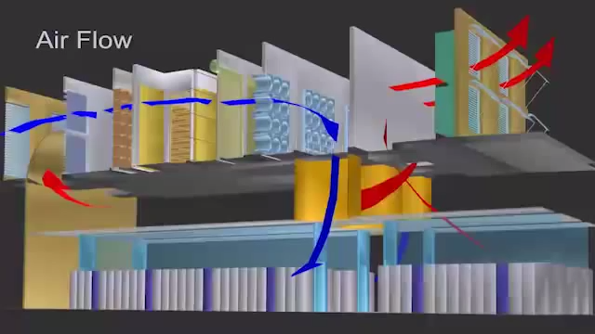
Air Conditioning

Slide 19
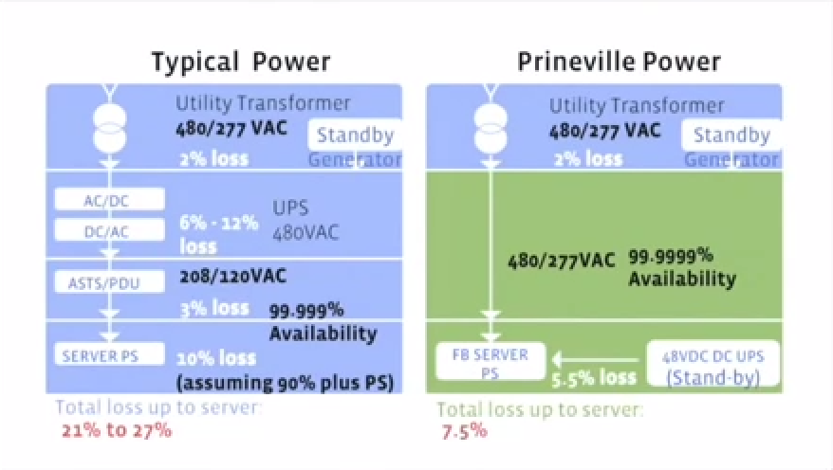
Power Supply
UPS = Uninterrupted Power Supply

Slide 20
Power Supply
Power Supply takes AC and DC to cope with normal and backup electrical systems
Industry did not support such supplies

Slide 21
„Cold Storage“
250 billion photos total
82% of traffic focused on 8% of photos
Photos were treated the same
  8% with very high traffic stored on the same infrastructure as other 92%
  Waste of energy and storage

Slide 22
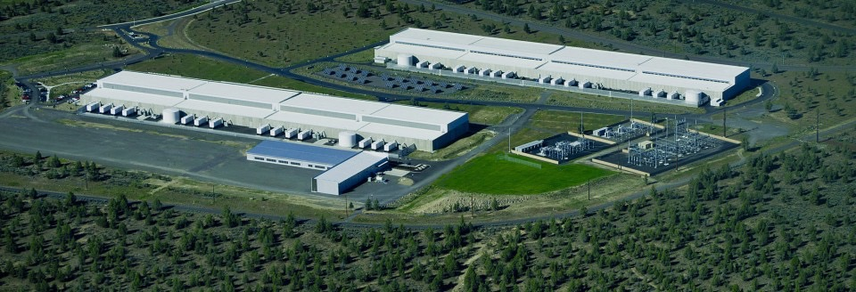
„Cold Storage“
New data center design for 250.000 servers
  1 exabyte per data hall
  1.5MW per room
  500 racks of servers
  No power redundancy
1/5 of cost of conventional data center

Slide 23
Servers
Standard Server Motherboards
Standard form factor
  Standard dimension and component placement
Wide target audience
  Many features for many requirements
  Unused components for certain use cases
  Increased cost
Low power efficiency
  Optimized for costs

Slide 24
OCP Data Center Specification
Electrical and mechanical specification
  Diesel backup generators
  Battery monitoring
  Server battery backup
  Programmable LED Lighting System
  Fire Alarm and Sprinkler System
  …

Slide 25
OCP Data Center Specification
38% more energy efficient
24% lower cost
1.2 billion USD saved

Slide 26
감사합니다

Slide 27
References
Project Website
List of specification documents
  Direct link to Data Center Specification V1.0
Introducing the Open Compute Project
OSCON 2013: Jay Parikh, "The Open Compute Project"
  Vice President of infrastructure engineering at Facebook
Open Compute Project and the Changing Data Center
HC23-T2: The Open Compute Project
How Facebook designed the data centre from scratch
OCP Summit 2015 - Facebook News - Jay Parikh
Efficiency is Profitable: Facebook's Approach to Global Infrastructure Optimization
OCP Summit 2015 - Data Center Project Update
Inside a Google data center
Open Compute Project Introduction
  Very informal introduction into the topic

