Slide 1
OCP: Open Rack
Seonyeong Heo
Dept. of CSE, POSTECH
heosy@postech.ac.kr
2016. 9. 27

Slide 2
Outline
What is Open Rack?
Why Create an Open Rack Standard?
Problems in the Traditional Rack Design
Implementation of Open Rack
References

Slide 3
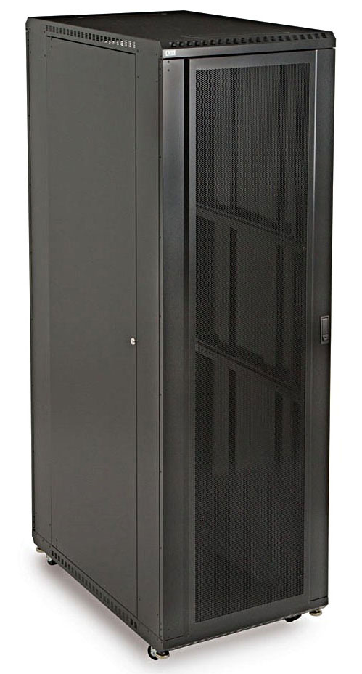
What is Open Rack?
Open API for Racks

Slide 4
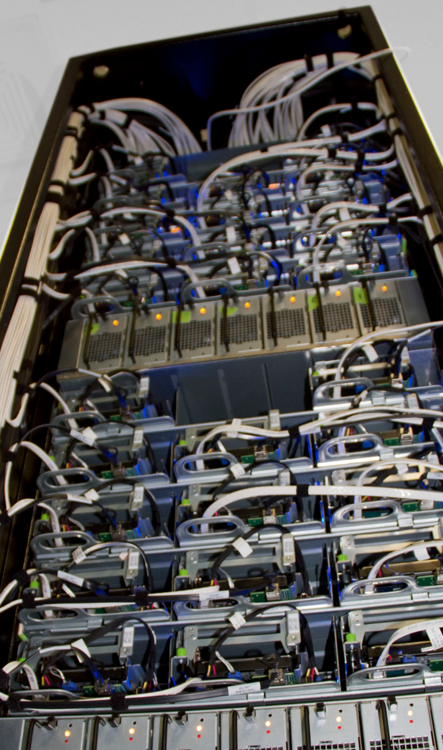
What is Open Rack?
The first rack standard designed for data centers
Timeline
Open Rack Standard V1.0: released in 2013
Open Rack Standard V2.0: under review
Facebook is the main contributor
Project Chairs
Steve Mills (Facebook)
Brian Obernesser (Fidelity Investments)

Slide 5

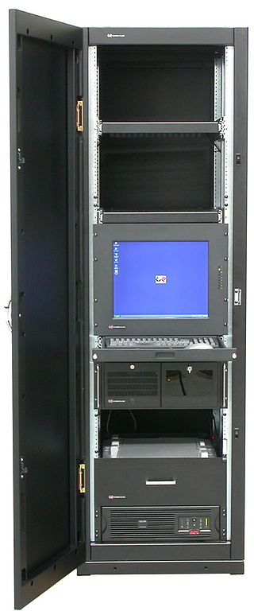
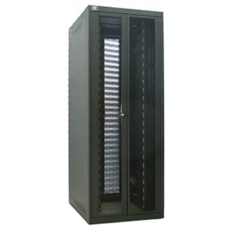
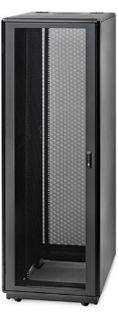
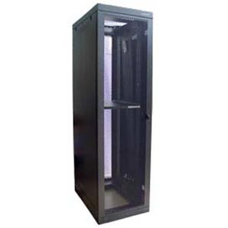
Background: Traditional Rack Design
The EIA 310-D Specification (The 19” Rack Standard)
Established in 1950s by EIA
Designed for railroad signaling relays
Standardize the width between the inner rails
Problems
Lots of variations in server and rack design
Unsuitable for data centers and scale computing

Slide 6
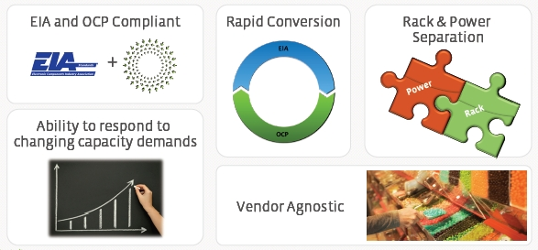
Why Create an Open Rack Standard?
To Define the Mechanical and Electrical Interfaces between the Rack and the IT Gear
Create Interoperability between Rack and IT Gear manufacturers
Retain flexibility for innovation
Optimize designs for large scale deployment
Reduce development and deployment cost and cycle time

Slide 7
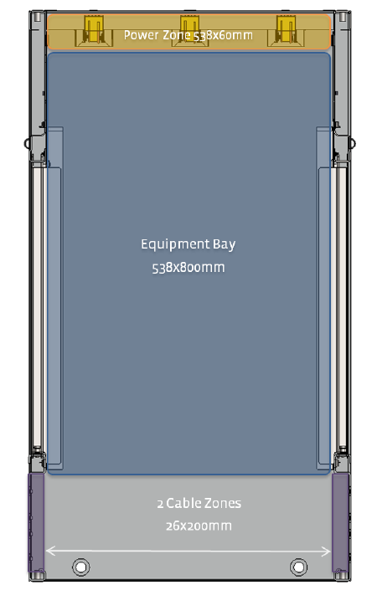

Implementation: Top View
Open Rack includes three zones
A cable zone
face the cool-aisle side of data center
manage and protect data cables
technicians can add and remove equipment easily
An equipment bay
where equipment sits (e.g. servers, storage and switches)
A power and cooling zone
face the hot-aisle side of data center
include one or more pairs of 12V bus bars
include rack-level cooling fans
Hot-aisle of the data center
Air Flow
Cool-aisle of the data center

Slide 8
Implementation: Assembly
OpenU
A rack unit for Open Rack
Slightly taller (48mm) than the traditional rack unit (44.5mm)
Advantage
Increase airflow, improving air economization
Better for cable and thermal management
Support ½ OpenU increments also
48mm
46U Rack
= 2.21m Rack

Slide 9
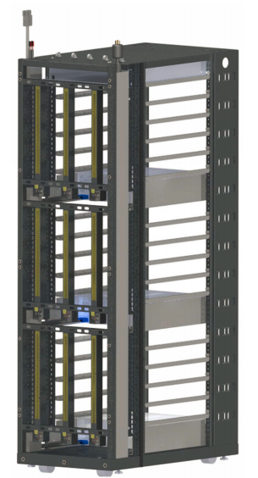
Mechanical Requirements
Rack Columns
Include rectangle holes
Rectangle repeats every 48 mm = OpenU
IT Support Shelves
Support equipment as small as 1 OpenU tall
Bus Bars
Located in the back of the rack
Transmit the 12V power
Include a cover for protecting people
Rack Column
IT Support Shelve
Bus Bar

Slide 10
Other Requirements
Electrical Requirements
Bus Bar Electrical Specifications
Bus Bar Power Connection
IT Gear
Hot Swap
Noise Limits
Max Power Draw
Power Shelf

Slide 11
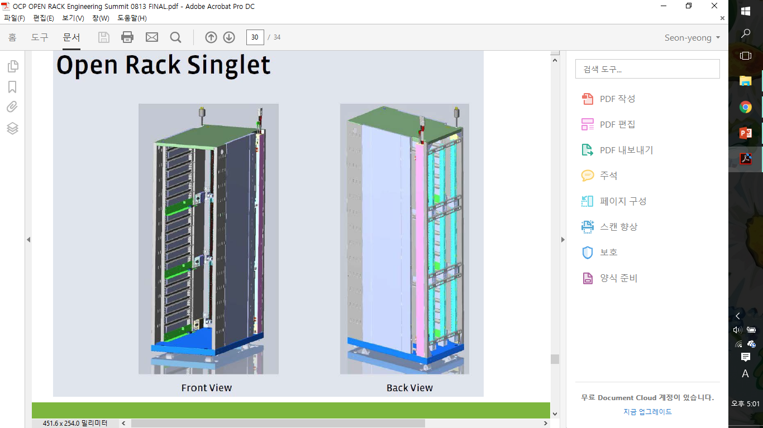
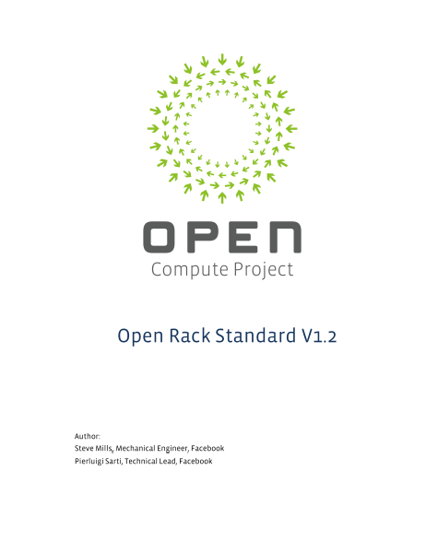
If You Want More Details...
A 3D CAD file is available at GitHub.
FRONT VIEW
BACK VIEW
Also, you can download the standard document at the OCP wiki website.

Slide 12
References
http://www.opencompute.org/blog/introducing-the-open-rack/
http://www.opencompute.org/wiki/Open_Rack
Open Rack Standard V1.0, Facebook, August, 2013
Community Update Slides, OCP Open Rack Engineering Submit, San Jose, 13 August, 2013
Introduction to Facebook Open Rack V2, OCP Open Rack Engineering Submit, San Jose, March, 2016

