Slide 1
Open Compute Project (OCP) : Server Design
Bongjun Kim
Dept. of CSE, POSTECH
bong90@postech.ac.kr
http://corelab.or.kr/~bongjun
2016. 9. 27
Notes:
Hello everyone
I will present Server Design part in Open Compute Project

Slide 2
Outline
Summary
Overview
Scope
Open Rack Compatible
Open CloudServer Compatible
Micro Servers, Chassis and Carriers
Components and Peripherals
Specification Standards
Electrical Interfaces
Mechanical Interfaces
Manageability
Debug
Test Framework
References
Notes:
This is a outline of my presentation

Slide 3
Summary
Notes:
Let me summarize what is OCP and what was achieved by adopting OCP

Slide 4
Summary
OCP: Open Compute Project
Designs, uses, and enables mainstream delivery of the most efficient designs for scalable computing
a set of technologies that reduces energy consumption and cost, increases reliability and choice in the marketplace, and simplifies operations and maintenance.
38% more energy efficient to build and 24% less expensive to run (Prineville, Oregon)
Notes:
Open compute project designs, uses, and enables ..
In more detail, this is a set of …
Facebook actually adopted OCP on their data center at Prineville,
Oregon, and they achieved 38% …

Slide 5
Overview
Notes:
Next, I wanna show you brief overview on OCP server design

Slide 6
Overview
The OCP Server Project
provides standardized server system specifications for scale computing.
The Server Committee collaborates with the other OCP disciplines to ensure broad adoption and achieve optimizations throughout all aspects from validation, to manufacturing, deployments, data center operations, and de-commissioning.
Notes:
The OCP server project provides standardized …
The Server committee is responsible to review and accept summited server design and collaborates with …

Slide 7
Scope
Notes:
There are several server designs that accepted by OCP server committee. Let’s find out.

Slide 8
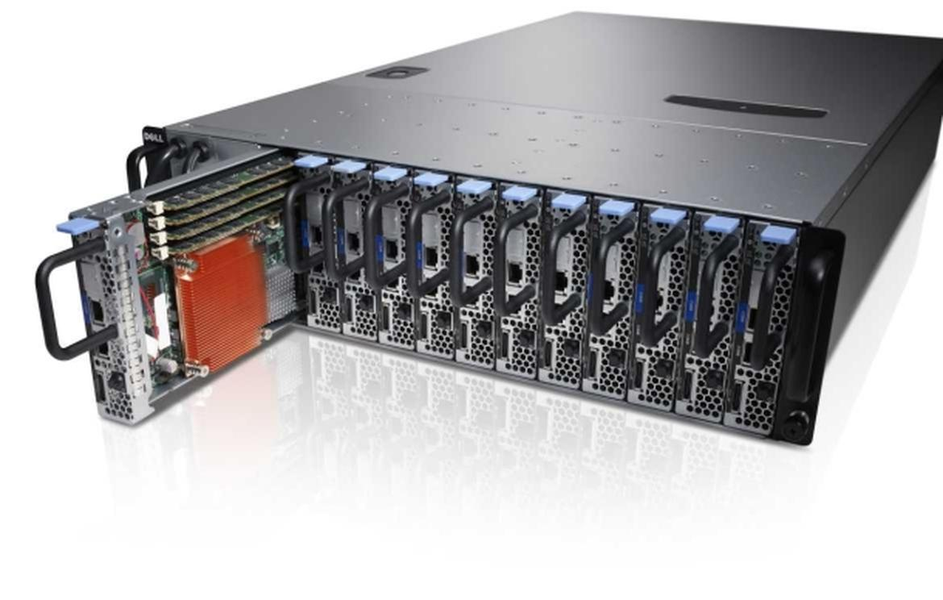
Scope
Open Rack compatible Chassis and Sleds
Open CloudServer (OCP) compatible Chassis and Blades
Micro Servers, Chassis and carriers
Components and Peripherals
Notes:
Open Rack compatible, Open CloudServer, Micro-server or System-on-Chip server, and components and peripherals.
Chassis is the framework that a vehicle is built on. We can also call chassis as server metal case.
Sleds or blades are the modular components built in server chassis. We can slide in when installing and out when decommissioning these from the server case like this picture does.
But this is not a OCP server, just for clarifying the terms.

Slide 9
Open Rack compatible
Facebook server Intel Next Generation Xeon motherboard
Intel Motherboard design and design requirement to integrate Intel Motherboard into Open Rack V1 and Open Rack V2
Physical and mechanical specification, BIOS, BMC, Thermal design requirements, I/O system, etc.
Open Rack 19” compatible derivative systems
can be installed in traditional EIA-310D/E racks
Ex1) original 1.5U Decathlete sled
Ex2) Winterfell motherboards
Notes:
The first server design is Open Rack compatible design contributed by Facebook.
The name is Facebook server Intel Next Generation Xeon motherboard. Up to now, this server has version 3.1 specification.
Their specification includes Intel motherboard design and design requirement to integrate …
The specification documents include physical and mechanical specification, BIOS, BMC, Thermal design requirements, I/O system, and even packaging.
BMC: Baseboard Management Controller a specialized service processor that monitors the physical state of a computer, network server or other hardware device using sensors and communicating with the system administrator through an independent connection.
There are also 19” compatible derivatives which can be installed in traditional EIA-310D/E racks. For example, original 1.5U Decathlete sled and Winterfell motherboard.

Slide 10
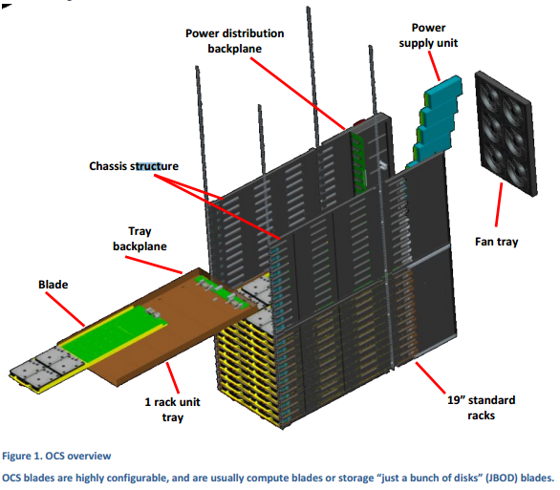
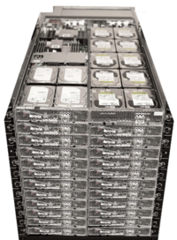
Open CloudServer (OCS) compatible
Self-contained high-density chassis compatible with EIA-310D rack (Microsoft)
A fully integrated rack of servers and IT equipment that is highly optimized and streamlined for large, web-scale deployments.
OCS is an off-the-shelf (OTS) commodity rack that is loaded with up to four modular chassis, each with trays, power supplies, power distribution, chassis management, system fans, and two side-walls
Notes:
Second one is Open CloudServer, so called OCS, which is contributed by Microsoft.
OCS is self-contained high-density …
OCS system is a fully integrated rack …
Off-the-shelf (OTS) means from stock and readily available (기성품의)

Slide 11
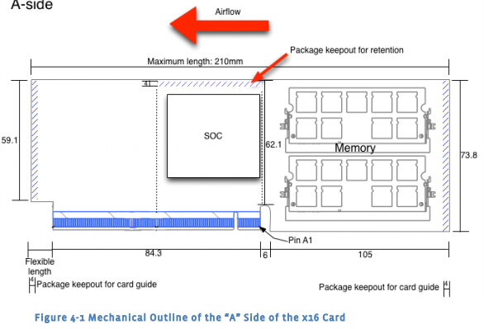
Micro Servers, Chassis and Carriers
Micro server
is a PCIe-like card that hosts the SoC, dynamic memory for the SoC, and a storage device.
can be installed in slots on a baseboard.
* The baseboard provides power distribution and control, BMC management capabilities, and network distribution.
Notes:
Next server design is a micro server or system on chip system.
Micro server means a PCIe-like card …
This should be installed in slots on a baseboard.
The baseboard provides …

Slide 12
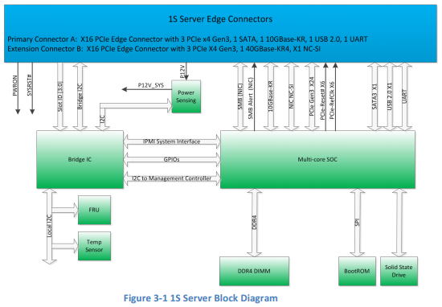
Micro Servers, Chassis and Carriers
This design focuses on the low power, low cost and distributed computing use case
small form factor optimized for high density clusters or installation into other devices such as storage
The SoC systems are typically a server card that must be installed into a larger platform to operate. These cards could be installed onto a larger "baseboard" with many SoC cards or as a single server into a larger platform.
Ex) 1S Server (Facebook)
Notes:
This is 1S Server block diagram. As you can see, this diagram shows many interfaces between components.
Micro server specification documents includes mechanical and electrical, thermal specification, and power, environmental requirements, and much more.

Slide 13

Components and Peripherals
Components and peripherals
Specifications will include: riser cards, mezzanine I/O, accelerators, networking.
Notes:
A riser card looks like this picture, and enables the board connect perpendicular to motherboard.
Mezzanine I/O, often called PCIe Mezzanine Card, PMC, is a kind of printed board connector which can connect other I/O devices.

Slide 14
Specification Standards
Notes:
Last one I would like to talk about is specification standards.

Slide 15
Specification Standards
Electrical Interfaces
All interfaces must be fully documented. Voltages, power, frequencies, standards are all required.
Extra: schematics, board and layout files, and manufacturing files.
Mechanical Interfaces
Form factors, xyz heights.
Extra: mechanical CAD and manufacturing files.
Manageability
Interfaces, protocols, commands must all be documented.
Debug
Hooks for troubleshooting and repair must be included.
Test Framework
require working with the C&I committee to identify test and certification strategy.
Notes:
At first, the vendor must provide electrical and mechanical interfaces in their specification documents.
The vendor must includes voltages, power, frequencies, and anything else which related with electrical interfaces.
Mechanical interfaces includes form factor, xyz heights, and even thickness. In addition, it is preferred to contain mechanical CAD and manufacturing files.
For manageability, interfaces, protocols, commands must all be documented.

Slide 16
References
http://www.opencompute.org/about/
http://www.opencompute.org/wiki/Server/SpecsAndDesigns

