Slide 1
OCP Storage
Jae-Hyeon Park
Dept. of CSE, POSTECH
parkeric3@postech.ac.kr
2016. 9. 27

Slide 2
Outline
Overview
Specification standard
Specification examples
Open Vault
Cold Storage
OpenNVM
Fusion-io
Hyve

Slide 3
Overview
Mission
Creating specifications and software to enable new storage application
Target
Open Rack compatible storage chassis and sleds
EIA 310-D/E 19’’ rack compatible
Different vendor components and peripherals

Slide 4
Specification Standard
Storage interfaces
SAS, SATA, PCIe, NIC
Electrical interfaces
Voltages, power, frequencies
Mechanical interfaces
Form factors, xyz heights, keep-in and keep-outs
Manageability
Rock-solid management solutions with full-documents
Debug
Hooks and repair
Test framework
For developers

Slide 5
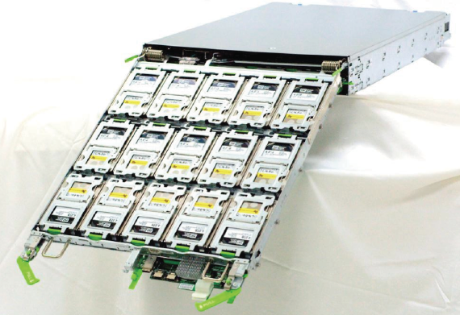
Open Vault
Simple and cost-effective storage solution
2U 30 3.5 ’’ HDD

Slide 6
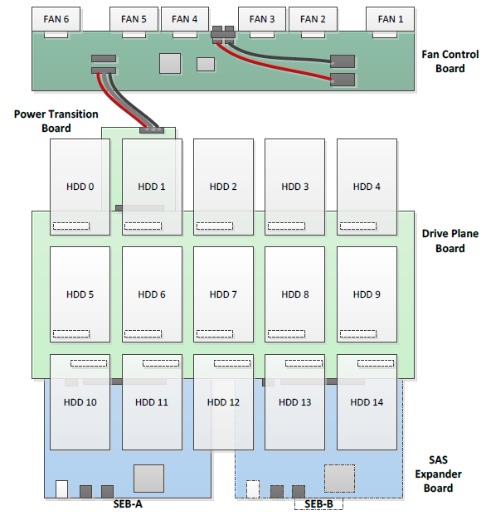
Open Vault

Slide 7
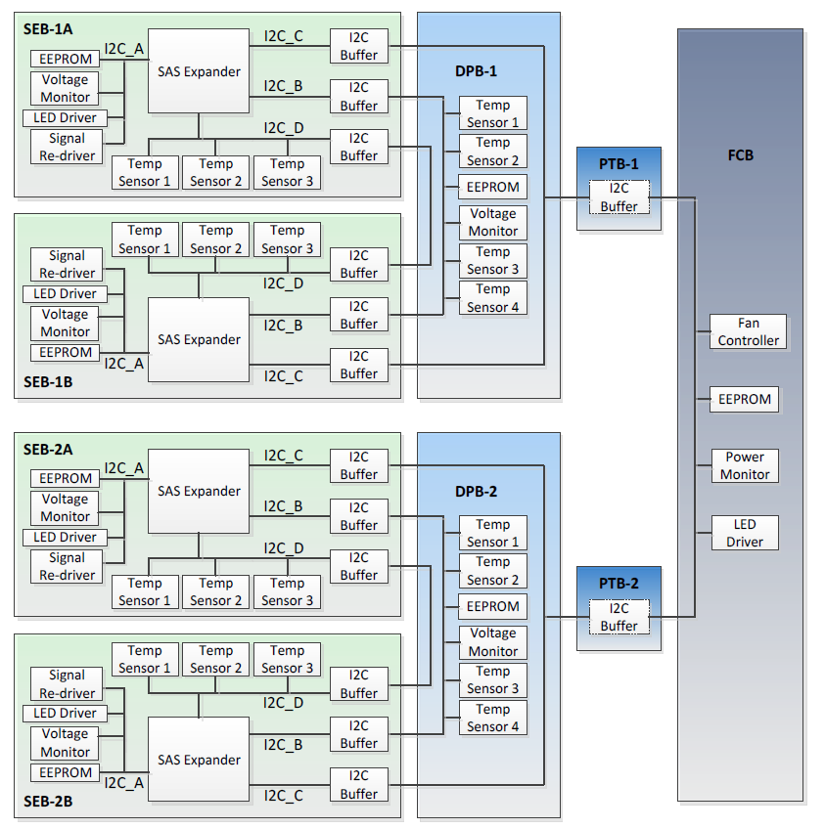
Open Vault

Slide 8
Cold Storage
Cold-data
Is stored on disk but almost never read again
ex) legal data, backups of third copies
Designed as bulk load fast archive
Using power off HDDs
Modification of storage unit based on Open Vault
Connected with SAS
Redefined topology for networking switch deployment
Custom Open Rack

Slide 9
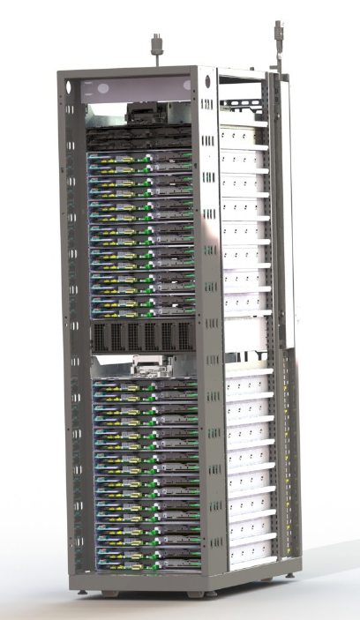
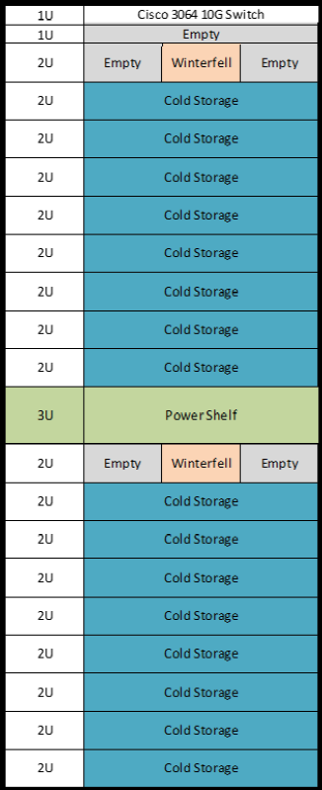
Cold Storage

Slide 10

OpenNVM
Open-source project for non-volatile memory (ex: flash memory)
Developer can make their applications flash-aware
Functions
Flash-aware Linux swap
When working set exceeds the capacity of DRAM then demand page from flash-aware virtual memory
Key-value interface to flash
Faster NoSQL databases, Automatic garbage collection
Flash programming primitives
Support journal-less update

Slide 11
Others
Fusion-io
3.2 TB I/O PCI express card
Designed for high capacity and small size
Hyve
Design concept of 2xOpenU storage server
Accommodate 15 3.5’’ drives arranged in a 3 x 5 arrays
Compatible with Open Rack

Slide 12
Reference
Project wiki
http://www.opencompute.org/wiki/Storage
Open Vault specification
http://files.opencompute.org/oc/public.php?service=files&t=ce5002840b137d6365b398e14c8c2774
Cold storage specification
http://files.opencompute.org/oc/public.php?service=files&t=fe369c02b049394b5d94b44e084aceb6
OpenNVM
https://opennvm.github.io/

