Slide 1
Indigo
Doyoung Lee
Dept. of CSE, POSTECH
dylee90@postech.ac.kr
http://dpnm.postech.ac.kr
2016. 9. 28

Slide 2
Outline
Introduction
Indigo Architecture
Indigo Use cases
References

Slide 3
Introduction

Slide 4

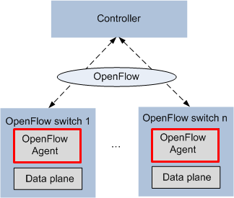
Introduction (1/4)
What is the Indigo?
Open source project by BigSwitch
Core OpenFlow agent and infrastructure module
Enabling support for OpenFlow on physical and hypervisor switches
High rates for high speed ports up to 48 10-gigabit ports by leveraging Ethernet switch ASICs
Exceed the limits of pure-software OpenFlow implementations
Eclipse Public License version 1
Free to use indigo when developing and distribution open source applications
For commercial OEMs and ODMs, flexible commercial license is essential

Slide 5

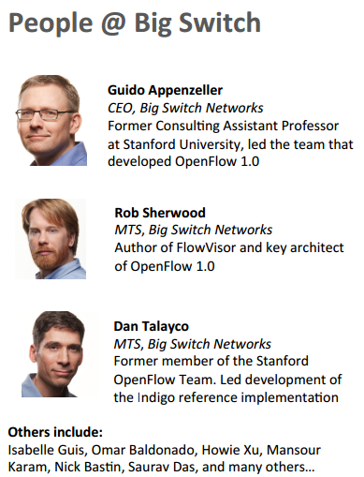
Introduction (2/4)
Big Switch
Data center networking company
Founded in 2010
Design, develop, and sell bare-metal SDN networking fabrics
Active member of open source communities: OpenStack, OCP, ONF
Open Source Projects include:
Floodlight
Indigo
OFtest
Source: http://www.internet2.edu/presentations/jt2012summer/20120717-Cohen-Floodlight.pdf

Slide 6

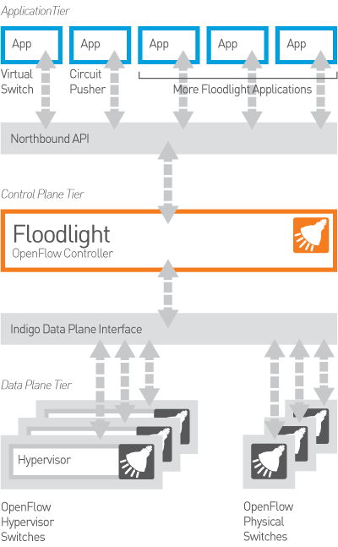
Introduction (3/4)
FloodLight
Open SDN Controller
Java based SDN Controller
Apache license
Designed to work with the growing number of switches, routers, virtual switches, and access points that support the OpenFlow standard
Support for OpenStack cloud orchestration platform

Slide 7

Introduction (4/4)

Slide 8
Indigo Architecture

Slide 9
Indigo Architecture (1/2)
Indigo Components
Indigo Agent
Represent the core libraries
A Hardware Abstraction Layer (HAL) to make it easy to integrate with the forwarding and port management interface of physical or virtual switches
A configuration abstraction layer to support running OpenFlow in a “Hybrid” mode on a switch
LoxiGEN
A compiler that generates OpenFlow marshalling/un-marshalling libraries
Generate libraries in multiple languages
Support C (called “loci”), but java and Python are in development

Slide 10
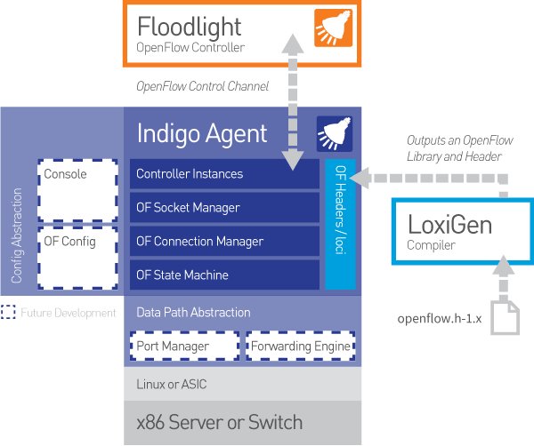
Indigo Architecture (2/2)
Overall Architecture
Notes:
- The socket manager: Provides the functionality for managing sockets. It provides a generic socket registration process as well as timer event processing to allow these functions to be integrated in single threaded environments.
- The OpenFlow connection manager: Provides the functionality for managing OpenFlow connections such as addition and removal of connection instances, tracking the connection state (handshakes, keep alives) and applying rate limiting policy for asynchronous messages.
- The OpenFlow state manager: Provides the functionality for representing the OpenFlow state of the switch in a platform independent way. This allows the decoupling of database-like queries on the OpenFlow flow table from the manipulation of the forwarding state that is platform specific.
- Configuration: This module provides platform and implementation specific access to the interfaces provided by the other modules that permit updating the running configuration of the application.
- Forwarding: This module exposes interfaces that allow the manipulation of the platform's forwarding engine as represented by OpenFlow protocol updates.
- Port manager: This module exposes interfaces the allow the interrogation and manipulation of the platforms data plane entries.

Slide 11
Indigo Use Cases

Slide 12
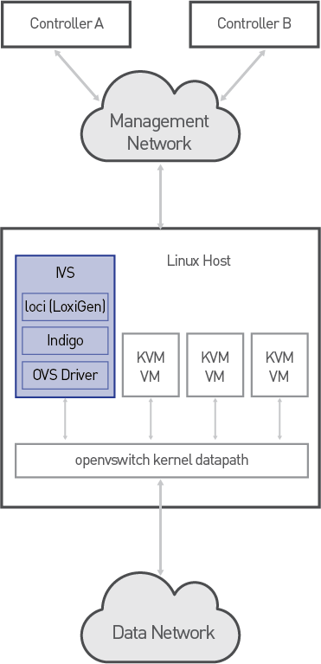
Indigo Use Cases (1/2)
Indigo Virtual Switch (IVS)
Open Source virtual switch
LINUX compatible with the KVM hypervisor
Use OVS kernel module for packet forwarding
Purposes of IVS
Large-scale deployments
Encourage community-based innovation
A thin, lightweight OpenFlow speaker that just worked and scaled up with low latency and multi-threading

Slide 13

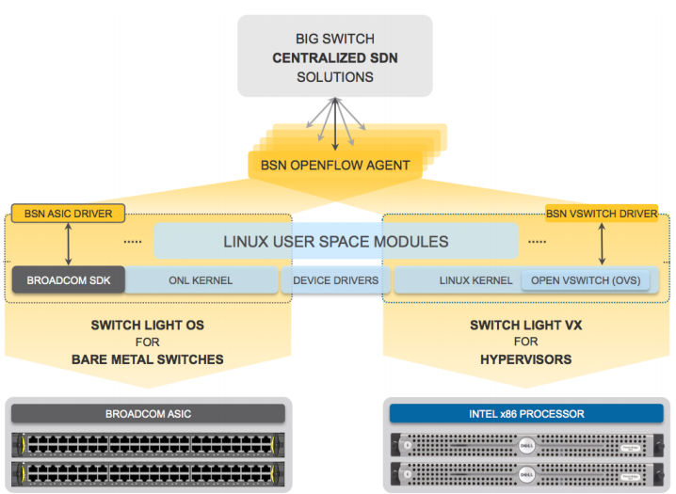
Indigo Use Cases (2/2)
Switch Light
Thin switching software for physical and virtual switches
Commercial SDN switching software from Big Switch Networks
Notes:
Switch Light OS: a complete SDN operating system based on Open Network Linux (ONL), an open source effort within the Open Compute Project.
Switch Light VX: a user space software agent for KVM-based virtual switches that adds advanced functionality and improved performance on top of the Open vSwitch kernel.

Slide 14
References
Indigo
http://www.projectfloodlight.org/indigo/
https://github.com/floodlight/indigo/blob/master/README.md
BigSwitch
http://www.bigswitch.com/
https://en.wikipedia.org/wiki/Big_Switch_Networks
FloodLight
http://www.internet2.edu/presentations/jt2012summer/20120717-Cohen-Floodlight.pdf
http://www.projectfloodlight.org/

Slide 15

Q&A

