Slide 1
Open Network Linux (ONL)
Dongho Son
Dept. of CSE, POSTECH
donghoson@postech.ac.kr
http://dpnm.postech.ac.kr
2016. 9. 28

Slide 2
Outline
What is OCP?
OCP Networking Project
Open Network Linux
References

Slide 3

What is OCP?
Projects
Data Center
Certification
Hardware Management
Networking
Open Rack
Server Design
Storage
Shares designs of data center products among companies.
Design and enable the delivery of the most efficient server, storage and data center hardware designs for scalable computing.
Notes:
OCP is an open project shares designs of data center products among companies, including Facebook, Intel, google, Apple, MS , …
Their mission is to design and enable the delivery of the most efficient server, storage and data center hardware designs for scalable computing.

Slide 4
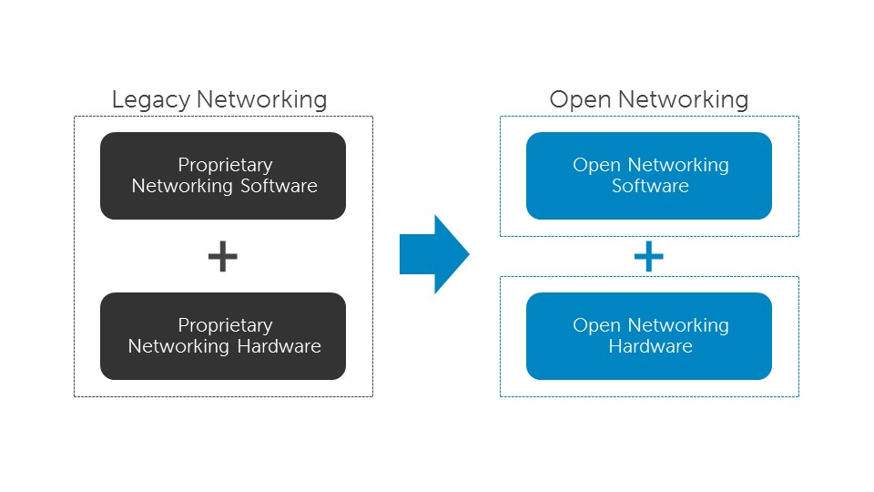
OCP Networking Project
Networking H/W + Networking S/W
Create a set of networking technologies that are dis-aggregated and fully open allowing for rapid innovation in the network space
Notes:
“The mission of Open Compute Networking Project is to create a set of networking technologies that are dis-aggregated and fully open allowing for rapid innovation in the network space”

Slide 5




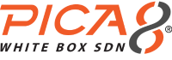
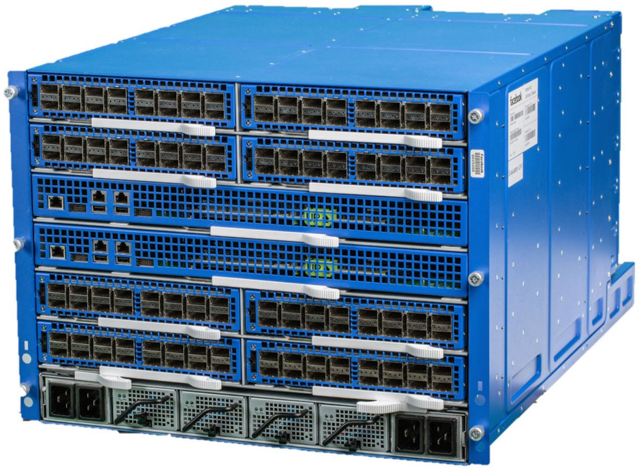
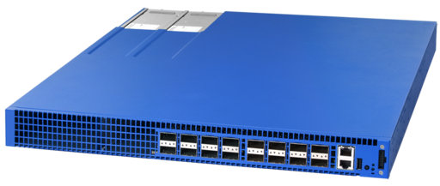
OCP Networking Project
Example(Facebook’s products)
6-Pack : Modular Switch
Wedge : ToR(Top-of-Rack) Switch
FBOSS : Linux based application set
S/W
FBOSS Agent
Linux
H/W
Wedge(ToR Switch)
6-Pack(Modular Switch)
Notes:
OCP Networking Community/Ecosystem
Wedge: facebook이 개발한 1RU(Rack Unit) 크기의 ToR 스위치
6-pack: wedge와 FBOSS를 기반으로 설계된 modular 스위치
FBOSS : Facebook이 개발한 Linux 기반의 스위치 관리 및 제어 소프트웨어

Slide 6
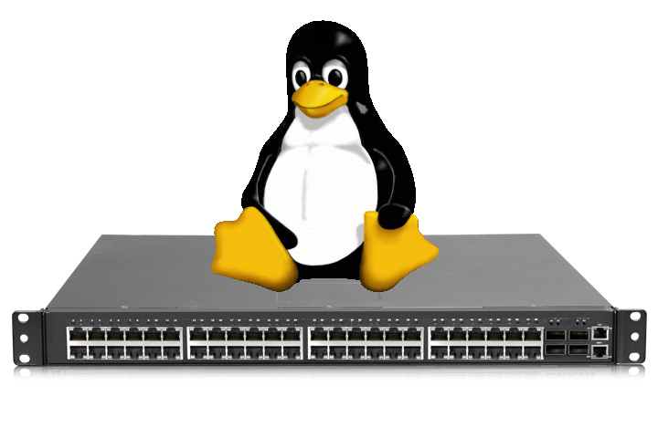
Open Network Linux
Definition
ONL is a Linux distribution for “bare metal switches”
A collection of software packages, utilities, drivers, and abstractions to run OCP Switch hardware
Reference NOS for the OCP
Notes:
ONL is a part of the OCP

Slide 7
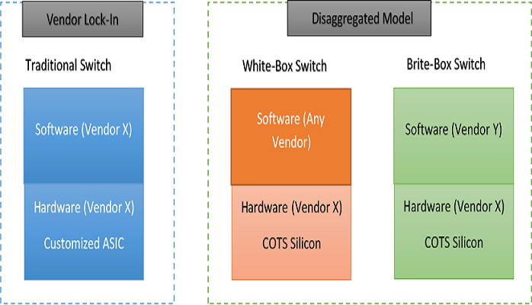
Open Network Linux
Terminology
“Bare Metal Switches”?
White-Box switches
Switches where the SW and HW are sold separately.
Free to load an operating system
Notes:
What are "Bare Metal Switches"?
Bare Metal refers to the switches where the software and hardware are sold separately, that is, you can buy just the "bare metal". In other words, the end-user is free to load an operating system of their choice. ONL is an open source distribution of Linux for Bare Metal switches.
Cost Saving
Building the network you want
Evolving Models

Slide 8
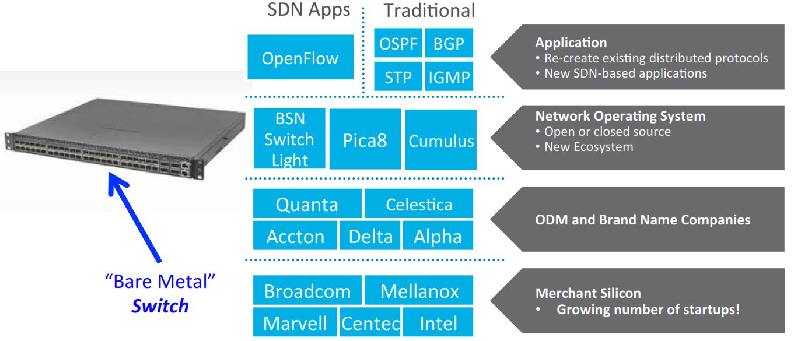
Open Network Linux
Vendors
Bare metal switches are produced by a H/W manufacturer
Build a motherboard and chassis, adds a Switch ASIC Silicon and processing board for loading the switch OS
H/W vendor doesn’t build any OS
Notes:
bare Metal switches are very similar to Bare Metal servers/
They are produced by a hardware manufacturer. the hardware manufacturer builds a motherboard, and chassis, adds a Switch ASIC Silicon (Similar to the Servers's CPU) and adds a processing board (Either ARM or x86) for loading the switch operating system.
Hardware vendor does not build any switch Operating System. End-user procures its own choice of switch Operating system.
Switch has a boot loader called ONIE (Open Networking Install Environment) which allows installation of Switch Operating System.

Slide 9








Open Network Linux
Vendors
Hardware vendors
Edge-Core(Accton), Quanta, DELL
Software vendors
Open-source software (operating system)
Open Network Linux (ONL)
Open Switch
Commercial software (operating system)
Switch Light OS (Big Switch Networks)
Cumulus Linux (Cumulus Networks)
PicOS (Pica8)
Notes:
There are multiple Bare Metal hardware vendors, we have listed 3 most popular ones
There are multiple vendors providing software for Bare metal Switches
Big Switch’s Switch Light OS is based on ONL, adding on Indigo's monitoring utilities and other production hardened tools.
Addition of NOS
-Cumulus Linux
-Switch Light
-PicOS
-Other ONL based NOSs

Slide 10
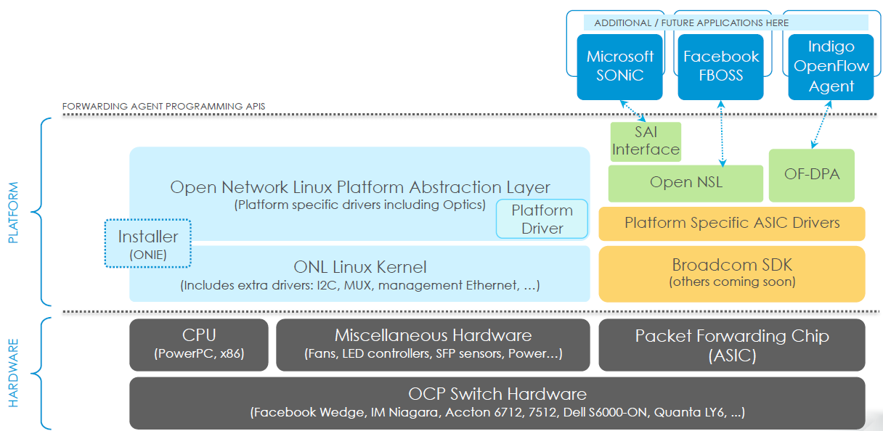
Open Network Linux
Structure
Notes:
20개 이상의 플랫폼을 하늘색의 플랫폼으로 통일
Three Forwarding agents
Each vendor has own Hardware Abstraction Layer(HAL) to a common interface “Service Abstract Interface(SAI)”

Slide 11




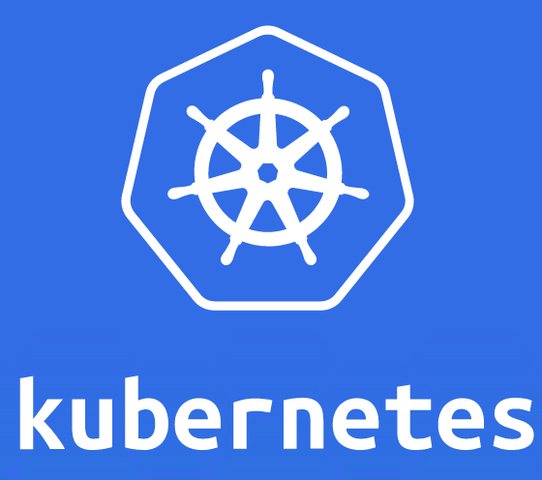


















Open Networking Ecosystem
Open Networking Reference Model
Programming Frameworks
Application Platforms
VM/VI Managers
Containers
Operating Systems
Virtual Machines
Management & Orchestration
Open-O
Carrier Networking Functions
Network Controllers
Programmable Data Plane Services
Network Switch Operating Systems
Hardware
Source: Huawei

Slide 12
References
https://opennetlinux.org
http://www.arpaware.com/page/white-box-1
https://www.sdxcentral.com/articles/contributed/open-networking-reveals-its-fractal-nature/2016/09/

