Slide 1
AI Agent for Virtual Network Function Deployment using Large Language Models
-Ph.D. Thesis Defense-

Slide 2
Table of Contents
Introduction
Background and Related Work
LLM-based VNF Deployment AI Agent
Implementation
Evaluation
Conclusion

Slide 3
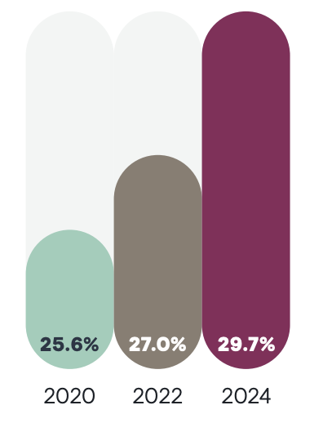
Introduction (1/4)
SDN/NFV (Software Defined Network/Network Function Virtualization)
The amount of traffic in computer networks has increased dramatically in recent years, and operating costs have also increased
SDN: Separates the control plane and data plane
NFV: Virtualizes network functions traditionally embedded in dedicated hardware
After SDN/NFV, network management costs are still increasing to manage increasing network traffic, and the management method is also becoming more complex
SDN/NFV
Scalability, Agility↑, CAPEX/OPEX↓
Human error ratio in Network-related problem*
* BlueCat Networks. Network management megatrends 2024. https://bluecatnetworks.com/wp-content/uploads/2024/08/ network-management-megatrends-2024.pdf, 2024.

Slide 4
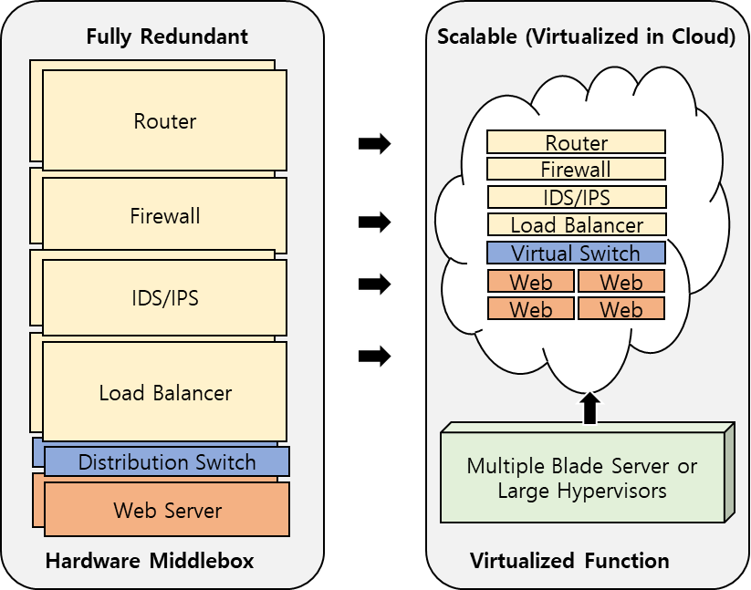
Introduction (2/4)
Virtualized Network Management
NFV Infrastructure (NFVI): Provides an environment where can run the network services and functions required to implement NFV in software
OpenStack, Kubernetes
GUI, Python, Ansible
Research is underway to reduce human errors by automating network management using AI
It is necessary to develop an automation method that can manage the network without network expertise based on natural language
Automate manual procedural tasks such as installing, setting up, validating, upgrading versions, and recovering network function
Automation based on LLM (Large Language Model)
Network Function Virtualization

Slide 5
Introduction (3/4)
IBN (Intent Based Networking)
Use high-level intent or business objectives to automate and optimize network operation
Intent: Specify desired outcome, not low-level configurations
What user want, not how to do it
AI-based Automation: AI and machine learning algorithms interpret the intent and dynamically configure the network to meet it
Thesis scope
Intent
Translation
Activation
Assurance
Physical and Virtual Infrastructure

Slide 6
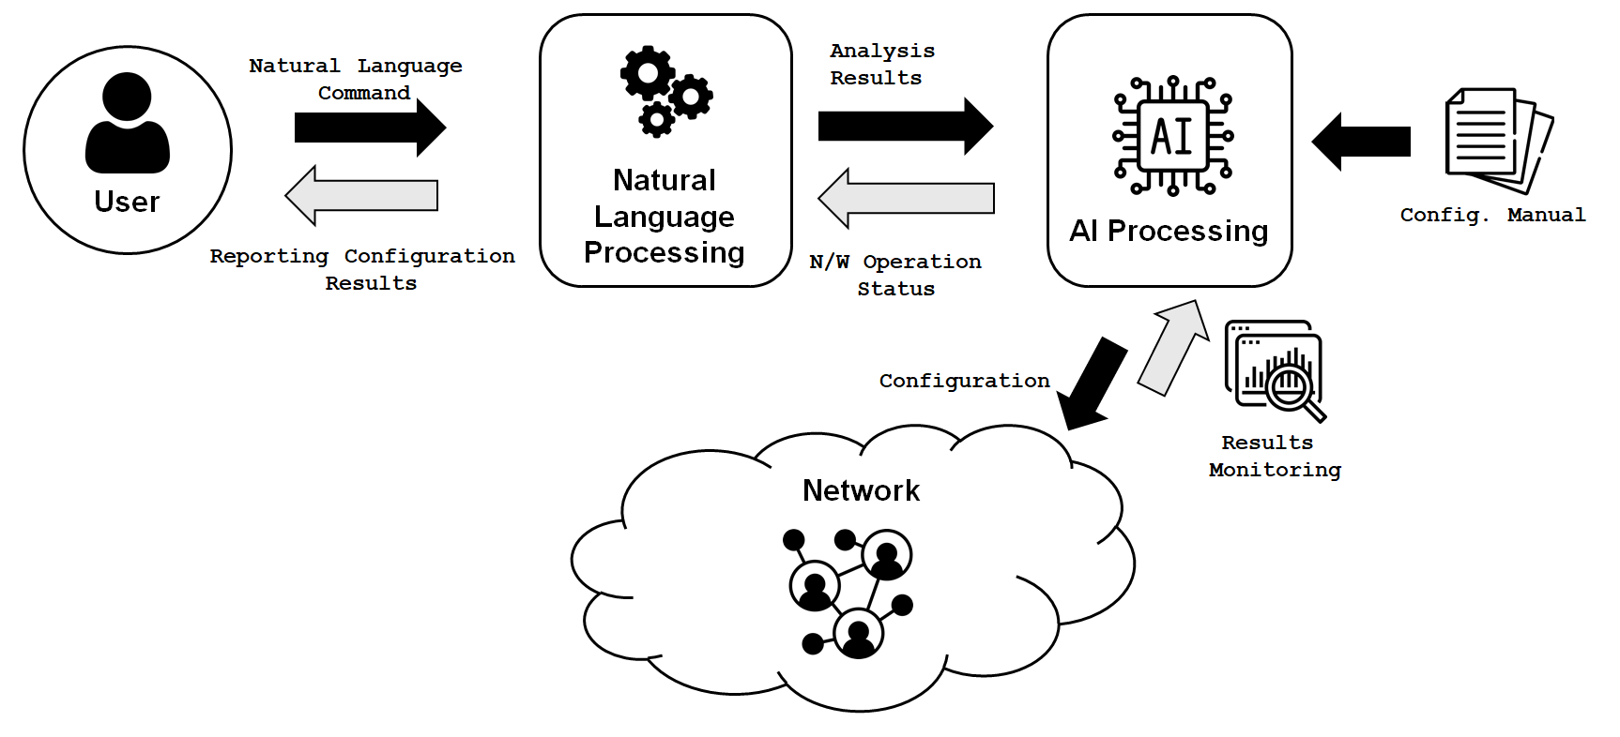
Introduction (4/4)
Problem Statement / Research Goals
AI-based Network Management
Size and complexity of the network grows
More knowledge and manpower are needed
Human error ratio increases in network management
Natural language based full automation required
AI Agent
LLM needs to be checked for correct response
Self-healing
Communicate with NFVI to verify correct setup
Dataset/Evaluation
No dataset related to VNF configurations
Create minimal dataset for experiments

Slide 7
Table of Contents
Introduction
Background and Related Work
LLM-based VNF Deployment AI Agent
Implementation
Evaluation
Conclusion

Slide 8

Background (1/2)
LLM (Large Language Model)
Artificial intelligence model that performs natural language processing tasks by training based on large amounts of text data
Can learn common sense from big data
Can minimize task specific datasets
In-Context Learning
Take advantage of the pre-learning model
Also provides examples of the desired operation (One-shot, Few-shot)
Prompt Engineering
Prompt's design is critical, limited to complex tasks
RAG (Retrieval-Augmented Generation)
Retrieves relevant data from an external knowledge base
Provide external knowledge to LLMs that are not trained for specific purposes to perform specific tasks
Research is actively taking place on algorithms to find the text most related to the input query from external knowledge base

Slide 9

Background (2/2)
Kubernetes (NFVI)
Open-source platform for automating deployment, scaling, and management of containerized applications
Features
Container orchestration
Auto-scaling & load balancing
Works with Docker & other runtimes
Architecture
Master Node, Worker Node
Pod, Namespace
Service
Control Plane
Scheduler
API Server
Node
Pod
Cluster
Container
Container
API
Server
Container

Slide 10
Related Work
Method | Target | Output | Year
D. Donadel et al. [4] | Network topology QA System | Topology information | 2024
Mekrache et al. [5] | E2E network configuration | Domain-specific requirement formats | 2024
AppleSeed [6] | Network services across multiple domains | Python code framework | 2023
S-Witch [7] | Network switch configuration | Switch configuration commands | 2024
NETBUDDY [8] | Network policies translation | Low-level network APIs | 2023
K. Dzeparoska et al. [9] | SFC management policy | Actionable policies | 2023
N. Tu et al. [10] | NFV configuration | Configuration management templates | 2024
Nephio [11] | Intent-based fully automated networking system | K8S manifets (YAML/Helm, network config) | In progress
Ours | VNF deployment | NFVI runnable workflow | -
There is no study yet that fully automate the deployment of VNF

Slide 11
Table of Contents
Introduction
Background and Related Work
LLM-based VNF Deployment AI Agent
Implementation
Evaluation
Conclusion

Slide 12
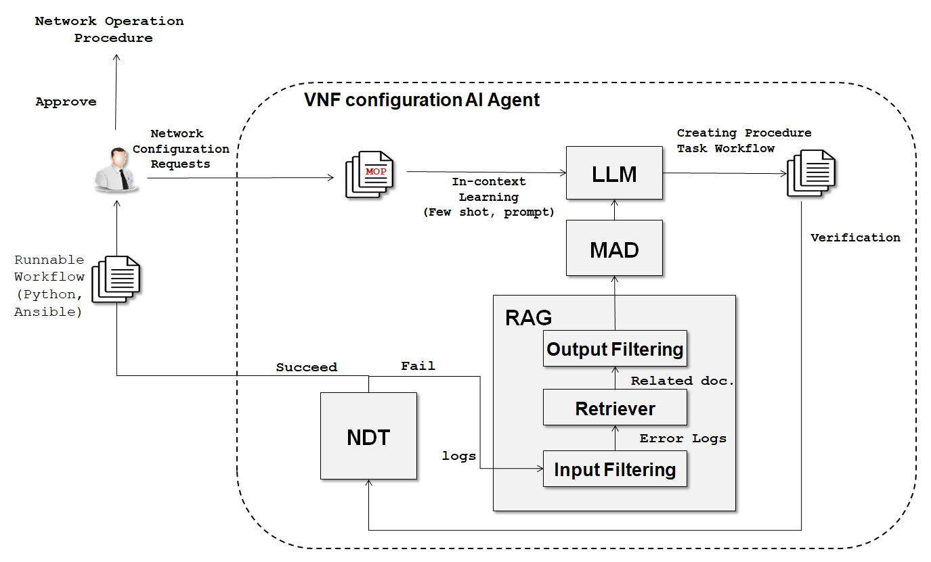
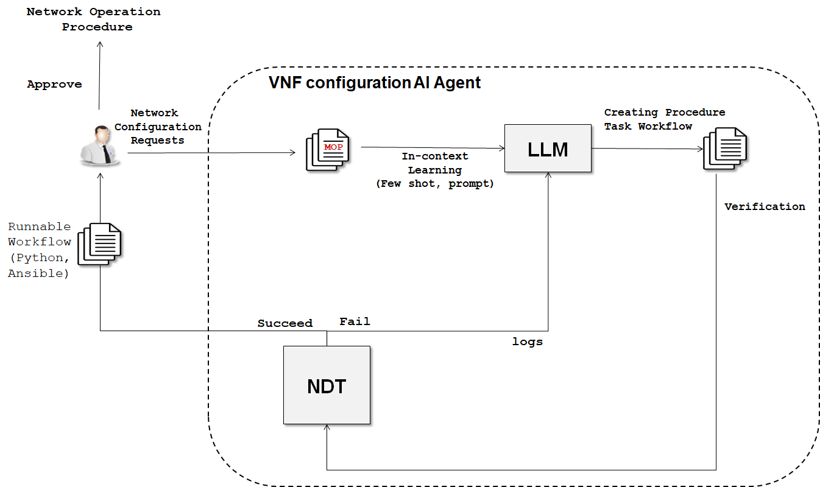
Proposed System Overview (1/2)
Automate VNF Installation Based on LLM
Use LLM to understand MOPs (Method of Procedures) about network configuration procedures and automatically generate workflow code to execute them

Slide 13
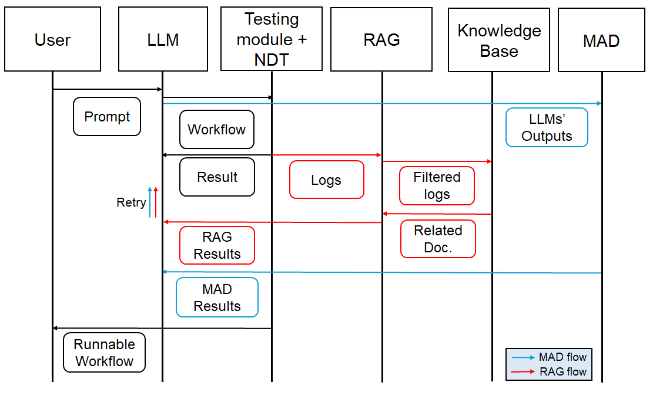
Proposed System Overview (2/2)

Slide 14
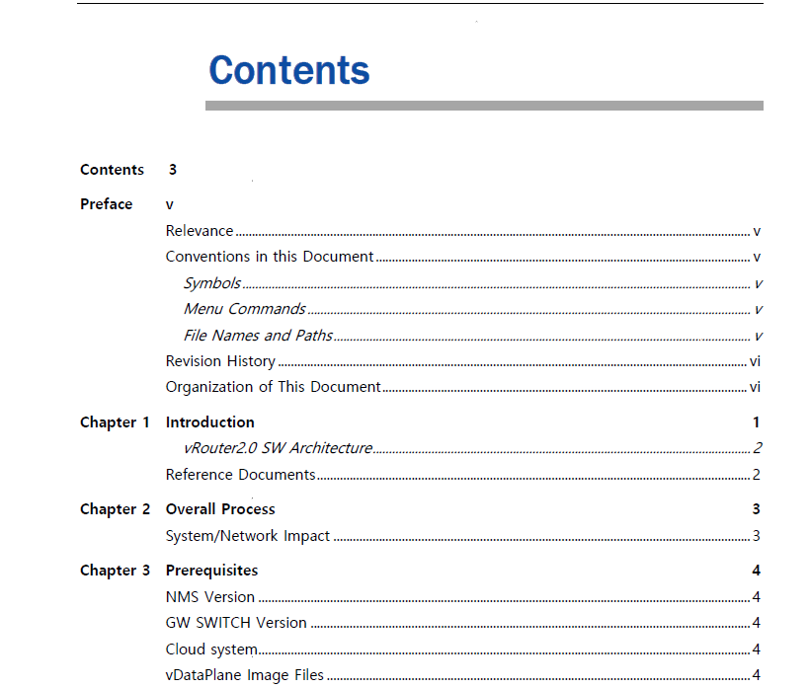
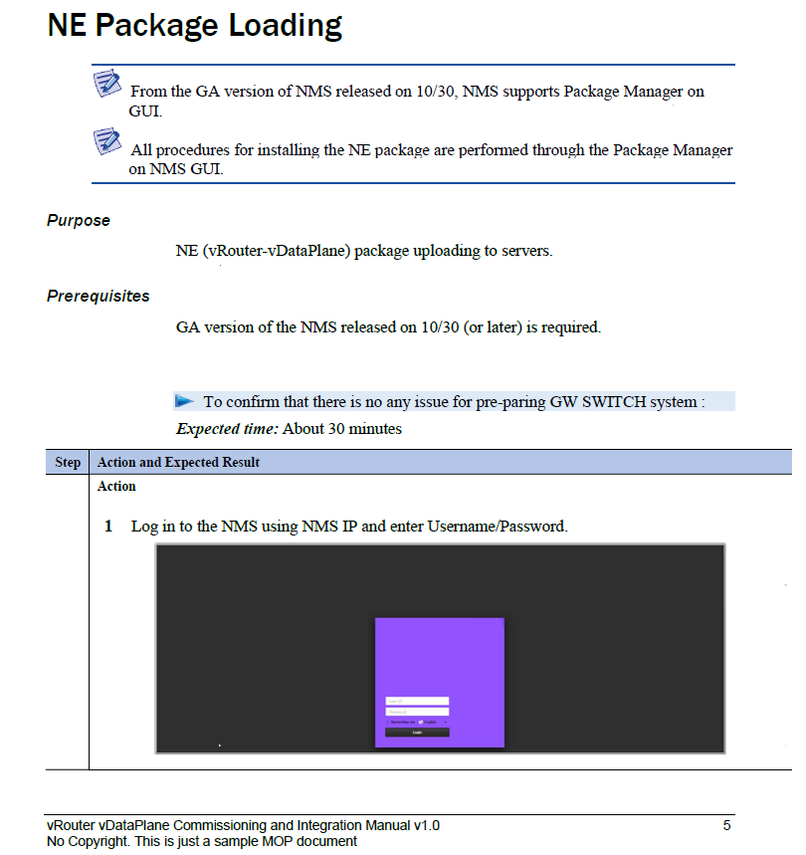
In-Context Learning (1/2)
Input: Method of Procedure (MOP)
Step-by-step instructions for carrying out specific tasks or processes
Companies have a large amount of MOPs with the process of setting up NF developed internally by them, and want to automate them to install without human error

Slide 15
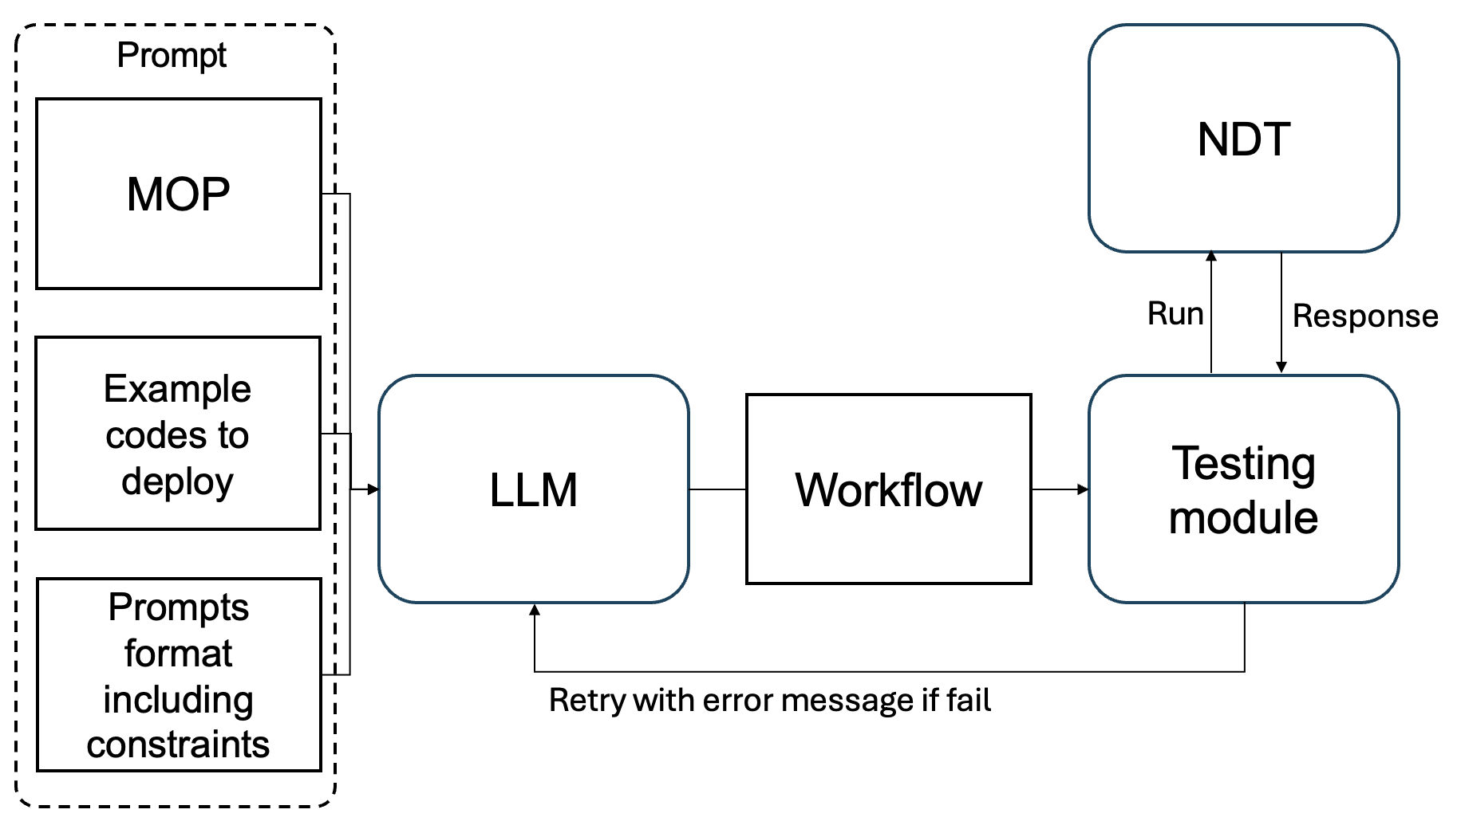
In-Context Learning (2/2)
Few-shot Learning
Provide working codes as example
Provide code for installing other VNFs
Prompt Format
Description of the situation, requesting to create a workflow
Constrained common mistakes in the experiment
Infinite loop
Put example usage
Change Pod name, etc.

Slide 16
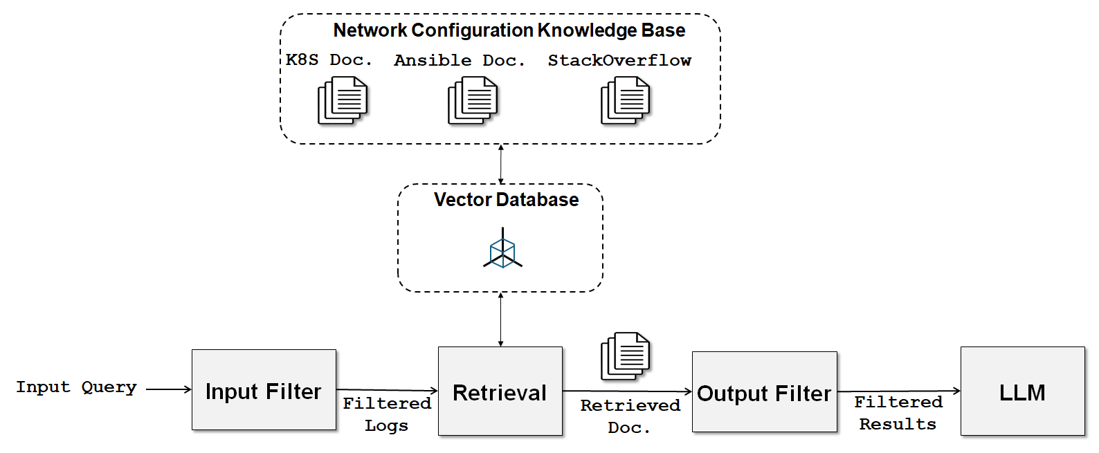
RAG (Retrieval Augmented Generation) (1/3)
Knowledge Base
Crawling Kubernetes official documents, Ansible official documents, Stack Overflow
Use the word embedding model to transform each document's title and question into a vector and store it
Vector-based search
Filtering
Input filtering
Output filtering

Slide 17

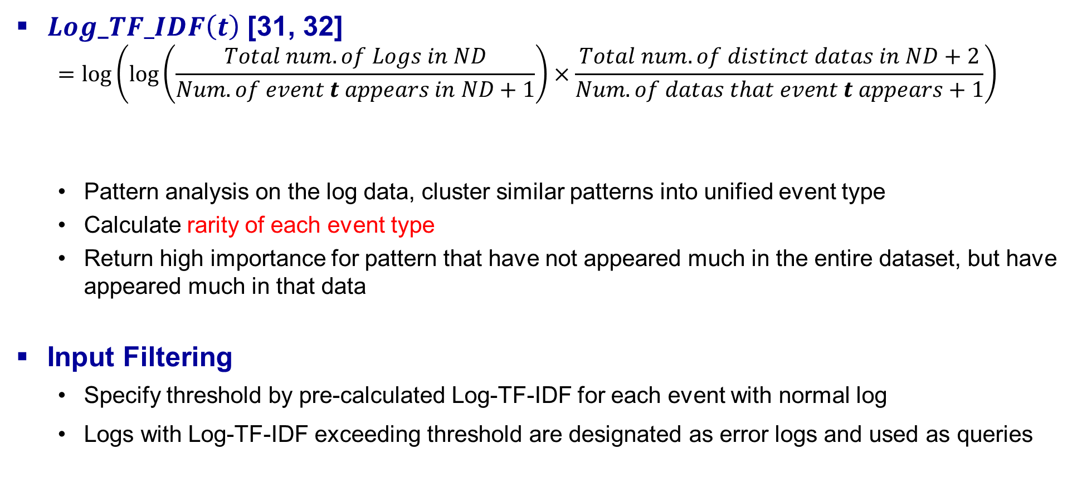
RAG (Retrieval Augmented Generation) (2/3)
$Log\text{_}TF_IDF\left(t\right)$ [31, 32]
$$=log⁡\left(log⁡\left(\frac{Total num. of Logs in ND}{Num. of event t appears in ND+1}\right)×\frac{Total num. of distinct datas in ND+2}{Num. of datas that event t appears+1}\right)$$
Pattern analysis on the log data, cluster similar patterns into unified event type
Calculate rarity of each event type
Return high importance for pattern that have not appeared much in the entire dataset, but have appeared much in that data
Input Filtering
Specify threshold by pre-calculated Log-TF-IDF for each event with normal log
Logs with Log-TF-IDF exceeding threshold are designated as error logs and used as queries
Log-TF
Log-IDF
$ND$: Normal Dataset

Slide 18
RAG (Retrieval Augmented Generation) (3/3)
Output Filtering
Determines if RAG's results are appropriate, if appropriate, leave only the key content and use it in AI agent
Judge LLM
Fine-tuned with manually tagged data

Slide 19
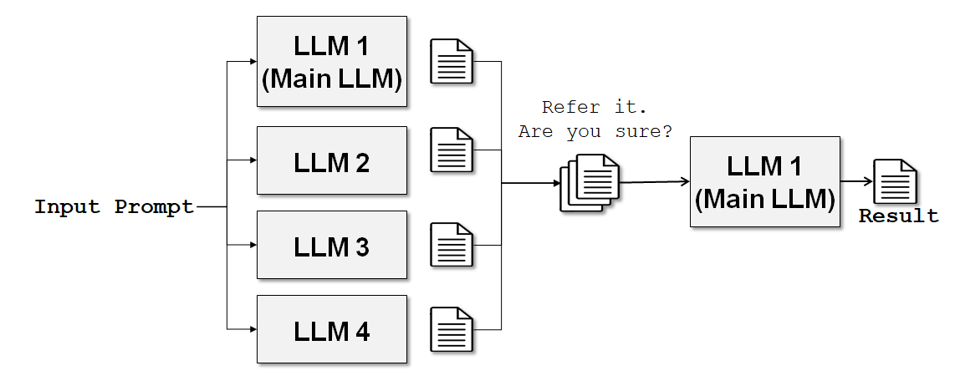
MAD (Multi-Agent Debate)
MAD
LLM has a large number of parameters, so even the same input produces different results every time, and it is not always correct
If LLM's response is incorrect, it may be stuck in the wrong idea, so refer to how other LLMs responded

Slide 20
Table of Contents
Introduction
Background and Related Work
LLM-based VNF Deployment AI Agent
Implementation
Evaluation
Conclusion

Slide 21
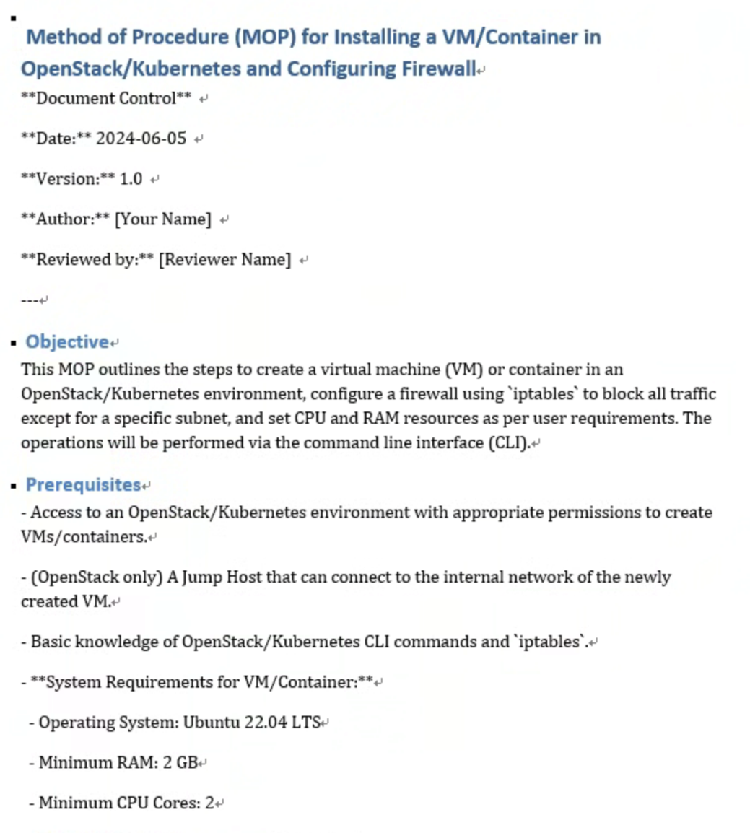
Implementation- MOP Dataset
Generating large MOPs dataset using GPT
A large dataset is required for experimentation
For fine-tuning, output examples are also necessary
Automatically generated using an LLM (GPT-4o mini)
Sample MOPs were provided, and the model was instructed to write MOPs for configuring specific VNFs in Kubernetes
Firewall (iptables): Allow only specific subnets, restrict to certain ports
Load Balancer (HAProxy): Distribute traffic across servers, redirect to specific servers
DPI (nDPI): Inspect specific subnets, block certain types of traffic
Monitoring (ntopng): Monitor specific protocols
IDS (Suricata): Run default detection rules
After manual verification, 60 MOPs were generated
30 in Korean, 30 in English
Example Generated MOP

Slide 22
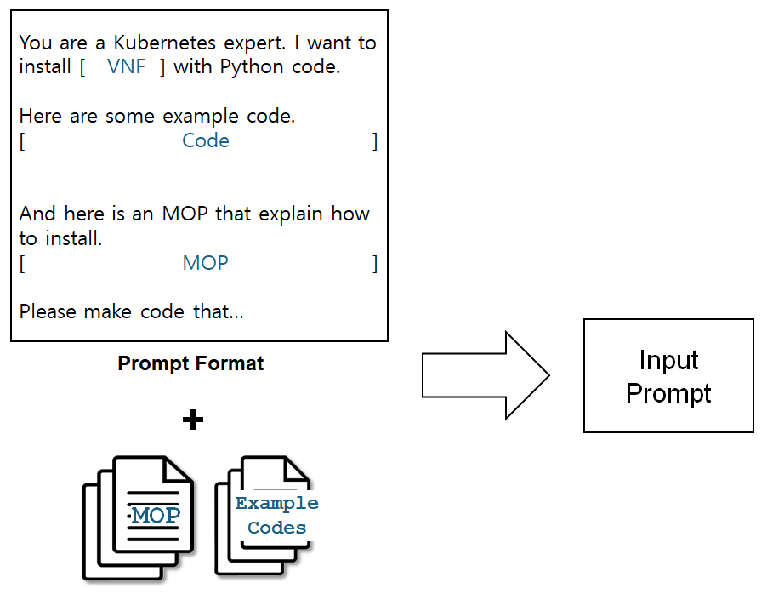
Implementation- Prompt Input
Instructions
(Python) Make ‘create_pod’ function, take ‘pod_name’, ‘namespace’, ‘image_name’ as factor, and put all code related to Pod creation and VNF configuration here
(Ansible) Variables ‘pod_name’, ‘namespace’, ‘image_name’ to specify when running
Restrictions
Prevent code from running in local node
Prevent infinite loop
Full prompt format in thesis paper

Slide 23
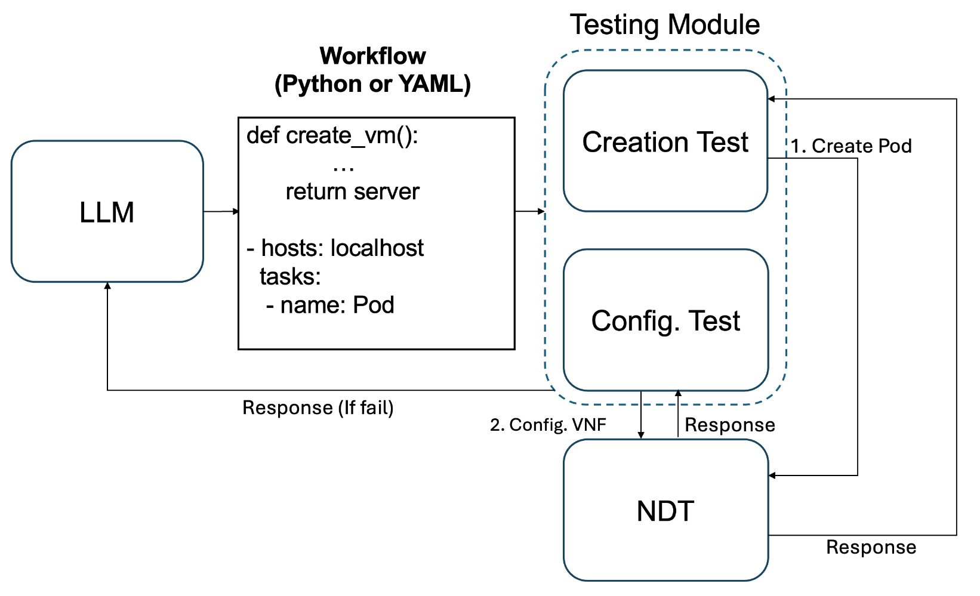
Implementation- Testing Module and NDT (1/2)
Network Digital Twin (NDT)
Kubernetes 1.29.15, Ubuntu 22.04 LTS
1 Master node, 4 Worker node
Testing Module
Communicate with NDT and run response workflow
If the workflow runs normally, access the Pod to verify the VNF settings

Slide 24
Implementation- Testing Module and NDT (2/2)
Testing Module
Execute some protect mechanisms to avoid problems with NDT
Delete infinite loop
Delete code running in local node
Delete code that access to invalid namespace
Run workflow and periodically check pod status for 150 seconds
Return predefined status code to AI agent in case of error
If logs exist, return them together
The AI agent identifies the workflow problem according to the status code and then passes it to LLM and requests correction

Slide 25
Implementation- RAG
Knowledge Base
Crawled 4,766 docs
Save in SQLite DB
Save vectors for docs in Chroma DB
Use all-MiniLM-L6-v2 [44] embedding model
Fine-tuned with our log data
Judge LLM
Use Phi-4:14b model
Fine-tuned with manual tagged data
129 pair of log data and related doc title
Fine-tuned with LoRA

Slide 26
Table of Contents
Introduction
Background and Related Work
LLM-based VNF Deployment AI Agent
Implementation
Evaluation
Conclusion

Slide 27
Evaluation - RAG
RAG evaluation
For 129 log data tagged directly, each RAG model searches for the corresponding document
If vector similarity of ground truth document title and searched document title is 0.8 or higher, determines correct
Better performance with fine tuned embedded models
Performance is much better when input filtering is performed
In the case of Ansible logs, unlike normal logs, they are very long, and useless logs such as Pod information, image information, etc. appear in one line, so in this case, RAG tend not to find corresponding documents
Base | Finetuned | Rule-based Input Filtering | Rule-based Input Filtering, Finetuned | Log-TF-IDF based Input Filtering | Log-TF-IDF based Input Filtering, Finetuned
55.48% | 56.37% | 69.32% | 71.06% | 73.53% | 82.17%

Slide 28
LLMs
LLM | Company | Model Name:Parameter Num. | Note
GPT | OpenAI | GPT-4o:220B(estimated), o3 | Not open to public Paid API only o3: logic, coding specialized
Gemma | Google | Gemma3:27B
Qwen | Alibaba | Qwen2.5:72B, Qwen2.5-coder:32B, QwQ:32B | QwQ: reasoning specialized, pre-revealed while in development
DeepSeek | DeepSeek | Deepseek-r1:671B, Deepseek-distill-Llama3:70B | Number of parameters was too large, so used as a distilled model
Mistral | Mistral AI | Mistral:7B
Llama | Meta | Llama 3.3:70B
Phi4 | Microsoft | Phi4:14B

Slide 29
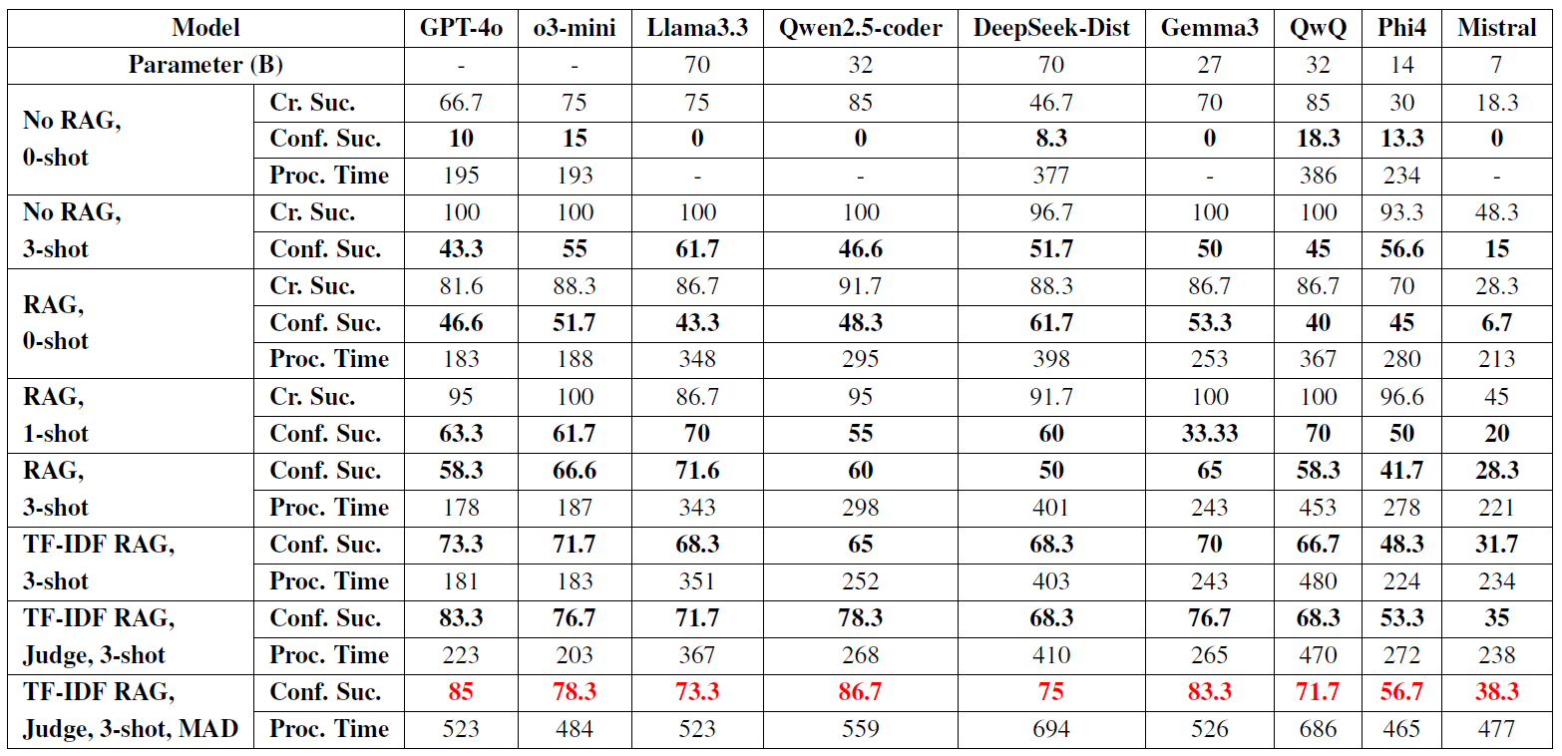
Evaluation - Python
For each method, measure accuracy based on how many of the 60 MOPs are successful

Slide 30
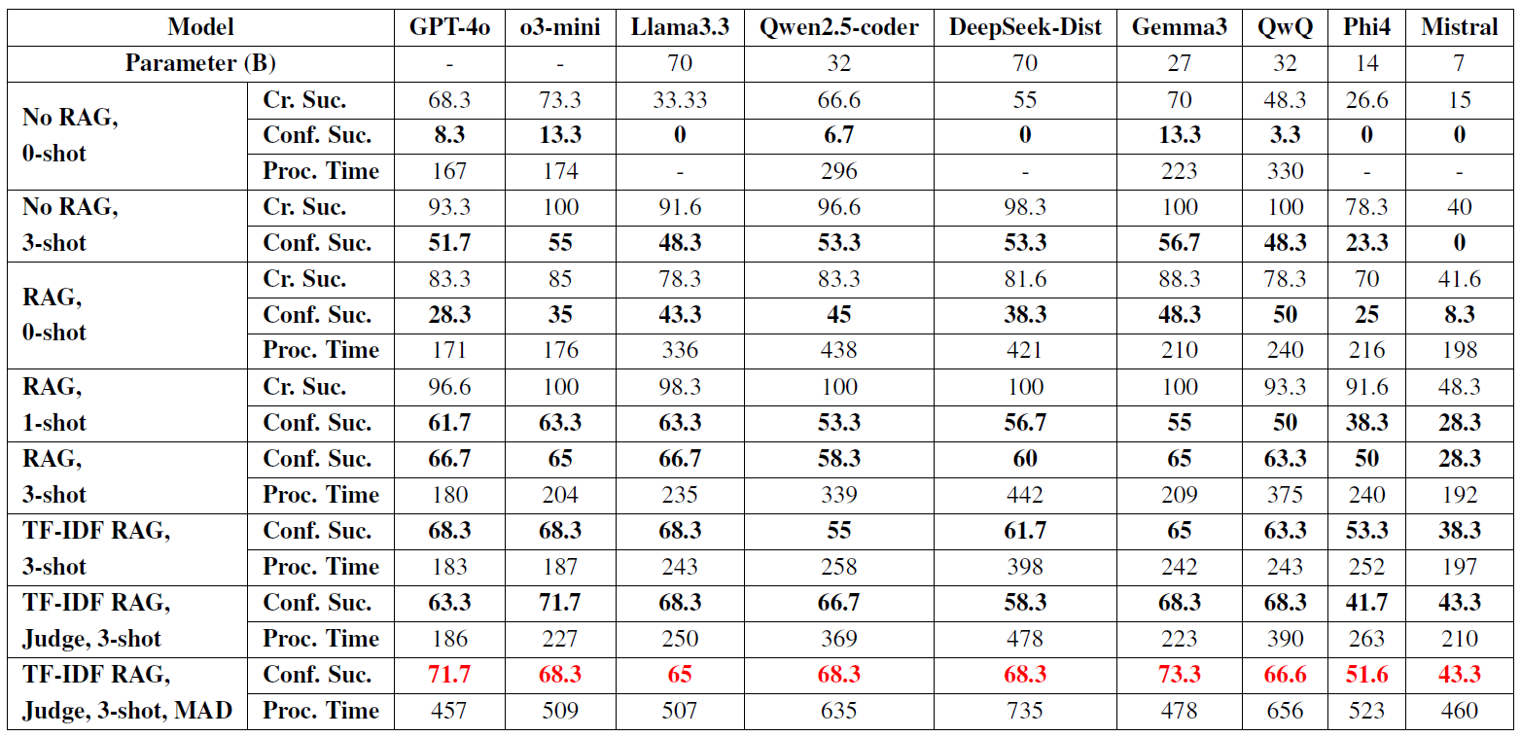
Evaluation - Ansible

Slide 31
Evaluation - 3-shot, RAG-TF-IDF, Judge, MAD
Python
Ansible

Slide 32
Evaluation – Processing Time
MAD
Judge LLM
RAG
LLM Process
Pod Creation

Slide 33
Evaluation
As additional modules are incorporated, the overall performance of the LLMs tends to improve
When applying RAG, the performance generally reaches 70–80%(Python) and 60–70% (Ansible)
With the addition of MAD, performance increases by approximately 2–5%
These results validate the self-healing capability enabled by RAG and MAD
Time measurements reveal that the performance gains vary across modules relative to the required execution time, indicating a trade-off between performance and time

Slide 34
Table of Contents
Introduction
Background and Related Work
LLM-based VNF Deployment AI Agent
Implementation
Evaluation
Conclusion

Slide 35
Conclusion
Summary
We proposed an automated workflow creation framework for VNF deployment based on LLM
Implemented in-context learning, RAG, MAD, etc. for LLM to correctly create workflows
Proposed a structure to verify that the workflow in LLM works correctly and then apply it to the real network
Created MOP dataset to validate proposed AI agents and experiment in Kubernetes environment
As a result of the experiment, it was confirmed that LLM, which had a success rate of 0% when only MOP was entered for Python, succeeded with a success rate of 86.7% through AI agent
Receiving rate (14.1%), Loss rate (-3.3%), Delay (15.3%)
Future Work
Applying supervised learning-based and reinforcement-based LLM fine tuning techniques
VNF management technology after VNF installation is also fully automated based on intent

Slide 36

Q&A

Slide 37
Related Work (1/3)
D. Donadel et al., IEEE LCN, 2024 [4]
Get network topology information
Build topology QA system with LLM
Mekrache et al., IEEE Network, 2024 [5]
E2E network configuration
Convert natural language inputs into predefined, domain-specific requirement formats
AppleSeed, NetSoft 2023 [6]
Convert natural language to Python code framework for network configuration
Implement compiler to convert LLM’s output to domain-specific executable programs
S-Witch, NOMS 2024 [7]
Network switch configuration
Convert natural language inputs into switch configuration commands
Design network digital twin (NDT)

Slide 38
Related Work (2/3)
NETBUDDY, arXiv, 2023 [8]
Transfer high-level natural language policies into lower-level configuration
Low accuracy, importance of prompt engineering
K. Dzeparoska et al., CNSM 2023 [9]
SFC management policy
Convert natural language into actionable policies
N. Tu et al., NOMS 2024 [10]
NFV configuration
Convert natural language into pre-defined NFV configuration management templates
Nephio, Open source project, in progress [11]
Open source initiative launched by Google and the Linux Foundation
Aim to make fully automated network management based on Kubernetes
Natural language based CNF deployment technique is still developing

